Slide 1
ANCHORAGE

Slide 2
ANCHORAGE IN ORTHODONTICS

Slide 3

Introduction
Sources of anchorage
Classification of anchorage
Intra oral anchorage
Extra oral anchorage
Muscular anchorage
Anchorage planning
Classifying anchorage requirements
Tweed’s classification of anchorage
Anchorage preparation

Slide 4
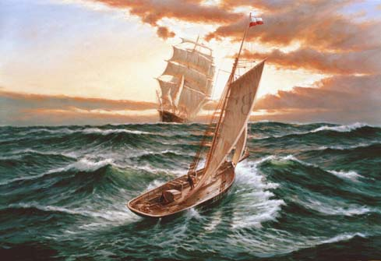

Slide 5
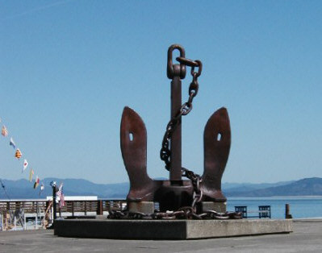
Anchor in Ships

Slide 6
Orthodontic tooth movement
Active element
Resistance element - Anchor

Slide 7
DEFINITION
Graber - the nature and degree of resistance to displacement offered by an anatomic unit when used for the purpose of effecting tooth movement
Anchorage – resistance to unwanted tooth movement
Used to describe the maneuvers followed to ensure the correct use of space in an extraction case.

Slide 8
SOURCES OF ANCHORAGE
  Intraoral anchorage
    Teeth
    Alveolar bone
    Basal bone
    Cortical bone
    Musculature
  Extraoral anchorage
    Cranium
    Back of the neck
    Facial bones

Slide 9
CLASSIFICATION
Extra oral
Cervical
Occipital
Facial
Combination

Slide 10
CLASSIFICATION OF ANCHORAGE
Based on manner of force application
    Simple anchorage
    Stationary anchorage
    Reciprocal anchorage
Based on the jaw involved
    Intramaxillary anchorage
    Intermaxillary anchorage

Slide 11
Site of anchorage
    Intraoral anchorage
    Extraoral anchorage
      Cervical, occipital, facial, cranial
    Muscular
Number of anchorage units
    Multiple anchorage
    Single or primary anchorage
    Compound anchorage
Group A anchorage
Group B anchorage
Group C anchorage

Slide 12
Intra-oral {
Extra-oral {
Types of Anchorage
{
Single
Compound
Reinforced
Intra-maxillary
[
Simple Anchorage
Stationary Anchorage
Reciprocal Anchorage
Inter-maxillary
Cervical
Occipital
Cranial
Facial
Minimum Anchorage
Moderate Anchorage
Maximum Anchorage
Absolute Anchorage
Space Availability {

Slide 13
Concepts of Anchorage
Anchorage preparation
Utilization of auxiliary holding appliances

Slide 14
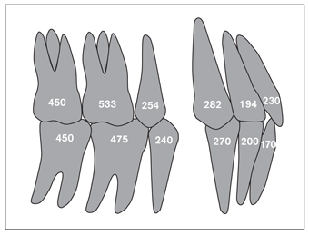
Important considerations:
    Assess number of roots and its surface area
    Shape, size and length of roots
    Multi-rooted tooth more resistant than single rooted tooth.
    Long rooted tooth more resistant than short rooted tooth.
    Triangular shaped tooth more resistant than ovoid or conical tooth.
    Inclination of teeth.
    Ankylosed teeth.

Slide 15
Alveolar bone…offers resistance.
Basal bone - intraoral sources of anchorage - hard palate, lingual surface of roots.
Musculature - use of hypertonic labial muscles in lip bumpers.

Slide 16
Alveolar Bone
Within limits, alveolar bone resists deformation.
Less dense alveolar bone offers less anchorage, more mature bone increases anchorage.

Slide 17
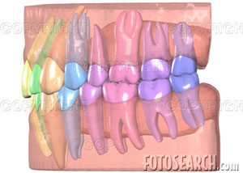
Teeth
Root form,
Size of roots,
Number of roots,
Position of the teeth,
Axial inclination of the teeth

Slide 18
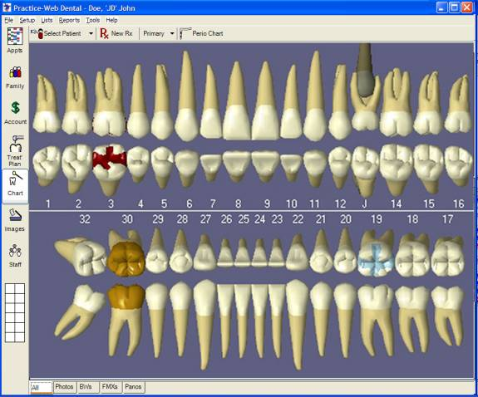
Root form
The root in cross section can be either
Round,
Flat (mesiodistally),
Triangular.

Slide 19
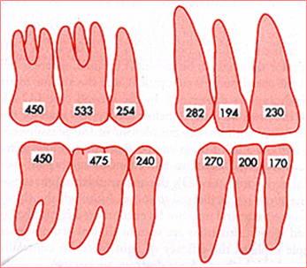
Root form
The distribution of the periodontal fibers affect anchorage potential.
Round roots have only half their periodontal fibers stressed in any given direction. Hence, offer the least anchorage.
Mesiodistally flat roots are able to resist mesiodistal movement, better as compared to labiolingual movement.

Slide 20
Root form
Triangular roots, like those of the canines are able to provide greater anchorage.
The tripod arrangement of roots, like the seen on maxillary molars also in increasing the anchorage.

Slide 21
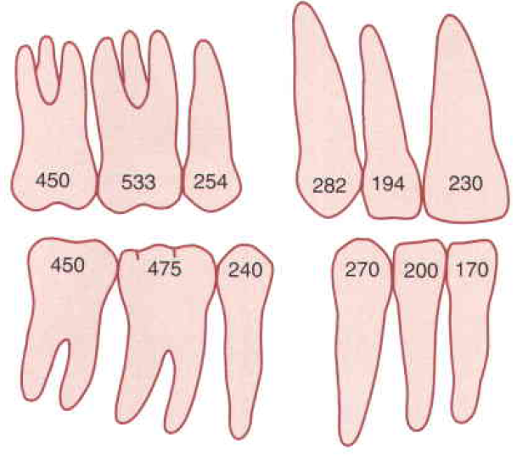
Anchorage Value
The "anchorage value“ of any tooth is roughly Equivalent to its root surface area.

Slide 22
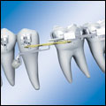
Size of roots : The larger or longer the roots, the more is their anchorage potential.
Number of roots : The greater the surface area, the greater the periodontal support and hence, greater the anchorage potential.
Multirooted teeth provide greater anchorage as compared to single rooted teeth with similar root length.

Slide 23
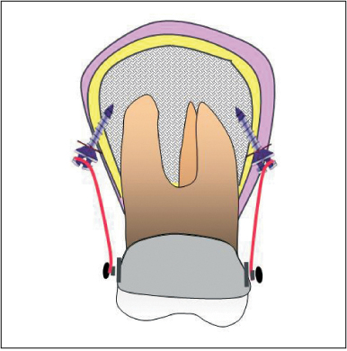
Cortical Bone
Ricketts – concept of using cortical bone for anchorage.
If certain teeth were torqued to come in contact with the cortical bone they would have a greater anchorage potential

Slide 24
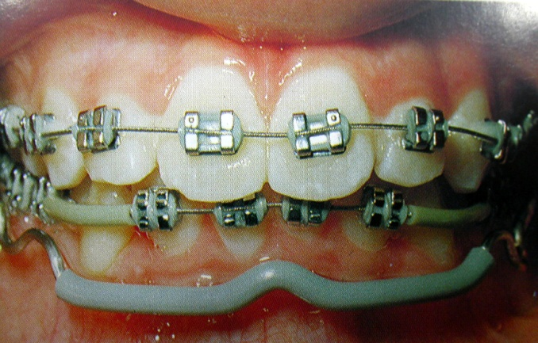
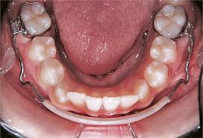
Musculature
Lip bumper is an appliance that make use of the tonicity of the lip musculature and enhances the anchorage potential of the mandibular molars preventing their mesial movement.

Slide 25
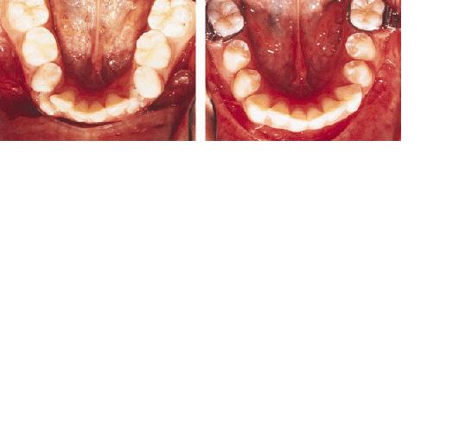
MUSCULAR ANCHORAGE

Slide 26
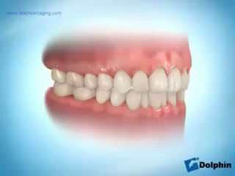

Slide 27
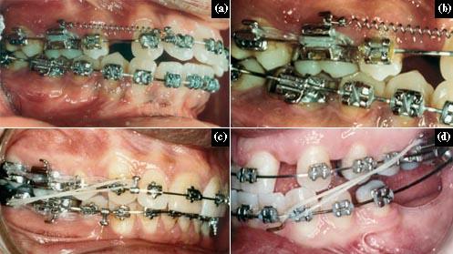
INTRAORAL ANCHORAGE
The type of anchorage is said to exist only when all the anchorage units are present within the oral cavity.
Anchorage from all the intraoral sources of anchorage including the teeth, palate, etc. can form part of this type of anchorage.
Intramaxillary
Intermaxillary

Slide 28
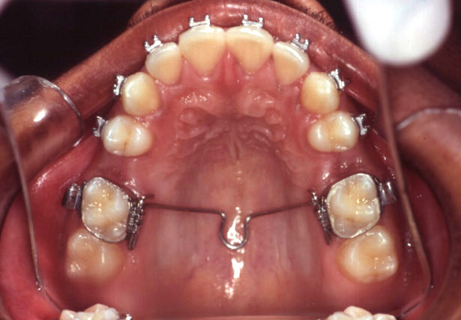
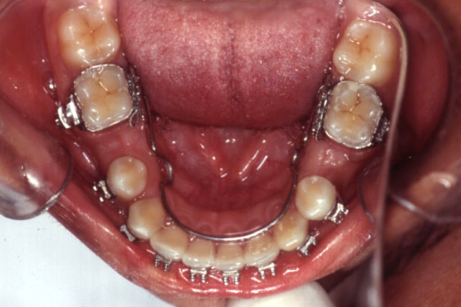
INTRAMAXILLARY ANCHORAGE
When all elements providing the anchorage as well as those to be moved are situated with in the same jaw, the anchorage is describe as intraxmaxillary.

Slide 29
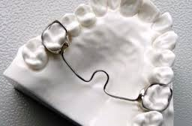
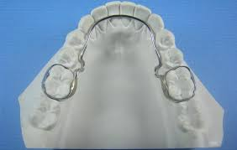

Slide 30
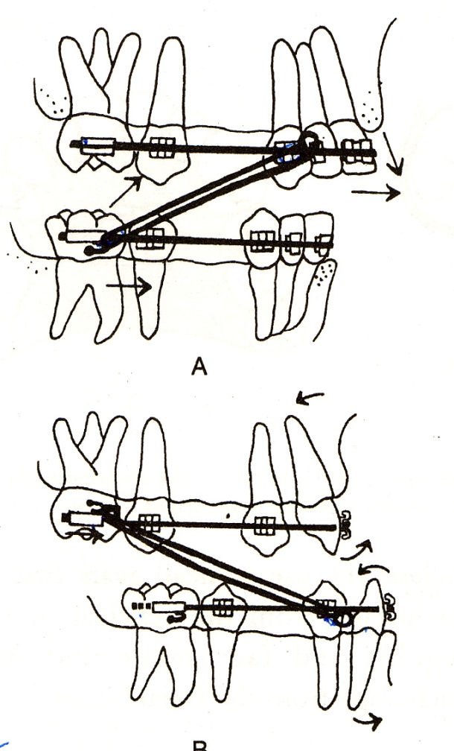
INTERMAXILLARY ANCHORAGE
This type of anchorage is also termed as Baker’s anchorage.

Slide 31
INTRA MAXILLARY ANCHORAGE

Slide 32
INTER MAXILLARY ANCHORAGE

Slide 33
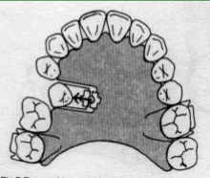
SIMPLE ANCHORAGE
Engaging a greater number of teeth than that are to be moved.
The root surface area of the anchorage units should be at least double that of the units to be moved.
Force tends to change the axial inclination of the teeth.

Slide 34
STATIONARY ANCHORAGE
Dental anchorage in which the manner and application of force tend to displace the anchorage unit bodily in the plane of space in which the force is applied.
In other words it is tooth movement without any change in its axial inclination.

Slide 35
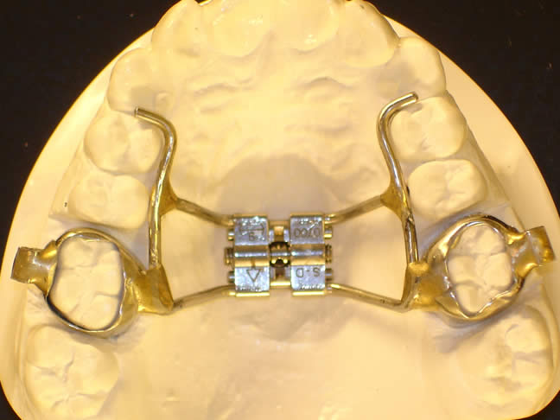
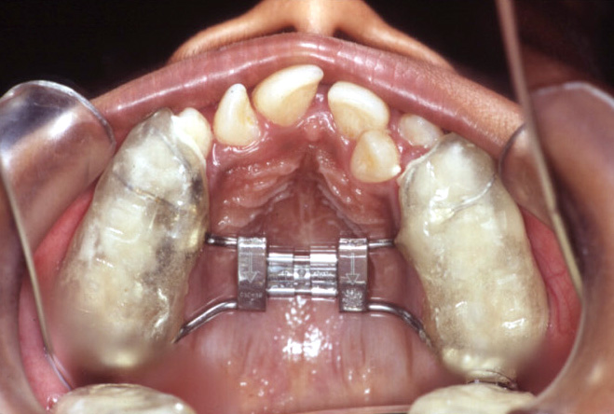
Reciprocal anchorage
Reciprocal anchorage is said to exist when two teeth or two sets of teeth move to an equal extent in an opposite direction.
Here the root surface area of the so-called anchorage units is equal to that of the teeth to be moved.
Requires two equal and opposite forces that tend to move each unit towards a more normal occlusion.

Slide 36
CROSS BITE CORRECTION
palatal
buccal

Slide 37
Reciprocal anchorage
Stationary Anchorage

Slide 38
EXTRA ORAL ANCHORAGE
Anchorage in which one of the anchor units is situated outside the oral cavity
Uses cranial, occipital and cervical areas as anchorage.
Employed in the correction of class II and class III maxillo-mandibular jaw relationships.

Slide 39
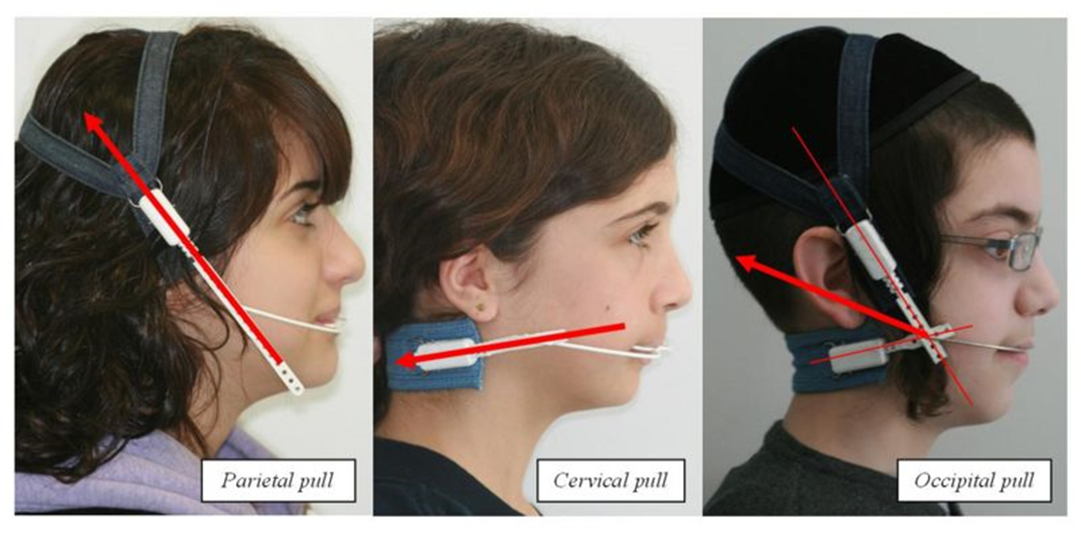
EXTRAORAL ANCHORAGE
The extraoral structures most frequently used are cranium, the back of the neck and the facial bones.

Slide 40
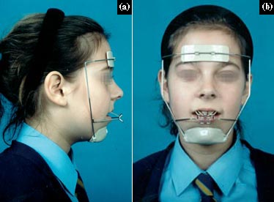
Facial bones

Slide 41
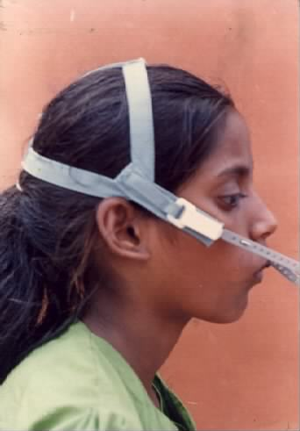
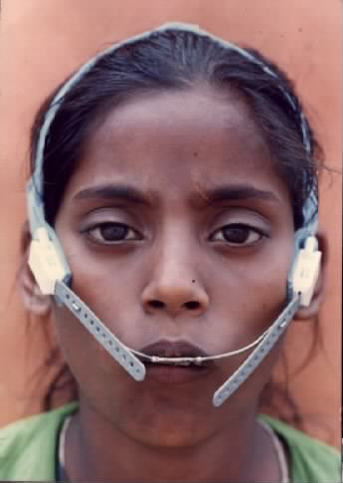
OCCIPITAL PULL

Slide 42
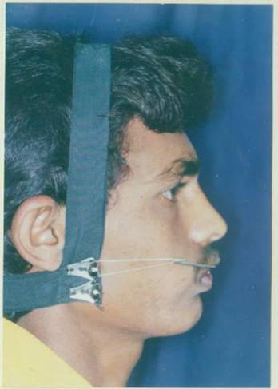
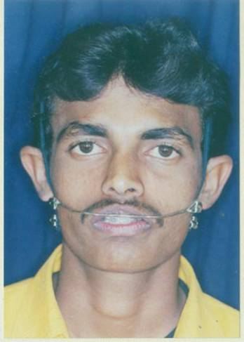
COMBI PULL

Slide 43
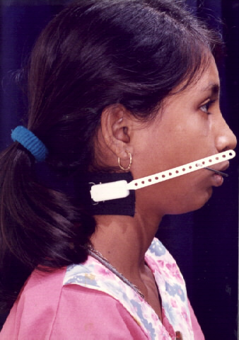
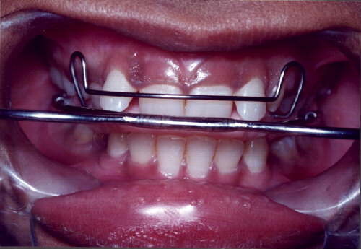
CERVICAL PULL

Slide 44
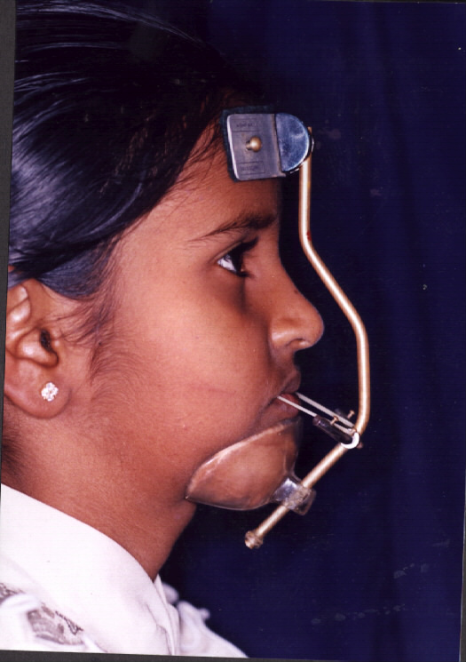
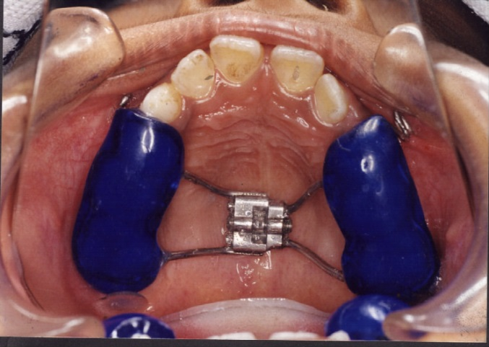
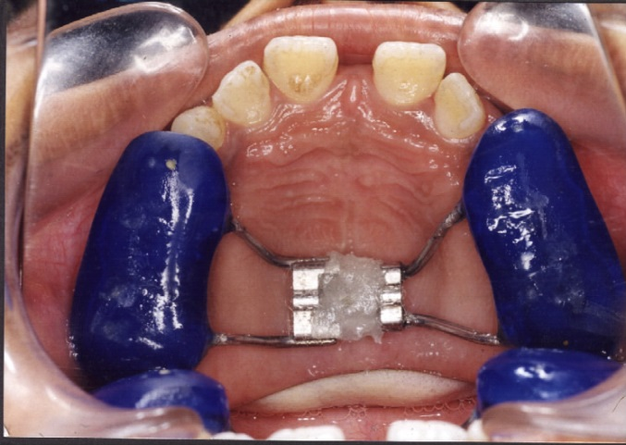
FACIAL PULL

Slide 45
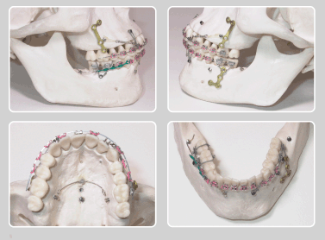
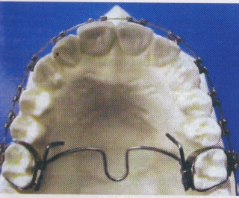
SIMPLE ANCHORAGE
COMPOUND ANCHORAGE
REINFORCED ANCHORAGE

Slide 46
NANDA’S CLASSIFICATION
  MAXIMUM ANCHORAGE
  MODERATE ANCHORAGE
  MINIMUM ANCHORAGE

Slide 47
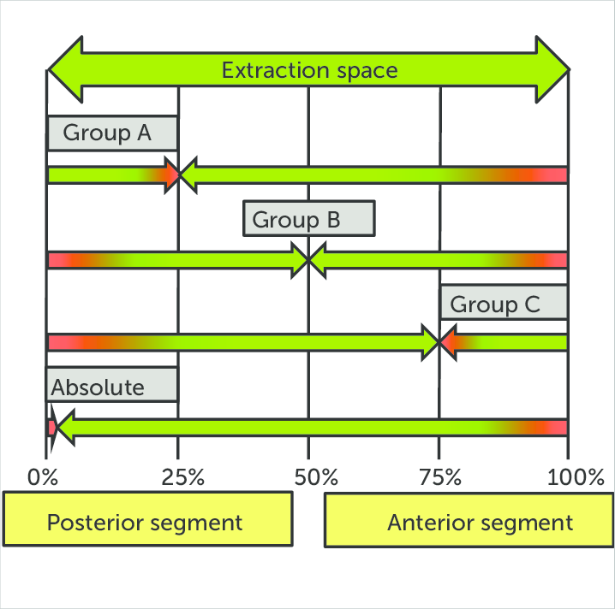

Slide 48
MAXIMUM ANCHORAGE
In cases where the anchorage demand is very high, not more than 1/4th of the extraction space should be lost by forward movement of anchor teeth.
That means the extraction space closed by maximum incisor retraction.

Slide 49
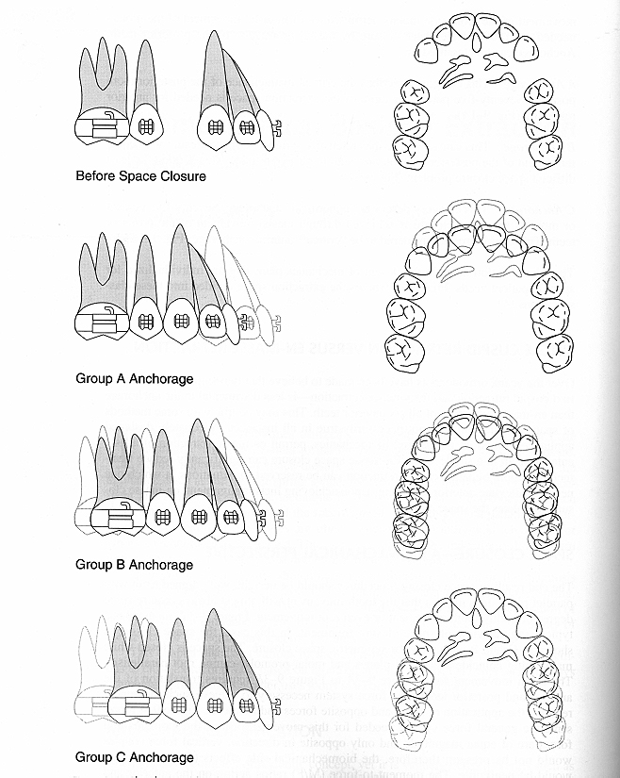

Slide 50
MODERATE ANCHORAGE
In these cases the anchor teeth can be permitted to move forward by almost half of extraction space.
Extraction space closed by retraction of incisors and protraction of posterior teeth.

Slide 51
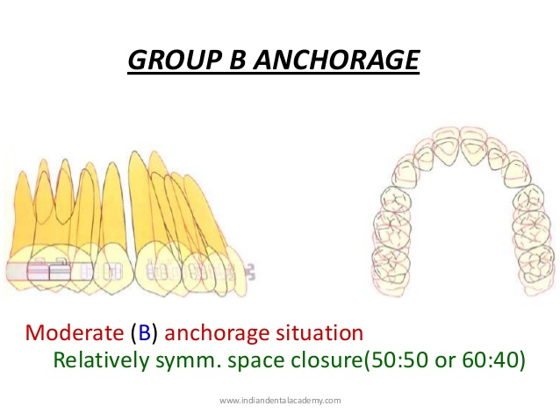

Slide 52
MINIMUM ANCHORAGE
In these cases anchorage demand is very low, more than half the extraction space is lost by moving the anchor unit mesially.
In other words extraction space closed by more protraction of posteriors and minimal retraction of incisors.

Slide 53
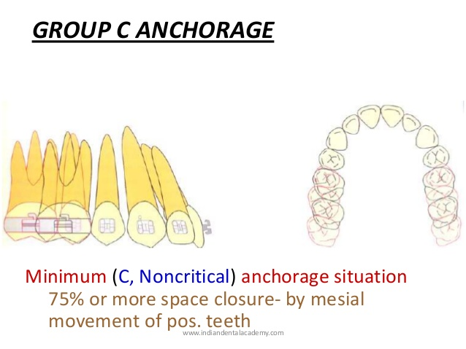

Slide 54
Recent advances ...

Slide 55
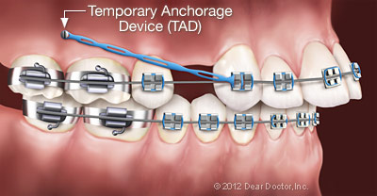
Skeletal anchorage
Recent advances….
  Implants.

Slide 56
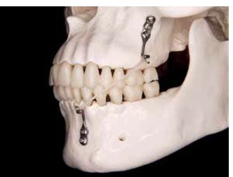
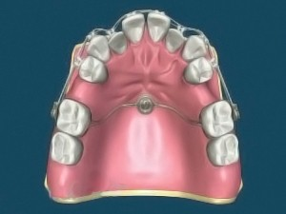
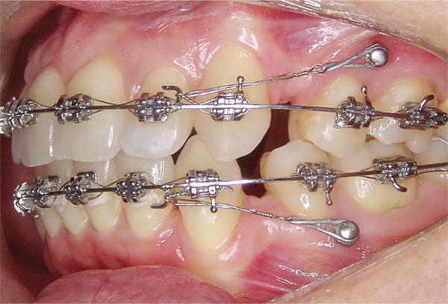
  Onplants.
  Micro implants.
  Surgical mini plates.
  Skeletal anchorage systems.

Slide 57
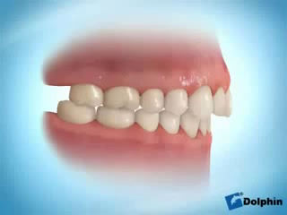

Slide 59
Anchorage planning…
Based on
1. number of teeth being moved.
2. type of teeth being moved.
3. type of tooth movement.
4. duration of tooth movement.
    Anchorage loss …

Slide 60
‘Anchorage loss’ - used for mesial movement of molars in the sagittal plane.
Anchorage gain describes distal movement of incisors.

Slide 61
