Slide 1
INDICES

Slide 2
INTRODUCTION
Dental index or indices are devices to find out the incidence, prevalence and severity of the disease ,based on which preventive programs can be adopted.

Slide 3
INDEX
‘ A numerical value describing the relative status of a population on a graduated scale with definite upper and lower limits, which is designed to permit and facilitate comparison with other populations classified by the same criteria and methods. ’
- Rusell A.L

Slide 4
IDEAL REQUIREMENTS OF AN INDEX
Clarity, simplicity and objectivity
The examiner should able to remember the criteria easily. It should be easy to apply and criteria should be clear.
Validity
The index must measure what is intent to measure.

Slide 5
Reliability
The index should measure consistently at different time and various conditions.
Sensitivity
The index should b able to detect reasonably small shifts, in either direction in the group condition.

Slide 6
Acceptability
The use of index should not be painful or embarrassing to the subject.
Quantifiablity:
The index should be amenable to statistical analysis.

Slide 7
CRITERIA FOR SELECTING AN INDEX
Simple to use and calculate.
Should permit the examination of many people in a short period of time.
Should require minimum armamentarium and expenditure.
Should be highly reproducible in assessing a clinical condition when used by one or more examiners.
Should not cause discomfort to the patient and should be acceptable to the patient.

Slide 8
CLASSIFICATION OF INDICES
Based upon the direction in which their scores can fluctuate.
Irreversible index : measures conditions whose scores will not decrease on subsequent examinations. Eg: DMFT index
Reversible index: measures conditions that can increase or decrease on subsequent examinations. Eg: Loe and Silness gingival index.

Slide 9
Depending upon the extent to which areas of oral cavity are measured.
Full mouth indices : measures the patient’s entire periodontium or dentition. Eg : Russell’s periodontal index (PI)
Simplified indices : measures only a representive sample of the dental apparatus. E.g. : Oral hygiene index simplified(OHI-S).

Slide 10
Based upon entity which they measure
Disease index: ‘D’ (decay) portion of the DMFT index.
Symptom index: measuring gingival / sulcular bleeding.
Treatment index: ‘F’ (filled) portion of DMFT index .

Slide 11
Special categories
Simple index : measures presence or absence of a condition.
Eg Silness and Loe Plaque index
Cumulative index : measures all evidences of a condition past and present. Eg DMFT index for dental caries.

Slide 12
USES
FOR INDIVIDUALS
Provide individual assessment to help patient recognize an oral problem.
Reveal degree of effectiveness of present oral hygiene practices.
Motivate the person in preventive and professional care for elimination and control of oral disease.
Evaluate the success of individual & professional treatment over a period of time by comparing index scores.

Slide 13
In research:
Measure effectiveness of specific agents or devices for prevention/control/treatment of oral conditions.

Slide 14
In community health
Show prevalence and trends of incidences of a condition occurring within a population.
Assess needs of a community.

Slide 15
Dental plaque: is a complex, metabolically interconnected , highly organized , bacterial ecosystem. It is a structure of vital significance as a contributing factor to the initiation of the carious lesion.
Dental calculus : is a hard deposit that forms by mineralization of dental plaque & is usually covered by a layer of unmineralized plaque.

Slide 16
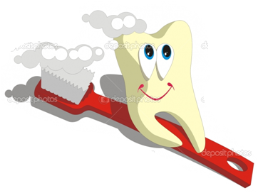
ORAL HYGIENE INDEX(OHI)
SIMPLIFIED ORAL HYGIENE INDEX(OHI-S)
PLAQUE INDEX(PI)
GINGIVAL INDEX(GI)
RUSSELL’S PERIODONTAL INDEX(PI)
COMMUNITY PERIODONTAL INDEX OF
TREATMENT NEEDS (CPITN)
DECAYED-MISSING-FILLED
TEETH INDEX(DMFT)
8. DEAN’S FLUOROSIS INDEX

Slide 17
1.ORAL HYGEINE INDEX(OHI)
Developed in 1960 by John C Greene & Jack R vermillion.
To classify and assess oral hygiene status.
OHI comprises of 2 components
DEBRIS INDEX(DI)
CALCULUS INDEX(CI)

Slide 18
Mouth is divided into 6 segments:

Slide 19
Each segment examined for debris or calculus.
From each segment one tooth is used for calculating the individual index for that segment.
The tooth used for the calculation must have the greatest area covered by either debris or calculus.
Buccal/labial and lingual surfaces.
DI – no:23 explorer (shepherd’s hook)
CI – no:5 explorer

Slide 20
Criteria and scoring
DEBRIS Scores | Criteria
0 | No debris or stain present
1 | Soft debris covering not more than one third of the tooth surface, or presence of extrinsic stains without other debris regardless of surface area covered
2 | Soft debris covering more than one third, but not more than two thirds, of the exposed tooth surface.
3 | Soft debris covering more than two thirds of the exposed tooth surface.

Slide 21
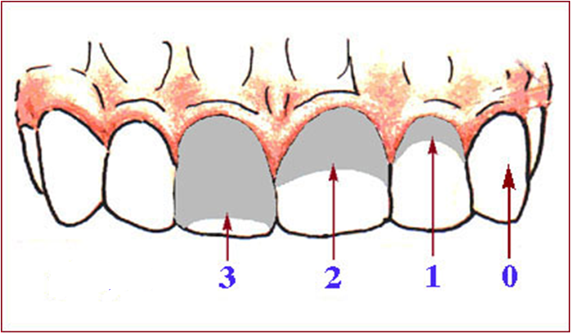

Slide 22
CALCUS SCORE
Scores | Criteria
0 | No calculus present
1 | Supragingival calculus covering not more than one third of the exposed tooth surface.
2 | Supragingival calculus covering more than one third but not more than two thirds of the exposed tooth surface or the presence of individual flecks of subgingival calculus around the cervical portion of the tooth or both.
3 | Supragingival calculus covering more than two third of the exposed tooth surface or a continuos heavy band of subgingival calculus around the cervical portion of the tooth or both.

Slide 23
Calculation
DI = buccal total score + lingual total score
no: of segments
CI = buccal total score + lingual total score
no: of segments
OHI = DI+CI
DI & CI = 1-6
OHI = 0-12
Higher the score poorer the oral hygiene.

Slide 24
2.Simplified oral hygiene index (OHI-S)
1964,John C Greene & Jack R vermillion.
No : of tooth surfaces scored is 6 rather than 12.
Criteria and scoring same as OHI.

Slide 25
Surfaces and teeth to be examined

Slide 26
Substitution : 16 -17
17 - 18
11 – 21 etc
Natural teeth with full crown restorations and surfaces reduced in height by trauma/caries not scored.
Instruments: Mouth mirror,no:23 explorer(shepherd’s hook)

Slide 27
Criteria & scoring
Debris index-simplified
DEBRIS Scores | Criteria
0 | No debris or stain present
1 | Soft debris covering not more than one third of the tooth surface, or presence of extrinsic stains without other debris regardless of surface area covered
2 | Soft debris covering more than one third, but not more than two thirds, of the exposed tooth surface.
3 | Soft debris covering more than two thirds of the exposed tooth surface.

Slide 28
Calculus index- simplified
Scores | Criteria
0 | No calculus present
1 | Supragingival calculus covering not more than third of the exposed tooth surface.
2 | Supragingival calculus covering more than one third but not more than two thirds of the exposed tooth surface or the presence of individual flecks of subgingival calculus around the cervical portion of the tooth or both.
3 | Supragingival calculus covering more than two third of the exposed tooth surface or a continuos heavy band of subgingival calculus around the cervical portion of the tooth or both.

Slide 29
Calculation
DI-S = Total score
No : of surfaces examined
CI-S = Total score
No : of surfaces examined
OHI-S =
DI-S + CI-S

Slide 30
Interpretation
For DI-S & CI-S score,
For OHI-S
Study of epidemiology of periodontal diseases.
Good | 0.0 – 0.6
Fair | 0.7 – 1.8
Poor | 1.9 – 3.0
Good | 0.0 – 1.2
Fair | 1.3 – 3.0
Poor | 3.1 – 6.0

Slide 31
3.PLAQUE INDEX(PII)
Described by Silness P and Loe H in 1964.
This index measures the thickness of plaque on the gingival one third.
Used as full mouth index/simplified index.
INDEX TEETH:16,12,24,36,32,44
No substitution if any one of the above teeth are missing.
Areas examined: distofacial, facial,mesio-facial and lingual surface of tooth.
Instruments: mouth mirror,dental explorer.

Slide 32
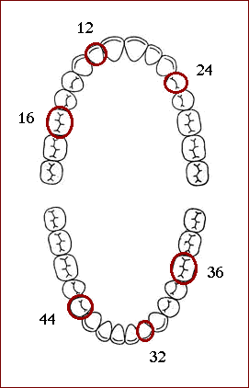

Slide 33
Criteria & scoring
Score | Criteria
0 | No plaque
1 | A film of plaque adhering to the free gingival margin and adjacent area of the tooth, which can not be seen with the naked eye. But only by using disclosing solution or by using probe.
2 | Moderate accumulation of deposits within the gingival pocket, on the gingival margin and/ or adjacent tooth surface, which can be seen with the naked eye.
3 | Abundance of soft matter within the gingival pocket and/or on the tooth and gingival margin.

Slide 34
Calculation
PII for a tooth = Scores of 4 areas
4
PII for individual = total scores
no: of teeth examined
PII for group = total score
no: of individuals
Interpretation
Excellent | 0
Good | 0.1-0.9
Fair | 1.0-1.9
Poor | 2.0-3.0

Slide 35
4. Gingival Index(GI)
Developed by Loe H and Silness P in 1963.
For assessing severity of gingivitis.
Instrument: mouth mirror , periodontal probe.

Slide 36
Index teeth
Tissues surrounding each tooth divided into 4 gingival scoring units.
DISTO-FACIAL PAPILLA
FACIAL MARGIN
MESIO-FACIAL PAPILLA
LINGUAL GINGIVAL MARGIN.

Slide 37
Scoring criteria
SCORE | CRITERIA
0 | Absence of inflammation/normal gingiva.
1 | Mild inflammation, slight change in color, slight edema, no bleeding on probing.
2 | Moderate inlammation,moderate glazing, redness, edema and hypertrophy, bleeding on probing.
3 | Severe inflammation, marked redness and hypertrophy , ulceration, tendency to spontaneous bleeding.

Slide 38
Calculations
GI score for a tooth = Scores from 4 areas
4
GI score individual = Sum of indices of teeth
no: of teeth examined
3. GI score for group = Sum of all members
total no:of individuals
Interpretation
Gingival scores | Condition
0.1-1.0 | Mild gingivitis
1.1-2.0 | Moderate gingivitis
2.1-3.0 | Severe gingivitis

Slide 39
5.Russell’s periodontal index(PI)
Developed by Russell A.L in 1956
To estimate deeper periodontal diseases.
All teeth present examined.
Gingival tissue surrounding each tooth assessed for gingival inflammation and periodontal involvement.
Instruments : mouth mirror, plain probe.

Slide 40
Scoring criteria
Score | Criteria | Additional radiographic features
0 | NEGATIVE, neither overt inflammation in investing tissues nor loss of function due to destruction of supporting tissue. | Radiographic features normal
1 | MILD GINGIVITIS , overt area of inflammation in free gingiva.
2 | GINGIVITIS: inflammation completely circumscribes tooth but no break in epithelial attachment.
4 | Used only when radiographs are available. | Early notch like resorption of alveolar crest.
6 | GINGIVITIS WITH POCKET FORMATION. | Horizontal bone loss involving alveolar crest up to half length of root.
8 | ADVANCED DESTRUCTION WITH LOSS OF MASTICATORY FUNCTION. | Advanced bone loss.

Slide 41
Calculation
PI score per person = Sum of individual scores
No: of teeth present
Interpretation
Clinical condition | Individual PI score
Clinically normal supportive tissues | 0-0.2
Simple gingivtis | 0.3-0.9
Beginning destructive periodontal disease | 1.0-1.9
Established destructive periodontal disease | 2.0 -4.9
Terminal disease | 5-8

Slide 42
6.Community periodontal index of treatment needs(CPITN)
Developed by “joint committee” of WHO & FDI in 1982.
To survey and evaluate periodontal treatment needs.
Advantages:
Simplicity
Speed
International uniformity.

Slide 43
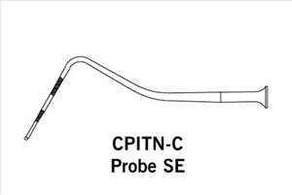
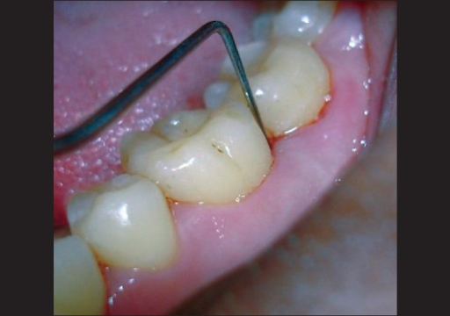
PROCEDURE:
Dentition divided into sextants.
Each sextant given a score.
INSTRUMENTS: CPITN PROBE
17-14 | 13-23 | 24-27
47-44 | 43-33 | 34-37

Slide 44
CPITN probe
WHO periodontal examination probe.
Used for
Measurement of pocket depth &
Detection of subgingival calculus.
Weight = 5gms
2 types:
CPITN-E(epidemiological probe)
Pocket depth measured through color coding; black
mark starting from 3.5mm - 5.5mm
- “Ball tip” diameter 0.5mm; easy detection of sub gingival calculus

Slide 45
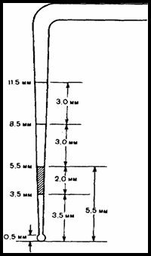
CPITN-C ( clinical probe)
Variant probe basic probe
2 additional markings
8.5mm & 11.5 mm
Detailed assessment & recording
of deep pockets.

Slide 46
Index teeth
Best estimators of the worst periodontal condition of the mouth.
>20 years
Molars examined in pairs & highest score recorded.
Up to 19 years
17/16 | 11 | 26/27
47/46 | 31 | 36/37
16 | 11 | 26
46 | 31 | 36

Slide 47
Coding criteria
Code | Criteria
CODE X | Only one tooth or no teeth present in a sextant.
CODE 4 | Pathological pocket of 6mm or more present.
CODE 3 | Pathological pocket of 4mm-5mm present.
CODE 2 | Presence of supra or sub gingival calculus.
CODE 1 | Gingival bleeding after gentle probing
CODE 0 | No signs of disease.

Slide 49
Classification of treatment needs
TN0 | Code 0(healthy) or code x (missing) for all sextants indicates no treatment required.
TN1 | Code 1 – need to improve oral hygiene.
TN2a | Code 2 – need for scaling, improve personal oral hygiene.
TN2b | Code 3 – need for scaling ,root planing,improve oral hygiene.
TN3 | Code 4 – needs deep scaling , root planing & complex surgical procedures.

Slide 50
7.DECAYED-MISSING-FILLED TEETH INDEX (DMFT)
Developed by Henry T Klein,Carrole E. Palmer and Knutson J W in 1938.
To determine prevalence of coronal caries.
Advantages:
Simple
Rapid
Versatile
Universally accepted

Slide 51
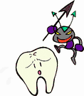
PROCEDURE
DMFT applied only to permanent teeth.
3 components:
D – decayed teeth
M – missing teeth due to caries
F - filled teeth
Instruments : mouth mirror , explorer.
Teeth not included :
3rd molars
Unerupted teeth
Congenitally missing & Supernumerary teeth
Teeth removed & restored for reasons other than caries

Slide 52
Principles & rules in recording DMFT
No tooth counted more than once , its either decayed/missing/filled/sound.
Tooth having several restorations also counted as one.
Deciduous teeth not included in DMFT.
Tooth considered present even though crown is destroyed and only roots are left.

Slide 53
Calculation of index
Maximum DMFT score for an individual is 28 or 32.
Individual DMFT:
Eg:DMFT score of 3+2+5=10;3 teeth decayed,2 missing and 5 filled.
Also 28-10=18 teeth are sound.
D+M+F=DMF

Slide 54
Group average:
Average DMFT= Total DMF
Total no:of subjects examined.

Slide 55
WHO modification of DMF index(1987)
All third molars included.
Temporary restorations considered as ‘D’
Only carious cavities considered as ‘D’. Initial lesions not considered as ‘D’.

Slide 56
8.Dean’s fluorosis index
Introduced by Trendley H Dean in 1934
Also know as “ Dean’s classification system for dental fluorosis”.
Recording based on two teeth most affected.
If 2 teeth not equally affected , the score for the less affected tooth is recorded.

Slide 57
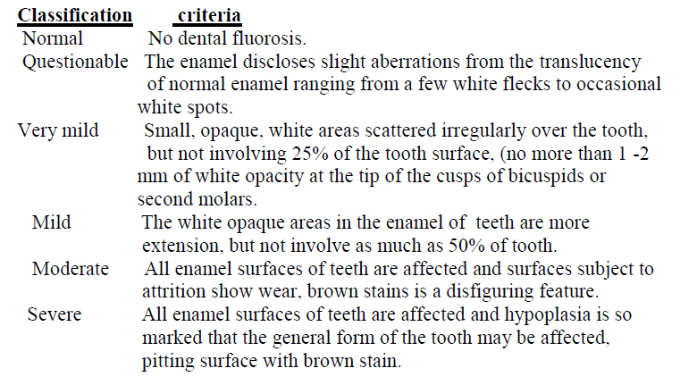
Criteria (modified 1942)
0
0.5
1
2
3
4

Slide 58
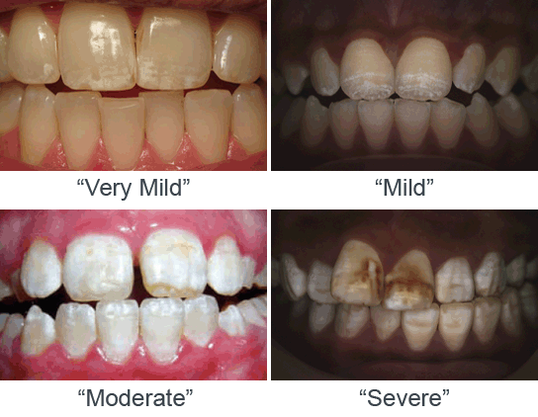

Slide 59
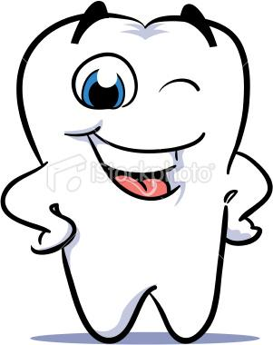
Thank “u”

