Slide 1
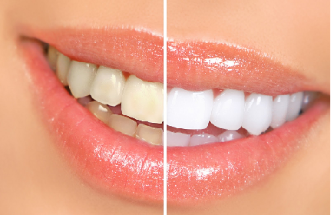
BLEACHING

Slide 2

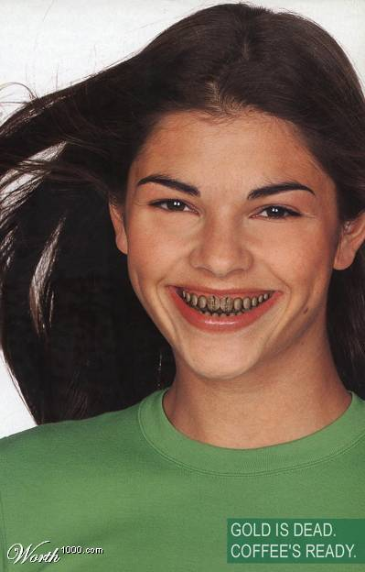
“Bad Smile”
You may be fully dressed but with a

Slide 3

The first thing people notice about you is your smile

Slide 4
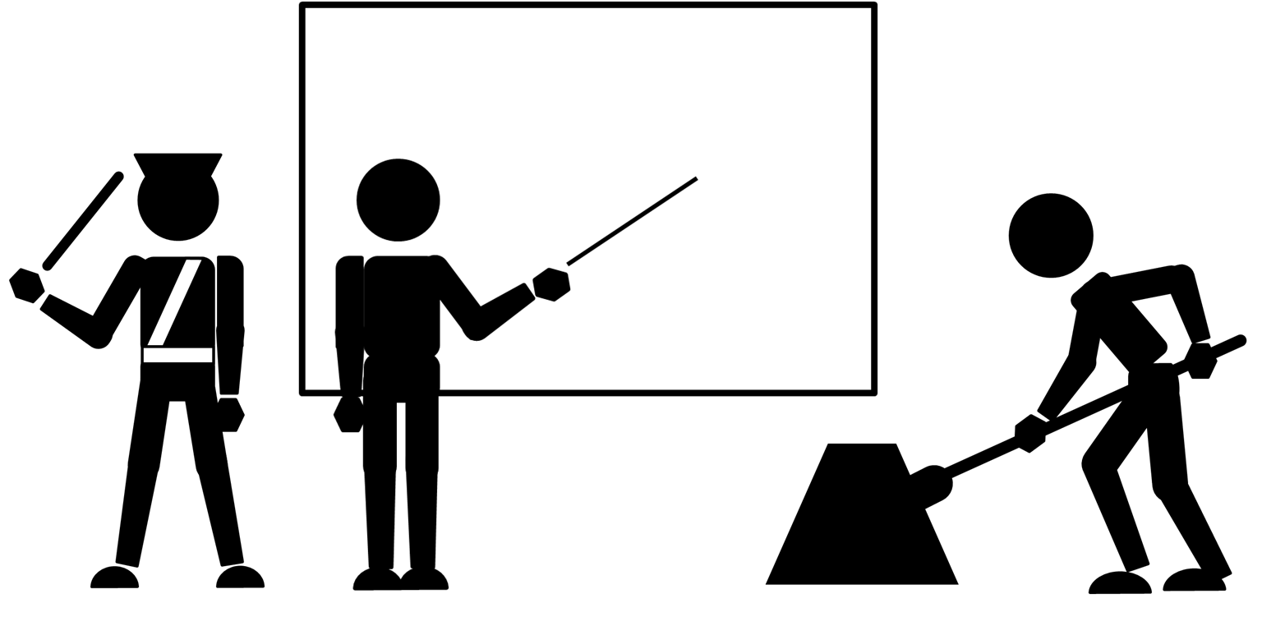
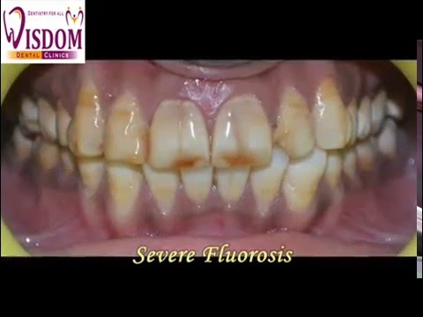
TOOTH
DISCOLORATION
“Any change in the hue, color, or translucency of a tooth due to any cause; restorative filling materials, drugs (both topical and systemic), pulpal necrosis, or hemorrhage.

Slide 5
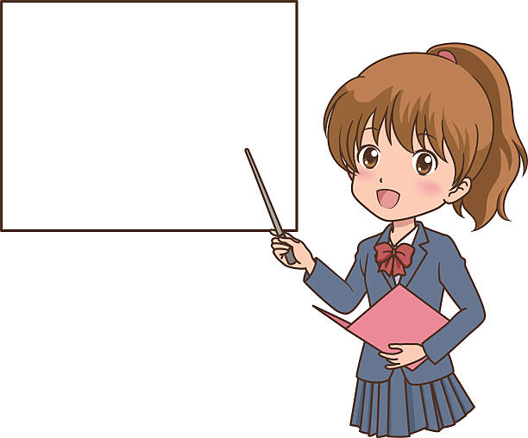
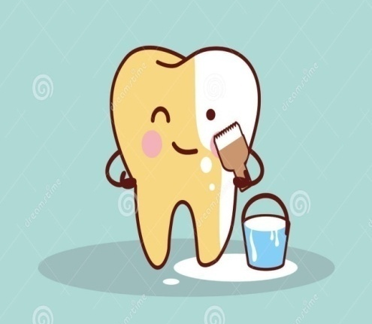
BLEACHING
Lightening of the color of the tooth through the application of chemical agent to oxidize the organic pigmentation in the tooth.

Slide 6
ETIOLOGY
Extrinsic Stains
Foods
Intrinsic Stains
PRE – ERUPTIVE
Beverages
Mouth rinses
Tobacco products
Restorative materials
Chromogenic microorganisms
Porphyria
Erythroblastosis fetalis
Amelogenisis imperfecta
POST ERUPTIVE
Age
Trauma
IATROGENIC
Tetracycline
Fluorosis

Slide 7
Extrinsic Stains
This primarily occurs as a result of charged surface interactions between the positively charged food molecules and the negatively charged tooth pellicle derived from salivary proteins.

Slide 8
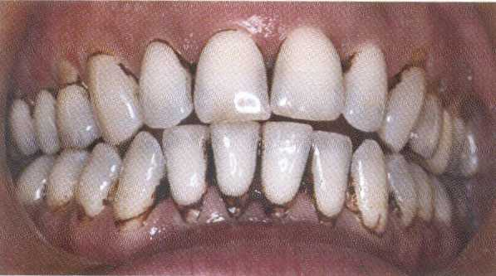
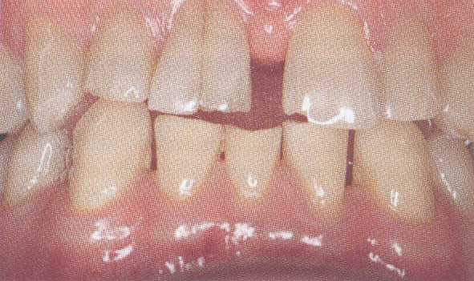
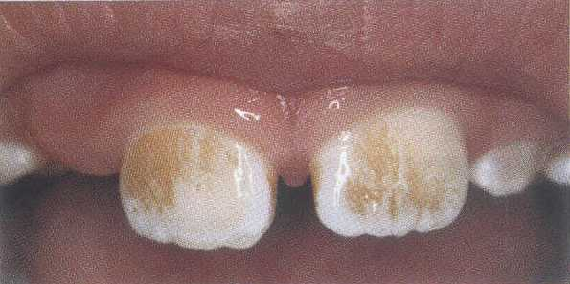
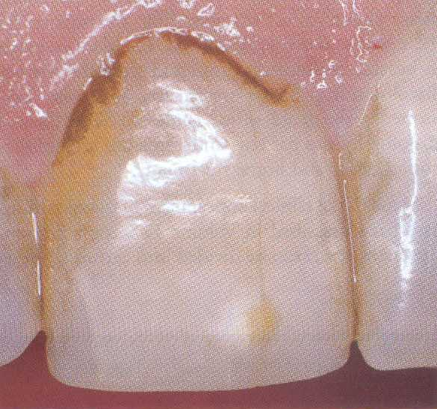
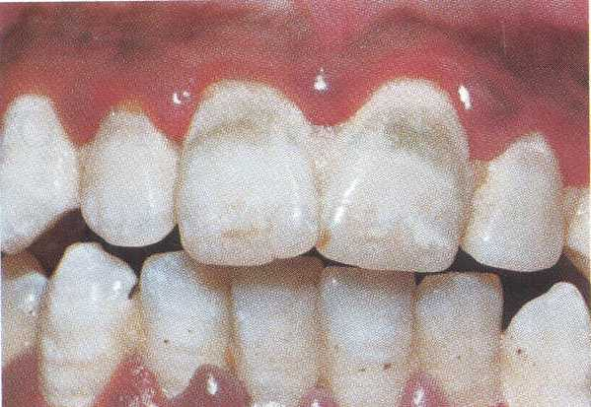
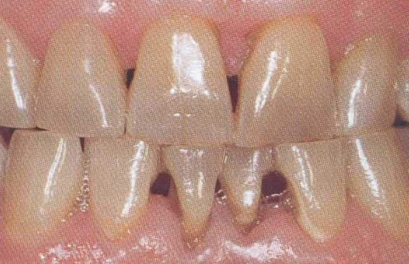
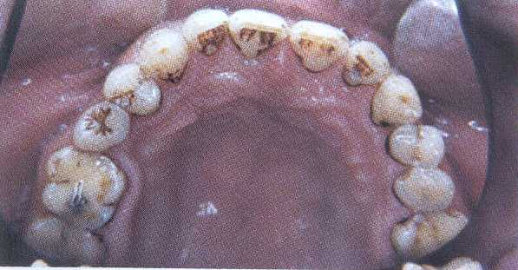
EXTRINSIC DISCOLORATION
Stains due to chromagenic foodstuffs
Regular use of chlorhexidine rinse
Black stains from chewing betel-nuts
Staining can occur in tooth defects
Brown stains resulting from pipe smoking
Green stain associated with poor oral hygiene
Thick brick-red stain on the cervical third

Slide 9
INTRINSIC STAINS
Occurs when stains exist or penetrate below the enamel surface.
This can happen when food molecules seep into enamel flaws and cracks, or, in some cases, between enamel rods
Can also occur following a change to the structural composition / thickness of the dental hard tissues.

Slide 10
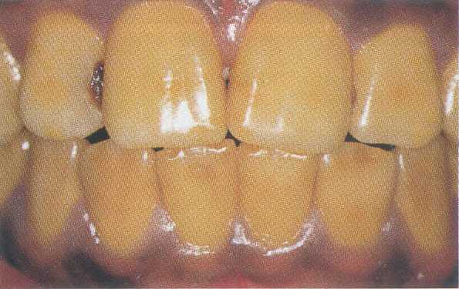
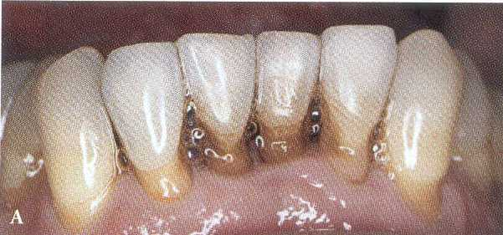
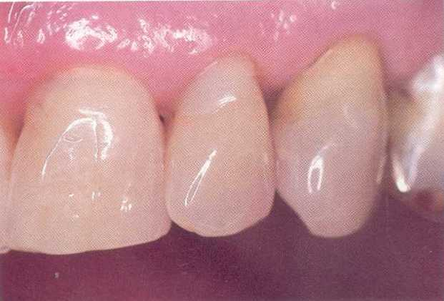
INTRINSIC DISCOLORATION
Discoloration associated with abrasion and erosion
Yellow teeth caused by ingestion of iron
Aging discoloration

Slide 11
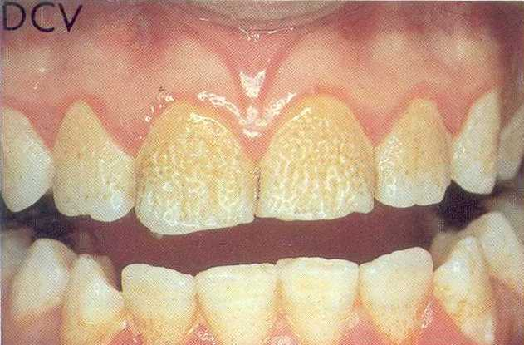
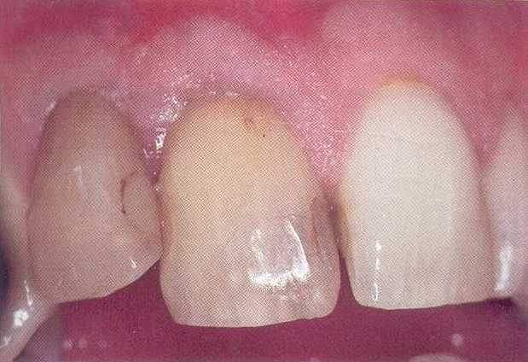
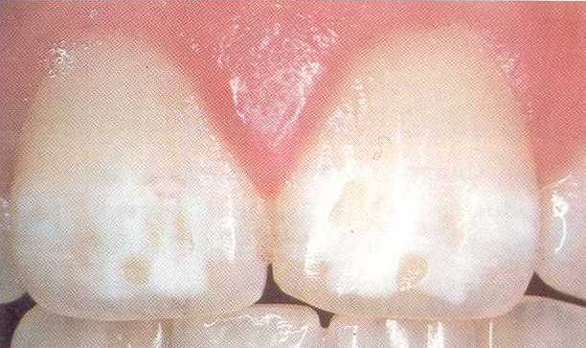
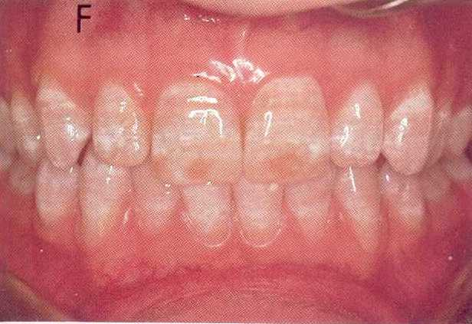
NONVITAL DISCOLORATION
Hypoplastic discoloration
Hypocalcific discoloration
Fluorosis discoloration

Slide 12
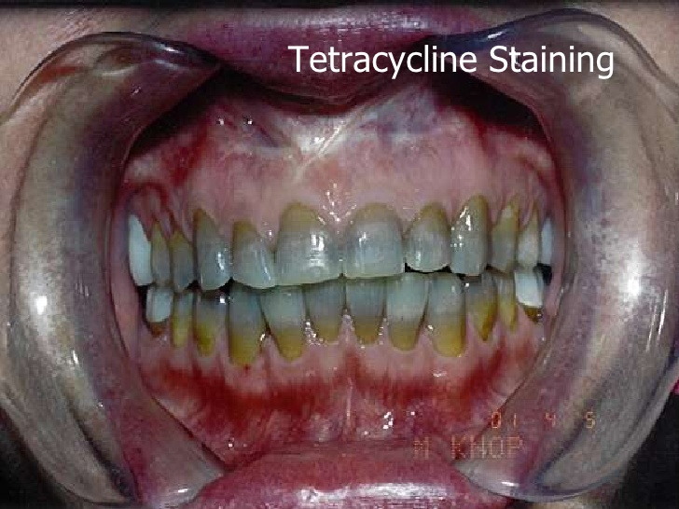
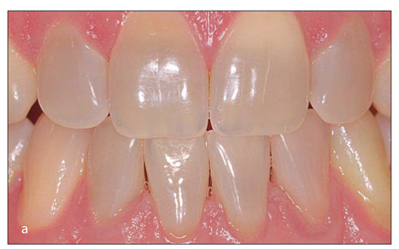
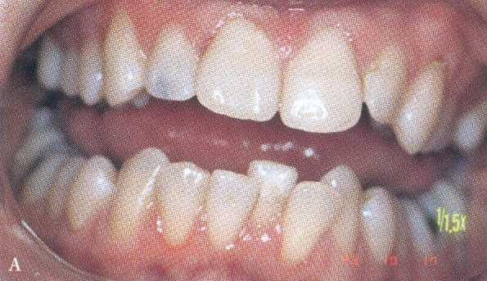
Mild minocycline
Gray stain is a result of an amalgam restorations

Slide 13

INTERNALIZED
Extrinsic , become intrinsic as nicotine stained teeth.

Slide 14
AGE RELATED
Secondary dentin deposition
Thinning of enamel
Increased exposure to external staining agents
Degradation of previously applied restorations

Slide 15
TYPES OF DISCOLORATION | COLOUR PRODUCED
Extrinsic (Direct stains) Tea, coffee and other foods Cigarettes/cigars Plaque/poor oral hygiene | Brown to black Yellow/brown to black Yellow/brown
Extrinsic (Indirect stains) Polyvalent metal salts and cationic antiseptics e.g. Chlorhexidine | Black and brown
Intrinsic (Metabolic causes) e.g. Congenital erythropoietic porphyria (Inherited causes) e.g. Amelogenesis Imperfecta e.g. Dentinogenesis Imperfecta (Iatrogenic causes) Tetracycline Minocycline Fluorosis (Traumatic causes) Enamel hypoplasia Pulpal haemorrhage products Root resorption (Ageing causes) | Purple/brown Brown or black Blue-brown (opalescent) Banding appearance: classically yellow, brown, blue, black or grey Grey White, yellow, grey or black Brown Grey black Pink spot Yellow
Internalized Caries Restorations | Orange to brown Brown, grey, black

Slide 16
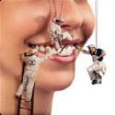
Stains Removal
Achieving an appealing smile is still one of the most interesting dental challenges for every operator.

Slide 17
Full Coverage Esthetic Crowns
Veneering
Macroabrasion
Microabrasion
BLEACHING
Removal of surface stains

Slide 18
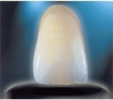
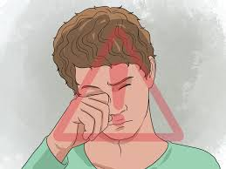
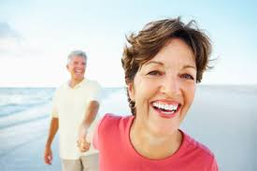
Factors Affecting Color of the Tooth
Lighting conditions
Translucency
Opacity
Texture
Gloss
Human eye: fatigue and blindness
Brain influence
Physiological conditions as aging

Slide 19

When Bleaching
May Not
Be Necessary?

Slide 20
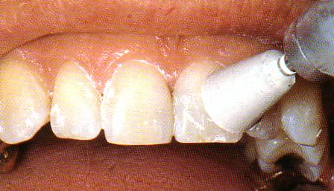
If Prophylaxis alone satisfy your patient.
Correction of discolored restoration.
Restoring the discolored carious tooth

Slide 21
When will be Bleaching Contraindicated?

Slide 22

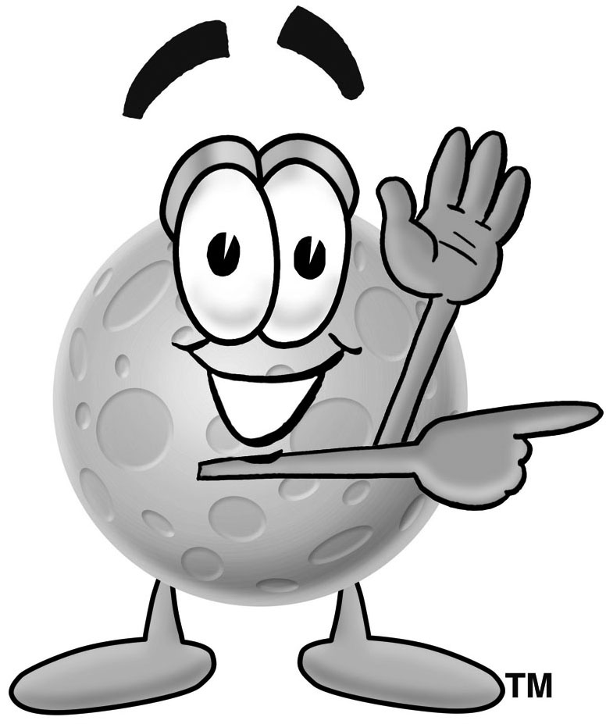
CONTRA INDICATIONS
Superficial stains that can be removed with rubber cup and prophylaxis paste
Children with large pulp chamber
Hypersensitive teeth
Pregnant and lactating women
ST-09
Exposed root surfaces

Slide 23

Teeth with multiple fillings

Slide 24
Tetracycline stains covered with porcelain / composite resin veneers cannot be bleached
Very dark / black stains resist bleaching as do small, deep, discolored / opaque white spots.
Fluorosis can result in superficial white, brown and yellow spots
These types of stains are best removed physically (enamel micro-abrasion) or managed restoratively.

Slide 25
Lighten the tooth color before restoration with bonded resin or porcelain veneers or crowns
Mild fluorosis, and tetracycline stains
Match the existing color of the crown that is lighter than the natural teeth
INDICATIONS
Notes:
Dissatisfaction of tooth color as a result of
Dissatisfaction of tooth color as a result of

Slide 26

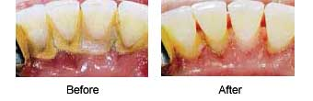

Prior to bleaching it is important to note the following for optimal results:
Perform a diagnosis, ensure the health of the soft tissue, restore carious teeth.
Remove calculus and external stains from the teeth.
Taking Photographs.

Slide 27
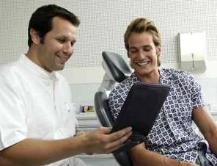
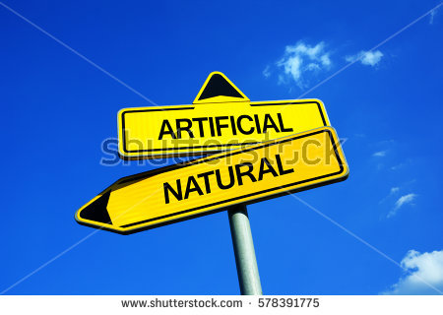
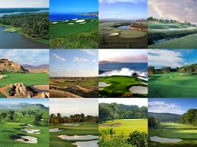
Behavioral History Dealing with the patients
“ Esthetic Formula”
“It was found in a study that there is a strong relation between color of the skin and color of the teeth.”
“Restoring naturality and not artificiality”.

Slide 28
BLEACHING
VITAL TOOTH
IN OFFICE/ POWER
NON – VITAL TOOTH
WALKING
IN-OFFICE
AT HOME/NIGHT GUARD

Slide 29
Methods
Non-vital
Vital
In-office
In office
Dentist supervised
Patient applied
Walking
Over-the-counter products

Slide 30
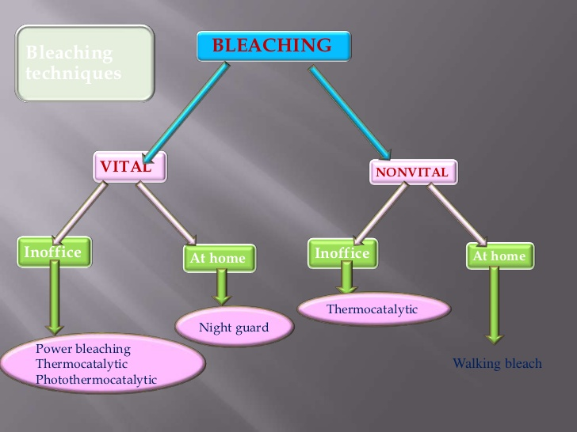

Slide 31
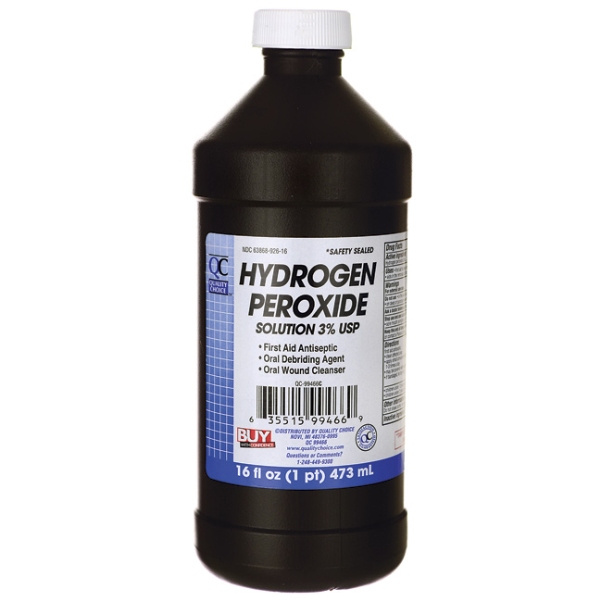

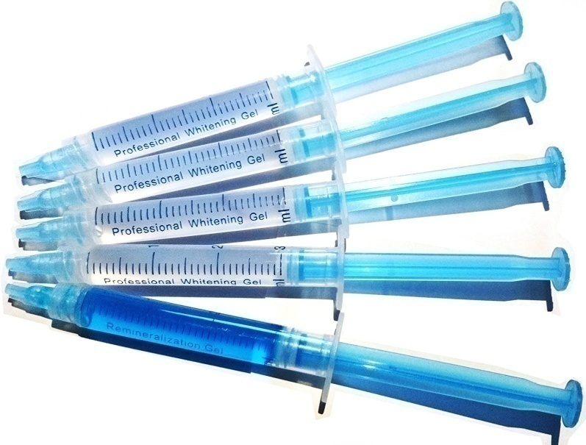
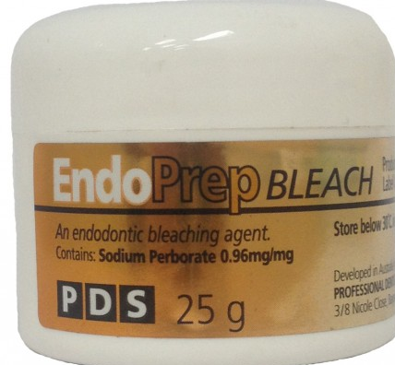
BLEACHING AGENTS
HYDROGEN PEROXIDE
CARBAMIDE PEROXIDE
SODIUM PERBORATE

Slide 32
AGENTS USED
30 % solution of hydrogen peroxide by weight
& 100% by volume
In distilled water, clear colorless odorless liquid .
Heat causes explosion
Shelf life - 3-4 months if stored in refrigerators
SUPEROXOL
Chemistry
Superoxol
Sodium metaborate , water & Oxygen

Slide 33
SODIUM PERBORATE
Stable white powder (granules)
Hydrogen peroxide & Sodium metaborate (Water soluble)
Oxygen
(Spaser et al 1963)
10%- 15% CARBAMIDE PEROXIDE
( Hydrogen peroxide carbamide / Carbamide urea /Urea peroxide / perhydrol urea )
(Rotstein et al JOE 1993)
Not powerful bleaching agent .
Oral antiseptic - Category I

Slide 34
CONSTITUENTS OF BLEACHING MATERIAL
FIRST GENERATION
SECOND GENERATION
THIRD GENERATION
Liquid form
Viscous materials
Have different colors and mode of activation.
Stays in the bleaching tray for longer
Not remain long-time in bleaching

Slide 35
MECHANISM OF BLEACHING
Hydrogen peroxide has a low molecular weight which enables it to diffuse through the enamel matrix
The free radicals interact with organic molecules to attain stability.
Bleaching agent opens the more highly pigmented carbon ring (yellow color) and converts them to carbon chains
When the carbon double bonds are converted to hydroxyl groups, the amount of light absorbed is reduced. Hence the tooth appears lighter in color.

Slide 36
CHEMISTRY OF BLEACHING :
REDOX reaction
Oxidizing agent
Free radicals with unpaired electrons
Acts on theTooth
Produces Bleaching
Hydrogen Peroxide ( Oxidizing Agent - Discolourant (Reducing Agent
BLEACHING = WHITENING

Slide 37

Whitening effect is entirely dependent on
=
Peroxide conc.
x
Time of contact with teeth

Slide 38



MODIFIED
Mc INNES SOLUTION
Mc INNES SOLUTION
BLEACHES ENAMEL
ETCHES ENAMEL
DISSOLVES CALCIUM
REMOVES SURFACE DEBRIS
HYDROGEN PEROXIDE
5 PARTS (1ml)
SODIUM HYDROXIDE 20%
HYDROCHLORIC ACID
5 PARTS (1ml)
ANESTHETIC ETHER
1 PART (0.2ml)

Slide 39
DISADVANTAGES OF OLD MCINNES SOLUTION
Loss of contour
Sensitivity
Irritation to gingiva
Ca dissolution is more

Slide 40
NON VITAL BLEACHING
CLOSED CHAMBER BLEACHING TECHNIQUES
Walking Bleaching
Modified intracoronal bleaching
OPEN CHAMBER BLEACHING TECHNIQUE
Inside/Outside technique (Combination of intra and extra coronal technique)
Thermo catalytic technique/ Heat-and –Light

Slide 41
WALKING BLEACH
In 1976 Nutting and Poe introduced walking bleach technique.
use of chemical agents within the coronal portion of an endodontically treated tooth to remove tooth discolouration.
Chemical used: sodium perborate

Slide 42
INDICATIONS AND CONTRAINDICATIONS
INDICATIONS
1. Discoralation of pulp chamber
2. Dentine discoloration
3.Discoloration not amenable to extracoronal bleaching
CONTRA INDICATIONS
1. Superficial enamel discoloration
2. Defective enamel formation
3. Severe dentiloss
4. Presence of caries
5. Discolored composites

Slide 43
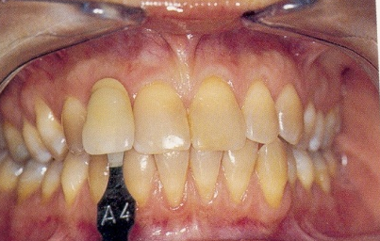
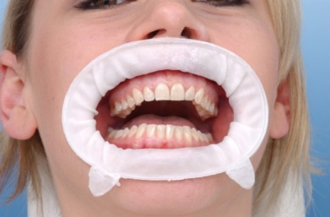
STEPS IN WALKING BLEACH
RADIOGRAPH - QUALITY OF OBTURATION
QUALITY AND SHADE OF RESTORATION

Slide 44
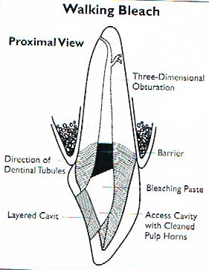
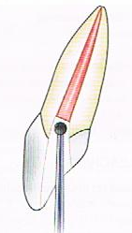
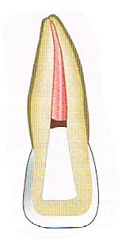
Prepare the access cavity , remove the coronal gutta percha , expose the dentine and refine the cavity.
mechanical barrier of 2 mm thick , preferably of glass ionomer cement , zinc phosphate , IRM polycaroxylate cement or cavit on root canal filling material.
The coronal height of barrier should protect the dentinal tubules and conformed to the external epithelial attachment

Slide 45
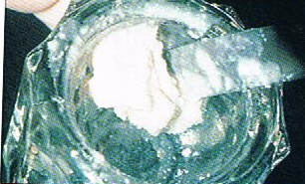
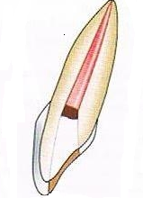
mix sodium perborate with an innert liquid (local anesthetic, saline or water) and place this paste into pulp chamber
after removing the excess bleaching paste place a temporary restoration over it.
Recall the patient after 1-2 weeks , repeat the treatment until the desired shade is achieved.
Restore excess cavity with composite after two weeks.

Slide 46
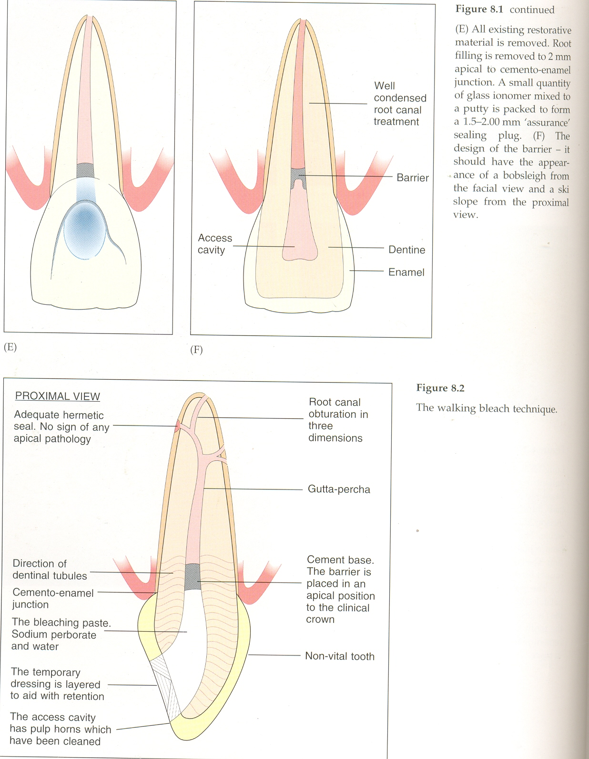

Slide 47
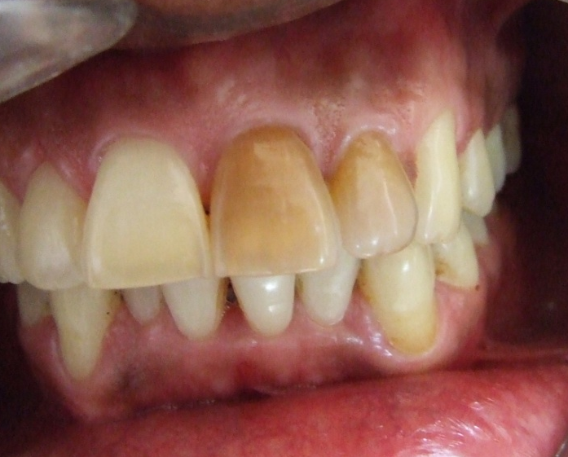
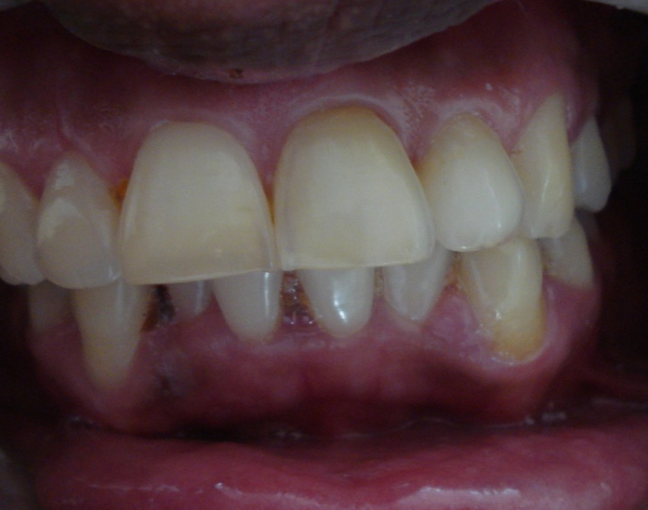
PRE AND POST OPERATIVE
Before
After

Slide 48
Open chamber bleaching:
Combining intra- and extracoronal bleaching; the material
is applied into the pulp chamber directly and retained with a
home bleaching matrix.
Inside/Outside technique with bleaching tray using different concentrations of Carbamide peroxide
Closed chamber bleaching:
The bleaching material is placed on the external surfaces of the
tooth.
Power bleaching using 35% hydrogen peroxide
Nightguard Vital Bleaching using 10%, 15% or 20% applied only to the non-vital tooth in the tray

Slide 49
COMPLICATIONS OF INTRACORONAL BLEACHING
External root resorption.
Chemical burns if using 30-35% H₂O₂
Decrease bond strength of composite.

Slide 50
PRECAUTIONS
Isolate tooth effectively
Adequate endodontic obturation
Use protective barriers
Protect oral mucosa
Avoid acid etching
Avoid strong oxidizers
Avoid heat
Recall periodically

Slide 51
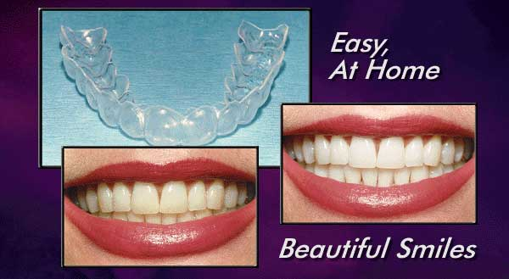
NIGHT GUARD BLEACHING/ HOME BLEACHING TECHENIQUE
Introduced by Dr. Van Haywood and Dr. Harald Haymann in 1989.
Dentist prescribed home bleach technique.

Slide 52
Various names:
Nightguard Vital Bleaching
Matrix bleaching
Dentist-assisted / prescribed home-applied bleaching
Dentist-supervised at-home bleaching
At-home bleaching

Slide 53
Advantages…
Simple and fast.
Simple for dentists to monitor without extended clinical time.
It is cost effective.
Not expensive.
It is not usually a painful procedure.
Patients can bleach their teeth at their convenience.
Results relatively quick.

Slide 54
Disadvantages…
Patients need to participate actively in their treatment.
The color change is dependent on the amount of time that the trays are worn.
The system may be open to abuse by using excessive amounts of bleach for too many hours per day.

Slide 55
INDICATIONS AND CONTRAINDICATIONS
INDICATIONS
Superficial enamel discoloration
Mild yellow discoloration
CONTRAINDICATIONS
Severe enamel loss
Brown fluorosis discoloration
Age –related discolorations
Hypersensitive teeth
Presence of caries
Defective coronal restorations
Allergy to bleaching gels

Slide 56

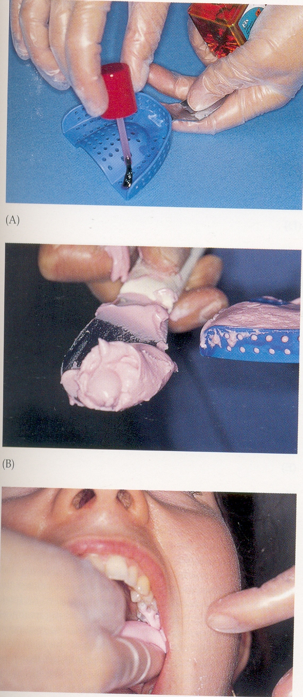
Clinical steps…
Clinical examination of all teeth
Pre-existing shade evaluation
Impression taking- Alginate impression of the arch to be taken.

Slide 57
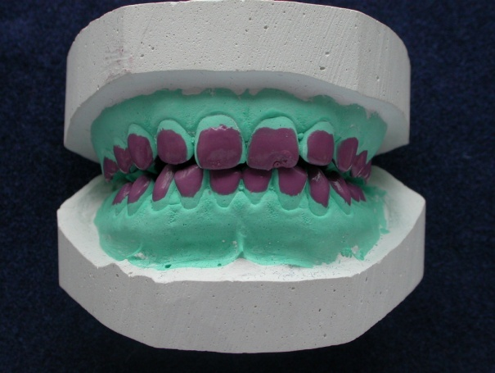


Tray: step by step
Cast a model
Alginate impression of the arch to be taken. Model prepared
Block resin applied on the labial surface of the teeth to be bleached to form a small reservoir for the bleaching agent.
Reservoir created at buccal aspects of teeth to be bleached

Slide 58


Fabrication of bleaching tray is done using BIOSTAR
BIOSTAR
Place the model on the base section of the vacuum tray forming machine. Ensure that the plastic sheet is properly placed over the model.
Model and tray material in position

Slide 59


Plastic sheet is now more easily removed from the press. Scalloping the tray on the buccal / facial surface of the model using a heated scalpel blade. Tray trimmed 1mm above the gingival margin.
Molded plastic tray
Polishing of the tray is done gently with a special soft cotton wheel. Finished tray placed back on the cast to prevent distortion.
Finished upper tray

Slide 60




BRUSHING
FLOSSING
Bleaching material is placed on the buccal surfaces of the tray

Slide 61


Gentle finger pressure is applied to the tray to improve retention and suction while removing the excess material at the same time.
Insufficient material is placed into the tray. The tray is over extended.
More material is added

Slide 62


STORAGE

Slide 63

Familiarize the patient with the use of bleaching agent and wearing the guard, instruct the patient that this procedure should be performed 3-4 hours per day or over night.
Recall the patient every 2 weeks to monitor stain lightening.
10% carbamide peroxide is used for this technique ,this can be later increased to 16%,or up to 20% as per the case requirements.

Slide 64



AFTER
BEFORE
BEFORE
AFTER

Slide 65

IN OFFICE BLEACHING
Equipment Needed
The power bleach material.
Tissue protector.
Energizing/Activating Source.
Protecting clothing and eye wear.
Mechanical timer

Slide 66

Various Light Sources
Conventional bleaching light
Tungeston halogen curing light
Xenon plasma arc light
Argon and CO₂ lasers
Diode laser light

Slide 67





Energizing/activating source
Ultrasonics
Diode laser
Plasma arc bleaching unit
Halogen curing lamp
Dental chair light

Slide 68
NAMES ASSOCIATED WITH IN OFFICE BLEACHING
Chair side bleaching
Power bleaching
Laser bleaching
Dentist administered bleaching
Assisted bleaching / dentist supervised bleaching

Slide 69
Advantages
The time factor - produces immediate results.
Avoiding problems with home bleaching procedures such as gag.
Disadvantages
The caustic nature of gel -isolation and protection mandatory.
Dehydration of the teeth

Slide 70


STEPS OF IN OFFICE BLEACHING
Intraoral examination
Preoperative photograph & shade evaluation
Prophylaxis of the tooth is preformed as a preliminary to examination.

Slide 71

Gingiva is isolated with a rubber dam
light cured resin barrier materials that are painted on to the gingiva
Protective eyewear

Slide 72

Gel is mixed to get good consistency
A 2-3 mm layer of freshly mixed gel should be applied to all the labial surfaces of teeth in the smile zone and lipped over to cover the incisal edges and extend slightly lingually or palatally
Composite curing light may accelerate oxidation process

Slide 73
The oxidizing paste changes to a cream color
gel is suctioned off the teeth using high volume suction and the teeth wiped using damp gauze before being lightly dried

Slide 74

The gel is left in place for a length of time dependent on the system and concentration of hydrogen peroxide used, usually about 10 minutes, but can range from 3-20 minutes at a time.
Surrounding mucosa are examined for blanching or areas of redness indicating hydrogen peroxide seepage through the isolation.
Areas of damage should be thoroughly washed with copious amounts of water before the application of a neutralizing agent, such as vitamin E, usually supplied within the bleaching kits
Antioxidants

Slide 75
ASSISTED BLEACH TECHNIQUE OR WAITING ROOM BLEACH TECHNIQUE
This bleaching technique was invented by Den- Mat.
The dentist applies the 35% carbamide peroxide into a custom-made bleaching tray. After the excess material is removed, the patient returns to the waiting room for a period of about 30 minutes with the bleaching tray in the mouth.
After 30 minutes, the bleach is suctioned off the teeth before rinsing. The procedure can be repeated 2 -3 times more in one session.

Slide 76
COMPRESSIVE BLEACHING TECHNIQUE
This technique, reported by Miara, suggests that the Power bleaching technique can be made more effective by compressing the gel against the teeth. In order to enable the permeation of oxidizing ions through the enamel, the nascent oxygen must be guided under pressure.
The procedure involves the usual isolation and placement of 35 % hydrogen peroxide gel in custom made tray, which is put in place and any excess material is removed before the lingual and buccal edges of the tray are sealed with light cured resin material to prevent any leakage during decomposition.

Slide 77

Sealing the margin of the tray with composite resin
Once edges are sealed , the gel is activated using either a halogen light or plasma arc.
After 30 minutes the gel and isolation are removed and teeth are washed .

Slide 78
THE IN-OFFICE DUAL-ACTIVATED TECHNIQUE
Ferrous and manganese sulfate, chemically and light activated respectively to activate the bleaching process.
35% hydrogen peroxide blue gel
The Hi-Lite in-office bleaching system is formulated for both light and chemical activation.
It includes ferrous sulphate, which serves as a chemical activator and manganese sulphate, which is light activator and can accelerate the bleaching process
Light curing
on oxidation
Gel color changes to green ( after 2 min)
Cream
White
Bleaching Completed

Slide 79


ULTRASONIC TECHNOLOGY
The latest addition to in office bleaching systems is the SONI whitening systems which utilizes ultrasonic technology with a 6 – 7.5 % hydrogen peroxide gel in upper and lower trays .
The procedure involves approximately two cycles of 5 minutes but it is thought that use of ultrasonic energy indirectly encourages the production of more oxygen free radicals that permeate through the tooth to produce whitening effect

Slide 80


THE LASER BLEACHING TECHNIQUE
Types of lasers
carbon dioxide,
Argon
Advantages of laser bleaching
Laser bleaching is faster due to the high concentration of an active ingredient .
It may act as a jump start for difficult cases by helping to remove difficult stains caused by tetracycline and fluorosis
Disadvantages
Cost ; expensive
The procedure is time consuming
Post operative sensitivity can be high

Slide 81


XENON HALOGEN BLEACHING
Non laser, high intensity light.
Produces lot of heat, thus applied for 3 seconds.
Action is thermal and stimulates the catalyst in the chemical.
Full smile illuminator used for dual arch bleaching.
Applied for three 10-minute passes.

Slide 82


BEFORE AFTER

Slide 83

THERMO/PHOTOCATALYTIC BLEACHING PROCEDURE
Hydrogen peroxide gel (30-35%) is placed in the pulp chamber and activated either by light or heat.
The temperature is usually between 50 and 60°C maintained for 5 minutes
The gel is removed by washing with water for a further minute. The tooth is dried and the 'walking bleach technique' is used between visits until the tooth is reviewed 2 weeks later to assess if further treatment is necessary.

Slide 84
Complications and adverse effects
External root resorption
Chemical burns
Damage to the restoration
Suggestions for safer non vital bleaching
Isolate the tooth effectively
Protect oral mucosa- Vaseline, catalase applied to oral tissues
Verify adequate endodontic obturation.
Use protective barriers.
Avoid acid etching
Avoid excessive heat
Recall patients periodically.

Slide 85
COMBINED BLEACHING TECHNIQUE
The inside/outside bleaching technique or
internal/external bleaching,
patient-administered intracoronal bleaching technique
modified walking bleach technique.
The technique combines the intracoronal bleaching technique with the home bleaching technique. It is used to lighten non-vital teeth in a simple manner.

Slide 86

Smartbleach
The Smartlite laser breaks down stained molecules within teeth. When combined with an alkaline gel, this photo bleaching effect produces a photochemical reaction which whitens teeth without causing thermal irritation to the pulp or etching the tooth surface.
Photochemical, not photothermal
Unique alkaline gel – no enamel etching
No home bleaching trays
Takes approximately one hour.

Slide 87



OVER-THE-COUNTER PRODUCTS
Strips.
Paint on.
Paint on plus.
Whitenning pens.

Slide 88
They are based on carbamide peroxide or hydrogen peroxide of various concentrations and placed in a pre-fabricated tray, or by the recently introduced strips or by patient painting.

Slide 89
Both the in-office and take-home methods achieve varying degrees of whitening for a period of time – the amount depends upon
the length of treatment,
concentration of oxidizer,
etiology of the stain, and
the individual patient’s teeth maintenance compliance and
diet.

Slide 90

FACTORS AFFECTING BLEACHING
PH
TIME
SHELF LIFE
TEMPERATURE
CONCENTRATION
SEALED ENVIRONMENT
SURFACE CLEANLINESS

Slide 91

ADVERSE EFFECTS
PULPAL DAMAGE
MERCURY RELEASE
SOFT TISSUE DAMAGE
HARD TISSUE DAMAGE
DENTIN HYPERSENSITIVITY
Notes:
Power toothbrush with a whitening toothpaste.
Bleaching can be maintained through the use of whitening toothpastes and bleaching toothpastes with yearly touch-up bleaching using a peroxide bleaching agent in the patient’s custom fitted tray.

Slide 92

LOCAL SIDE-EFFECTS
Tooth sensitivity: It is believed that the hypersensitivity
associated with whitening is caused by dehydration due to the acidified and thickened gels used that are held against the teeth. This results in a negative osmotic pressure and in odontoblastic processes being drawn into the dentinal tubules.

Slide 93
Other factors may contribute to dehydration include bleaching lights used in in-office treatments and that heat the tooth.
Anhydrous glycerin used as a thickening base in some formulations is also a dehydrating agent – this imparts greater levels of whiteness but is also responsible for higher levels of transient dentinal hypersensitivity. While sensitivity may be transient, it is an undesirable side effect.

Slide 94

It is solved by adding some ACP to the bleaching gel that crystallize and form hydroxyapatite. It also decrease the surface protein precipitation.

Slide 95

Recently
It was found that taking 1 tab. Of ibuprofen 1 hour prior to treatment may reduce the tooth sensitivity during the procedure but not after.

Slide 96

RELIEVE – REBUILD – RESTORE
Relief ACP’s triple action formula is a unique solution for patients that suffer from tooth sensitivity
0.375% Amorphous Calcium Phosphate
0.22% Sodium Fluoride
5% Potassium Nitrate

Slide 97

How ACP Works
Amorphous Calcium Phosphate clusters are applied to teeth
ACP settles into surface defects and begins to crystallize
ACP crystallizes into a new coating of hydroxyapatite
Hydroxyapatite rebuilds enamel and fills surface defects
ACP requires a dual-barrel delivery system to maximize benefits

Slide 98
Fluoride gels in the bleaching trays have been recommended for treating tooth sensitivity; however, fluoride's action in desensitization is unknown. It does not affect the whitening process.
Potassium nitrate applied either by brushing before initiating whitening or by application via a tray during whitening to reduce sensitivity.
Administer anti-inflammatory analgesics.

Slide 99

Mucosal Irritation:
The ill fitted bleaching tray may induce tissue irritation. It is one of the most major causes of tissue irritation.
Increase the concentration of hydrogen peroxide may induce chemical injury in the form of erythema or mucosal sloughing.
Increasing the time may induce inflammation or hyperplasia.

Slide 100
Tooth-bleaching products using concentrated H(2)O(2) should not be used without gingival protection; that H(2)O(2) containing products should be avoided in patients with damaged or diseased soft tissues.
For night guard vital bleaching, minimal amounts of low dose H(2)O(2) (including in the form of carbamide peroxide) are preferred, thereby avoiding prolonged and concentrated exposures.

Slide 101


It is recommended to advise the patient to use waxed dental floss, as the unwaxed one will act as wick. It absorbs the bleaching gel, leading to continuous gingival irritation.

Slide 102

Uneven Bleaching:
Some clients will experience a temporary mottling of the teeth, because some areas of the teeth will whiten quicker. This always settles down over time as treatment continues.

Slide 103

Effect of Bleaching on Tooth Structure

Slide 104

Alteration of enamel and dentin surface:
The enamel surface exposed to the bleaching agents underwent slight morphologic alterations.

Slide 105

The application of protective varnishes prior to bleaching treatment may reduce or even prevent dentin dehydration. (operative 2006)

Slide 106

Thanks to the saliva present naturally, it has a buffering and remineralizing capacity that is expected to maintain the pH level of oral cavity and increase or uphold the dentin mineral content.

Slide 107
Therefore, tooth-bleaching agents should not be used immediately after restorative treatment with resin-based materials.
After the bleaching treatment, the 10% sodium ascorbate application was effective in reversing bond strength.

Slide 108
Hydrogen
peroxide was totally
eliminated when
the bleached teeth were
treated with catalase,
sodium ascorbate
or 70% ethanol.

Slide 109

Pulp
Diffusion of peroxides into the pulp tissue lead to oxidative stress which could negatively affect the cell metabolism.
The inflammatory cells might be present in the pulp after 10% carbamide peroxide. But it does not affect the pulp enzymes.

Slide 110

The increase in surface temperature readings ranged from 0.44°C (Luma arc) to 86.3°C (Laser) with no bleaching gel present. Intra-pulpal temperature increases ranged from 0.30°C to 15.96°C.
The presence of the bleaching gel reduced temperature increases seen at the tooth surface and within the pulp.

Slide 111
The Zoom! light either used with or without bleaching gel showed no significant increase in the intrapulpal temperature of teeth when used for the recommended exposure time. (Yazici 2007)

Slide 112


How About The Safety of The Procedure?

Slide 113

Post-Bleaching Instructions

Slide 114
Refrain from eating, drinking, or smoking for 30 minutes after wearing the whitening gel. Also, avoid citrus foods and beverages to minimize discomfort from sensitivity.
If sensitivity should occur, cease treatment, and wait 24 hours before resuming bleaching treatments. Your dentist will be able to guide you in completing your treatment.
Never use lemon juice for teeth whitening because vitamin C will cause the teeth to lose calcium, damaging teeth quicker than anything else.

Slide 115

For woman wear a bright shade of lipstick-blue or pink based. It will make your teeth appear whiter. Avoid orange or brown shades.
• Check whether you need a touch up. Depending on the whitening method you used, you may need a touch up in 6 months or after a year or two. If you smoke or drink a lot of coffee, you may need a touch up more often

Slide 116




Slide 117
Avoid enamel staining substances such as coffee, tea and tobacco products for several days following your bleaching appointment.
To maintain whiteness, repeat the treatment procedure for two days every four to six months, or as needed.
Store the syringes in your refrigerator. The material expiration date is two years from receipt.

Slide 118

Chewing gums containing sodium hexametaphosphate decreases the induced stain formation by 33% compared to non-gum treatment. (Perra 2006)
Avoid the use of any mouthwash containing Chlorohexidine. (Bernardi 2004)

Slide 119
Use of Toothpaste That Promotes Whitening
Whitening toothpastes do not lighten the color of tooth structure, they simply remove surface stains with mild abrasives or special chemical or polishing agents.

Slide 120
Follow-up
Call the patient after 1-2 weeks to evaluate tissue response and monitor compliance.
Monitor lightening, check for complications and provide fresh bleaching agent.
If complications occur, stop treatment for a few days and proceed with shorter wearing time or lower concentration.
Take post operative photographs to verify changes.

