Slide 1
BIOLOGY OF
TOOTH MOVEMENT

Slide 2
Orthodontic treatment is based on the principle that if prolonged pressure is applied to a tooth, tooth movement will occur as the bone around the tooth remodels.
Bone is selectively removed in some areas and added in others

Slide 3
Essence of orthodontic treatment is tooth movement.
Application of appropriate forces
Cellular elements and tissue fluids of PDL

Slide 4
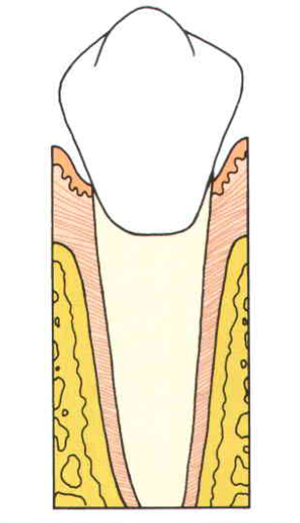
Tooth supporting structures
Periodontal ligament
Alveolar process
Cementum

Slide 5
CELLS IN THE PDL
Synthetic cells
a) Osteoblasts
b) Fibroblasts
c) Cementoblasts
  Resorptive cells
A) Osteoclasts
B) Fibroblasts
C) Cementoclasts

Slide 6
Functions of PDL
Physical
Formative & remodelling
Nutritional & sensory

Slide 7
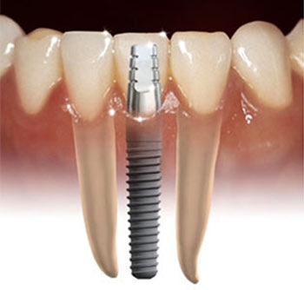

Slide 8
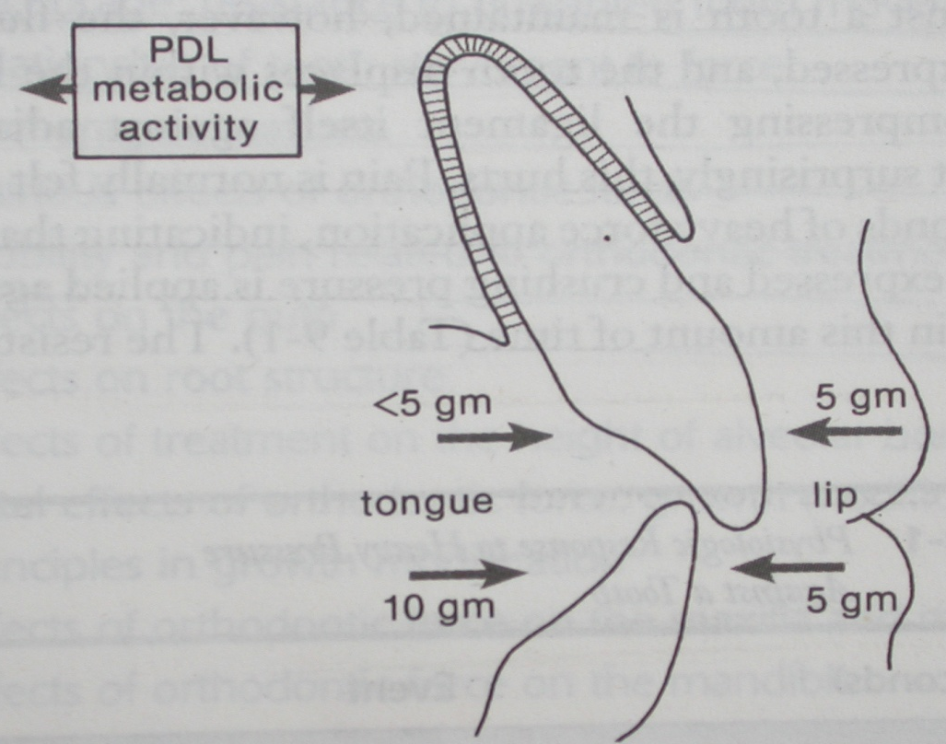
Active stabilization of teeth against
forces of low magnitude

Slide 9
Physiologic tooth movement
  1. tooth eruption
    Blood pressure theory
    Root growth
    Hammock ligament
    Periodontal ligament traction
  2. migration or drift of teeth
  3. changes during mastication.

Slide 10
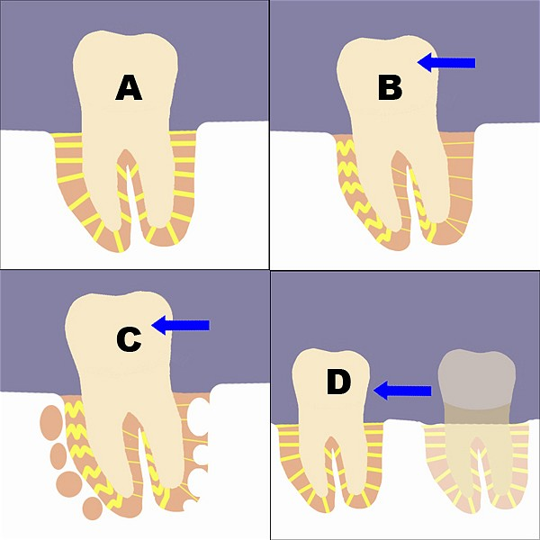

Slide 11
Response to normal function…
Tooth contact exists for less than 1 sec.
Moderate to heavy forces-
  <1 sec → PDL fluid incompressible, bone bends, piezoelectricity
  1-2 sec → PDL fluid displaced, tooth moves within PDL space
  3-5 sec → tissue compressed, pain

Slide 12
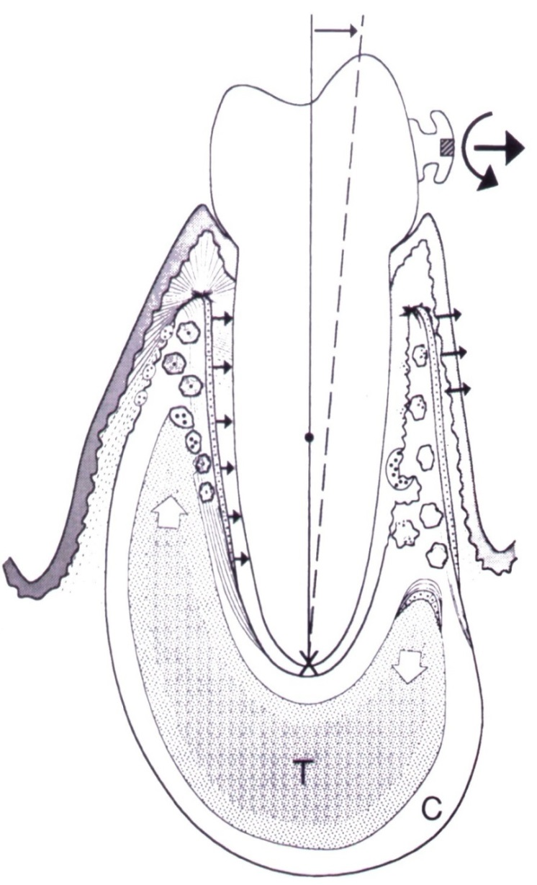
FORCE
Tension side - Deposition
Pressure side - Resorption

Slide 13
Biologic control of tooth movement:
Control elements:
  Biologic electricity and pressure tension
Theories of tooth movement:
  Bioelectric theory
  Fluid dynamic theory
  Pressure tension theory

Slide 14
TOOTH IS SUBJECTED TO SUSTAINED FORCE
PDL & INCOMPRESSIBLE TISSUE FLUID IN PDL
ALVEOLAR BONE
BONE BENDS
PIEZOELECTRIC CURRENT
TOOTH MOVEMENT STARTS

Slide 15
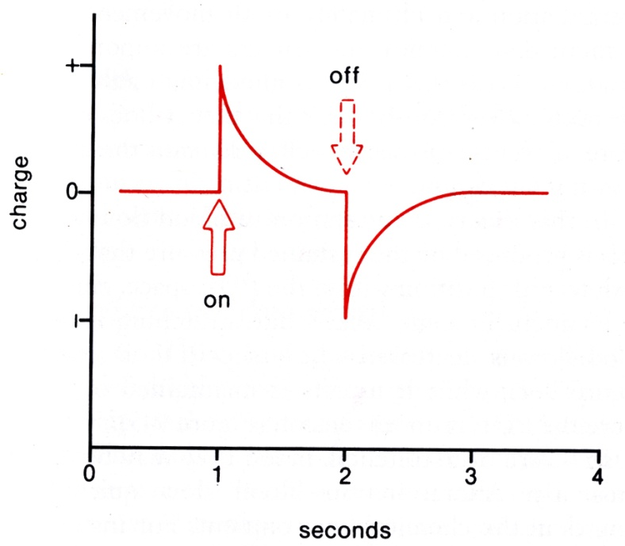
Bioelectric theory
-electric signals produced when alveolar bone flexes and bends.
- Changes in bone metabolism due to electric signals.
2 unusual characteristics
- quick decay rate
- equivalent signal in opposite direction

Slide 16
Piezoelectricity – crystalline substances.
Crystal deformation- electrons migrate.
Collagen, hydroxyapatite, ground substance of collagen
Electropositive response (convexity) –resorption
Electronegative (concavity) –deposition.
Bioelectric potential - Electric potentials explain bone remodeling.

Slide 17
Fluid dynamic theory
Given by Bien in 1966
Also called blood flow theory
Tooth movement occurs as a result of alterations in fluid dynamics in PDL
Periodontal space is a confined space & passage of fluid in & out of this space is limited
On application of force ‘squeeze film effect’ results

Slide 18
On application of orthodontic force - blood vessels get trapped –stenosis.
Vessels above stenosis balloon resulting in formation of aneurysm .

Slide 19
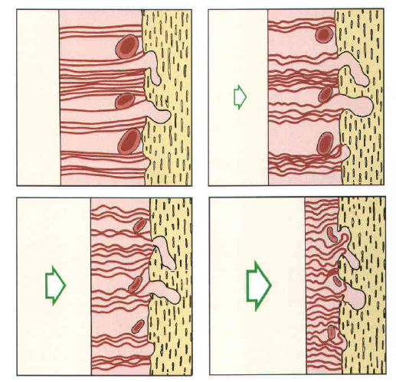
NORMAL
FORCE
FORCE
FORCE

Slide 20
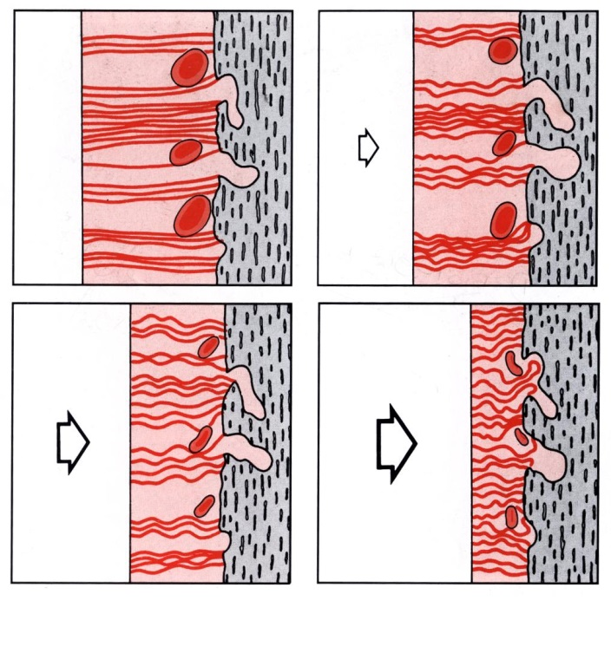
In essence, this view of tooth movement shows three stages:
1. Alteration in blood flow associated with pressure with in the PDL
2. Formation and\or release of chemical messengers, and
3. Activation of cells.

Slide 21
Pressure tension theory (Schwartz 1932)
Cellular changes produced by chemical messengers.
Alterations in blood flow – changes in chemicals – change in metabolites.
Pressure – compression and tension –stretch of blood vessels.

Slide 22
chemical signals as the stimulus for cellular differentiation.
Blood flow is decreased in areas of compression & increased or maintained in areas of tension
Alterations in blood flow – changes in chemical mediators – different messengers released.

Slide 23

FORCE
Tension side - Deposition
Pressure side - Resorption

Slide 24
Response to orthodontic forces…
Application of orthodontic force – resorption on the pressure side and deposition on the tension side.
Function of force magnitude
  Frontal resorption and
  undermining resorption

Slide 25
Effects of force magnitude
Light forces –
Changes in pressure side –
  PDL compressed
  Decrease in vascularity
  Mobilisation of cells – fibroblasts, osteoclasts
  Resorption from within howship’s lacunae – physiologic – frontal resorption

Slide 26
Changes on tension side:
  Opposite to the direction of applied force
  PDL stretched
  Ligament space widened
  Increased vascularity
  Osteoblasts lay bone – woven bone

Slide 27
Excessive forces – crushing of PDL
Occlusion of blood vessels on pressure side – hyalinization
Bone resorption in marrow spaces – undermining resorption.
Tension side – over stretching of tissues – ischemia.
Increase in osteoclastic activity – tooth loosens.
Pain and hyperemia

Slide 28
“Direct resorption or Frontal resorption” where the pressure is relatively light, and “Hyalinization”, where the pressure is large enough to produce degenerative changes.

Slide 29
time | Light force | Heavy force
< 1 sec | PDL incompressible, alveolar bone bends, piezoelectric signal generated | PDL incompressible, alv bone bends, piezoelectric signal generated
1 – 2 sec | PDL fluid expressed, tooth moves within socket | PDL fluid expressed, tooth moves within socket
3 – 5 sec | Blood vessels partly compressed on pressure side, dilated on tension side | Blood vessels occluded on pressure side
Minutes | Blood flow altered, oxygen tension changes, prostaglandins and cytokines released | Blood flow cut off to the compressed PDL area
Hours | Chemical messengers affect cellular activity, enzyme levels change | Cell death in compressed areas
4 hours | cAMP seen, cellular differentiation begins, frontal resorption
2 days | Tooth movement begins
3 -5 days |  | Cell differentiation in adjacent marrow, undermining resorption takes place
7 – 14 days |  | Tooth movement begins

Slide 30
HYALINIZATION
Increased pressure - exceeds the optimum force
Inhibits differentiation of osteoclasts.
Hence direct resorption cannot occur.
degenerative tissue reactions - ‘hyalinization’ - has a “glassy appearance”.
Elimination is by resorption of alveolar bone and invasion of cells and blood vessels into the necrotic tissue.

Slide 31
Hyalinization of the periodontal membrane occurs in areas of compression within 12 hours.
ligament nonfunctional; bone resorption cannot occur.
No further tooth movement till local damage is removed.

Slide 32
Optimum orthodontic force
One which moves teeth most rapidly in the desired direction, with least tissue damage.
Oppenheim and Schwarz
Capillary pulse pressure – 20-26 gm/sq.cm
Features of optimum force

Slide 33
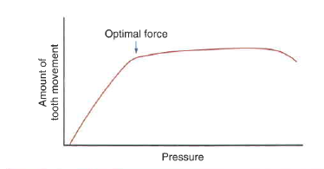

Slide 34
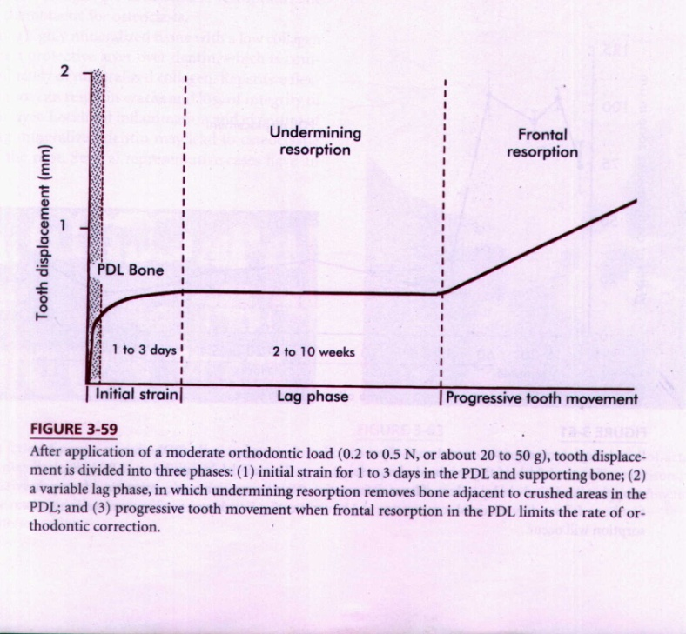
Phases of tooth movement
Categorized into
  Initial phase
  Lag phase
  Post lag phase.

Slide 35
Initial phase:
Very rapid tooth movement
Displacement within PDL and bone bending.
Light and heavy forces elicit the same response

Slide 36
Lag phase:
Little or no tooth movement
Formation of hyalinised tissue
Has to be resorbed
Duration depends on amount of force
Heavy forces – large hyalinised areas
Undermining resorption

Slide 37
Post lag phase
Rapid movement begins
Hyalinized zone undergoes resorption
Osteoclasts are increased
Direct resorption

Slide 38
Bone resorption
Seen on the pressure side
Osteoclasts
Multinucleated giant cells
Bay like depressions – howships lacunae

Slide 39
Bone deposition:
Seen on tension side
Increase in number of osteoblasts
Formation of organic matrix and mineralisation
Precursors – fibroblasts of PDL and perivascular stem cells.

Slide 40
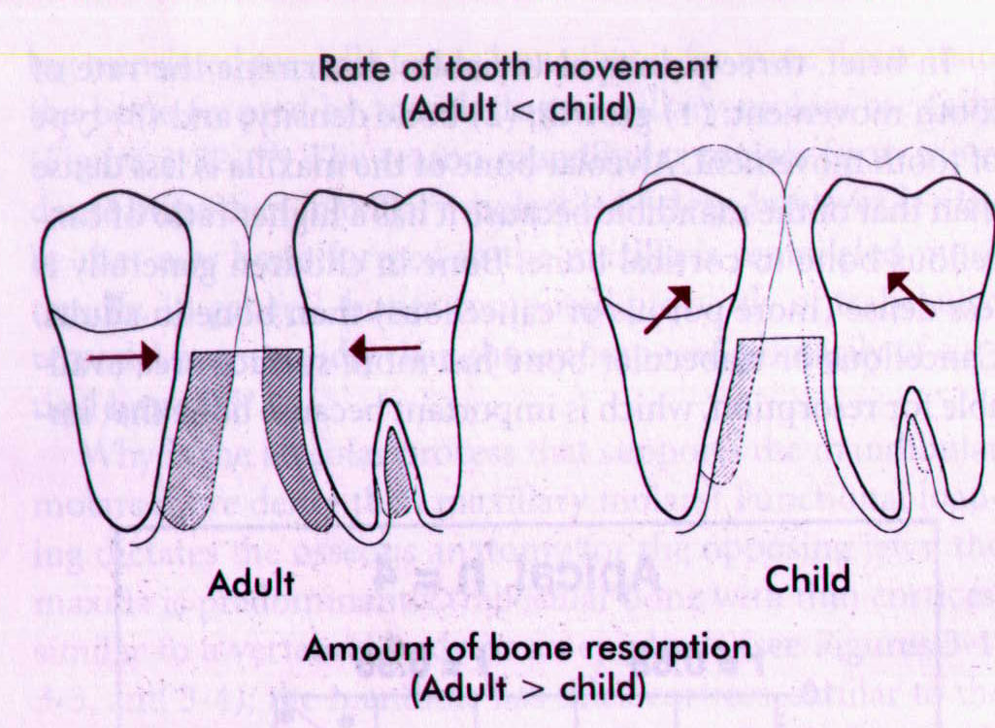
Factors Regulating Tooth movement
Growth;
Bone density
Type of tooth movement
Role of Periodontium
Duration and force magnitude
Circadian rhythm
Effect of chemicals

Slide 41
Drug effects:
Vit D admin enhances response
PG’s – increases rate of movement
Bisphosphonates and PG inhibitors – retard movement.
NSAID’s and corticosteroids – PG’s inhibitors.

Slide 42
Deleterious effects of excessive forces:
1. mobility and pain – wide PDL
2. effects on pulp – loss of vitality
3. Effects on root structure
4. Effect on alveolar bone height

Slide 43
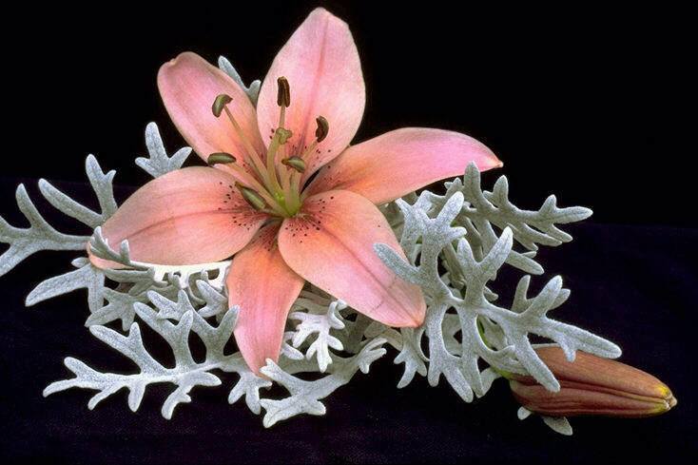
Thank you…

