Slide 1
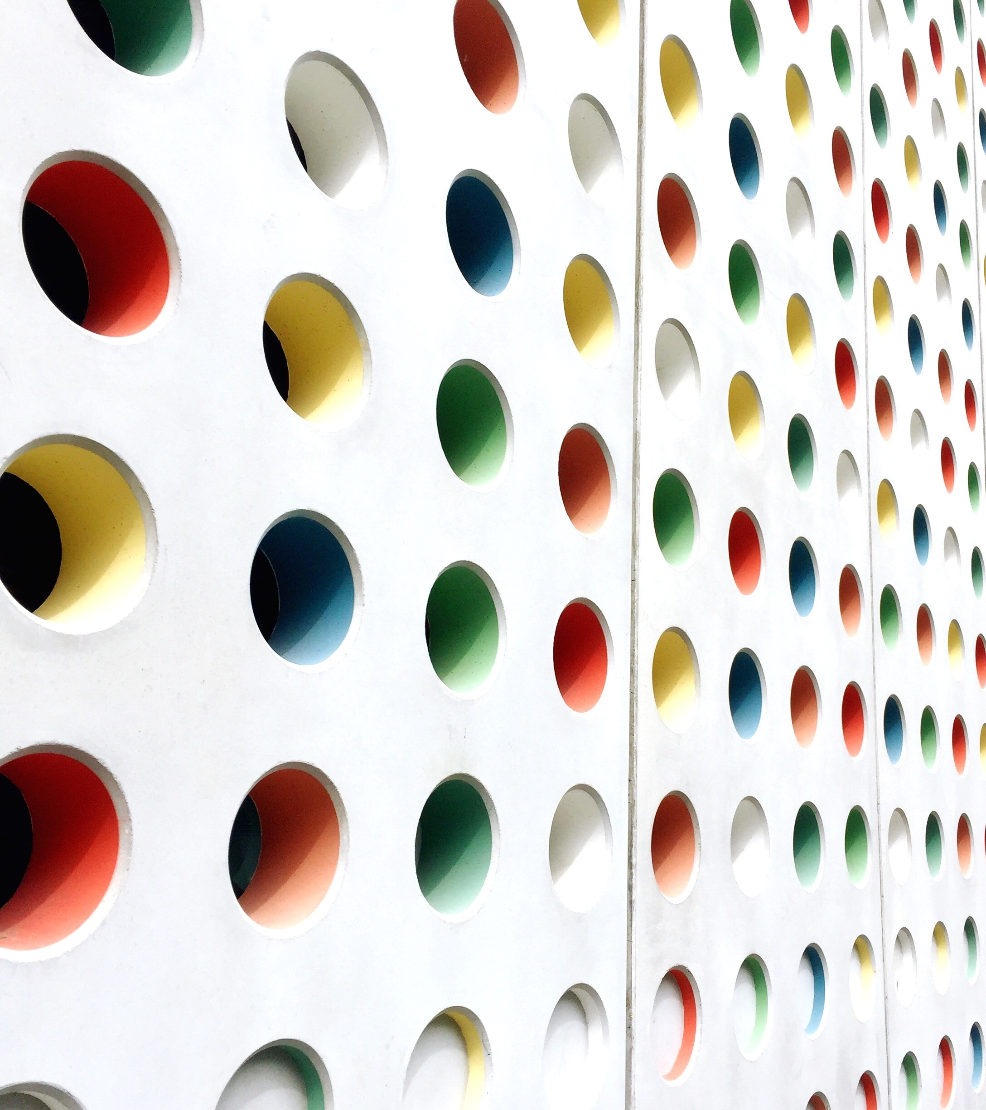
EXPANSION

Slide 2
Arch Expansion
Orthopedic force for widening the arches
Can be used for space gaining in Non-extraction cases
Used along with Reverse pull headgear/ Facemask in management of Maxillary retrognathism
Maxillary arch – skeletal and dental expansion possible
Mandibular arch – only dental expansion is possible

Slide 3
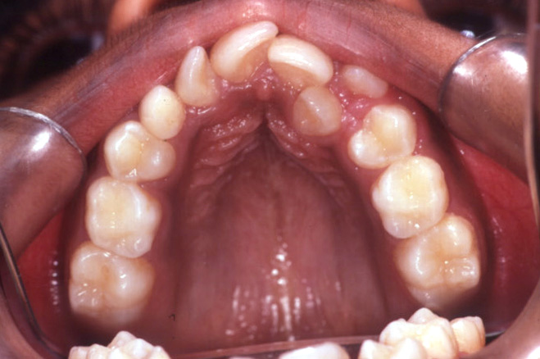
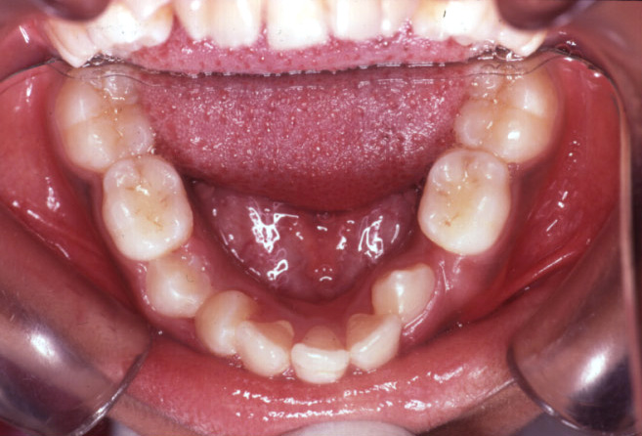
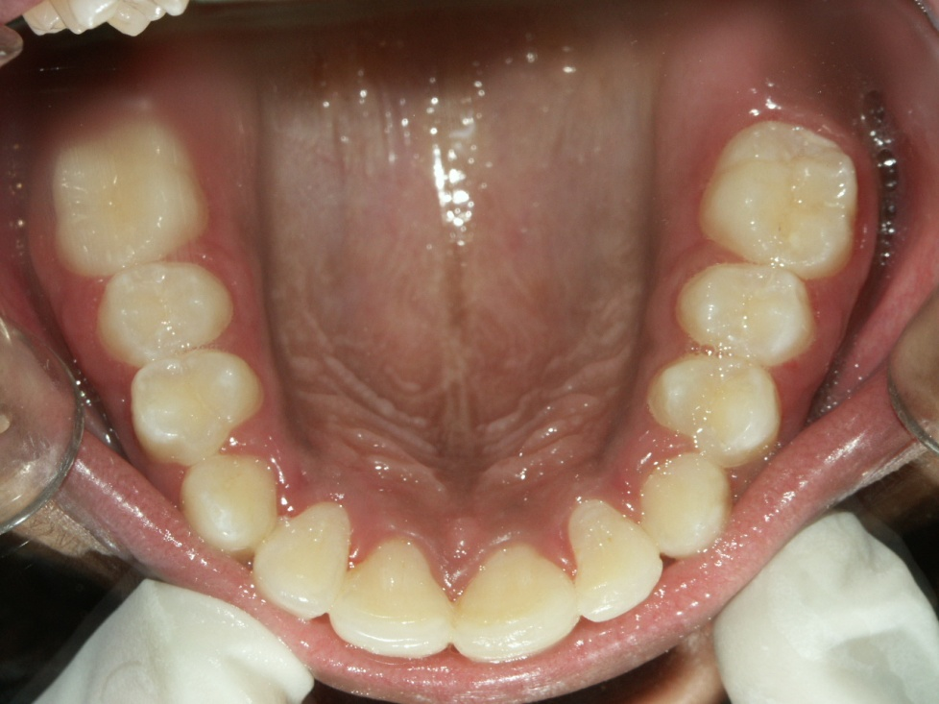
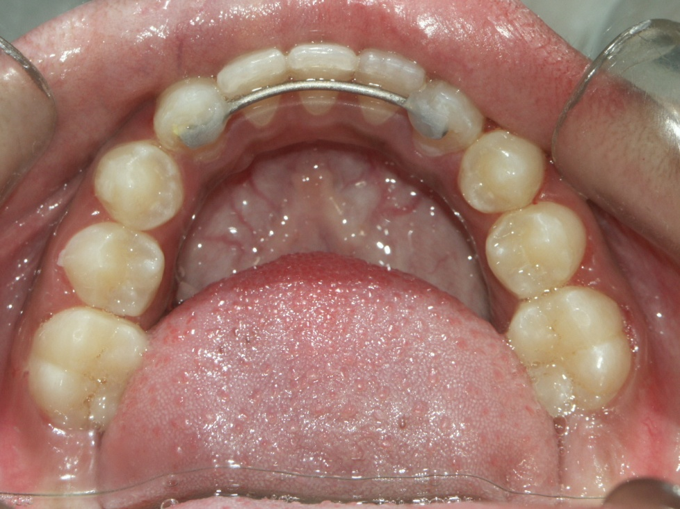

Slide 4
Space gaining
non extraction
Proximal stripping
Molar uprighting
Expansion
extraction
Molar distalisation
Derotation of posterior teeth
Proclining anterior teeth

Slide 5
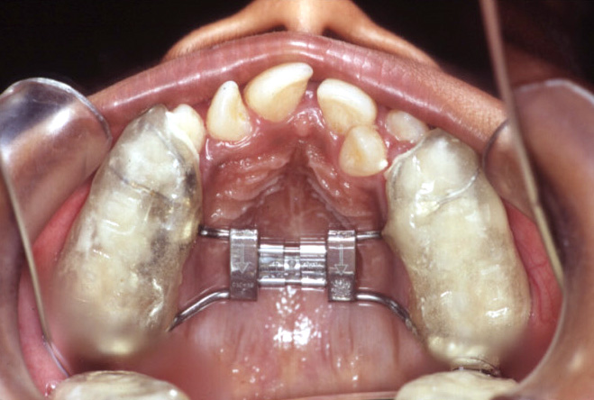
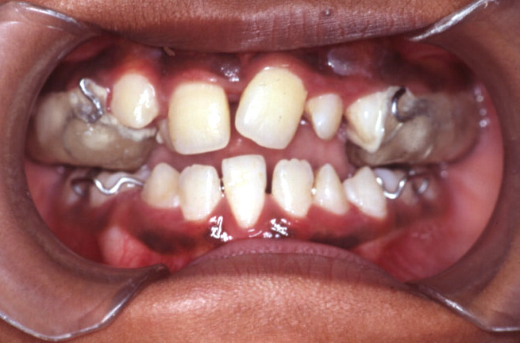
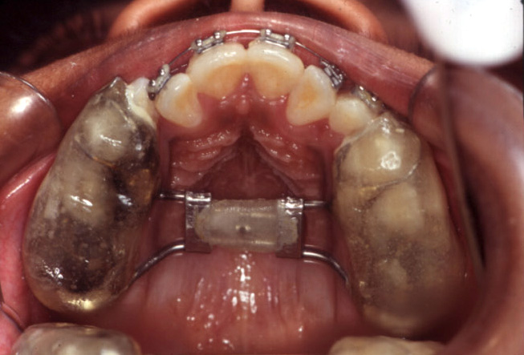

Slide 6
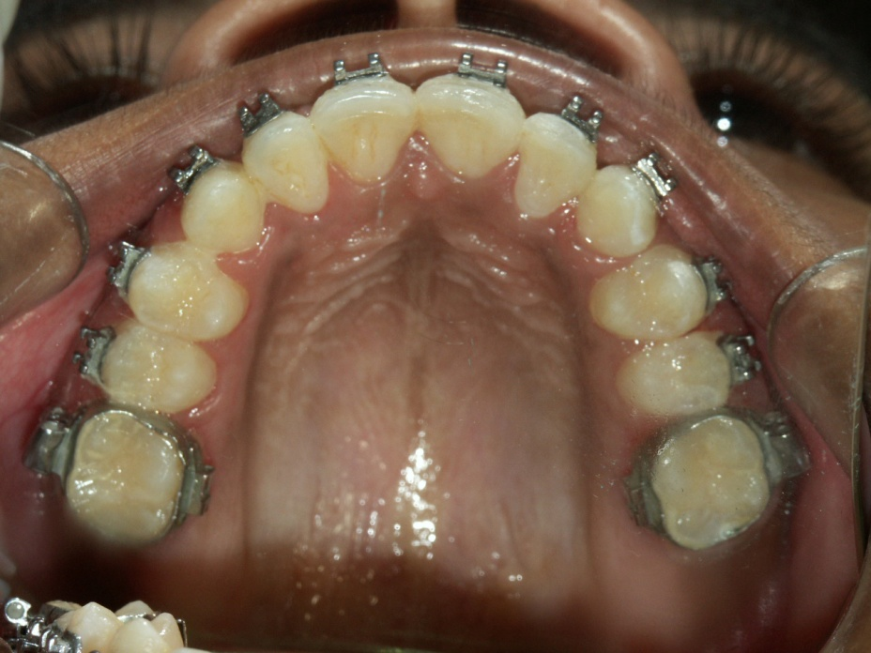


Slide 7
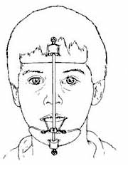
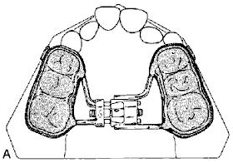
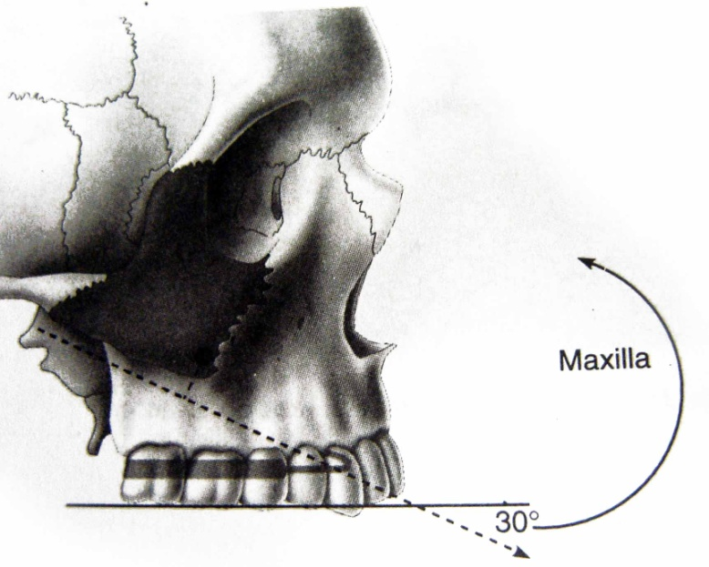
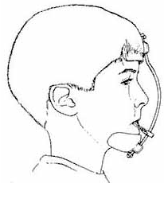
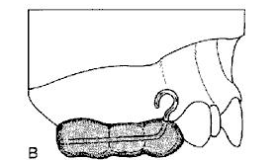

Slide 8
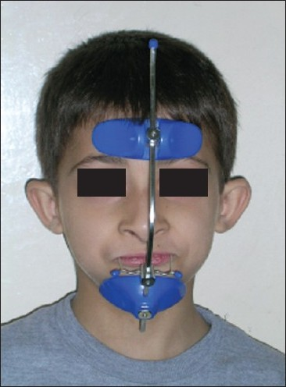
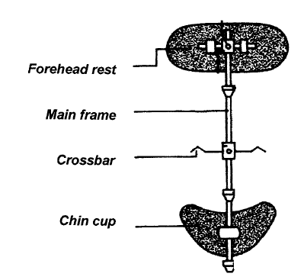

Slide 9
Classification…
Expansion
Skeletal
Dental
Expansion
Fixed
Removable

Slide 10
Removable expansion devices
Coffin spring
Slow expansion screws

Slide 11
Fixed expansion devices
Rapid palatal expansion
Quad helix
W arch
archwires

Slide 12
REMOVABLE EXPANSION DEVICES

Slide 13
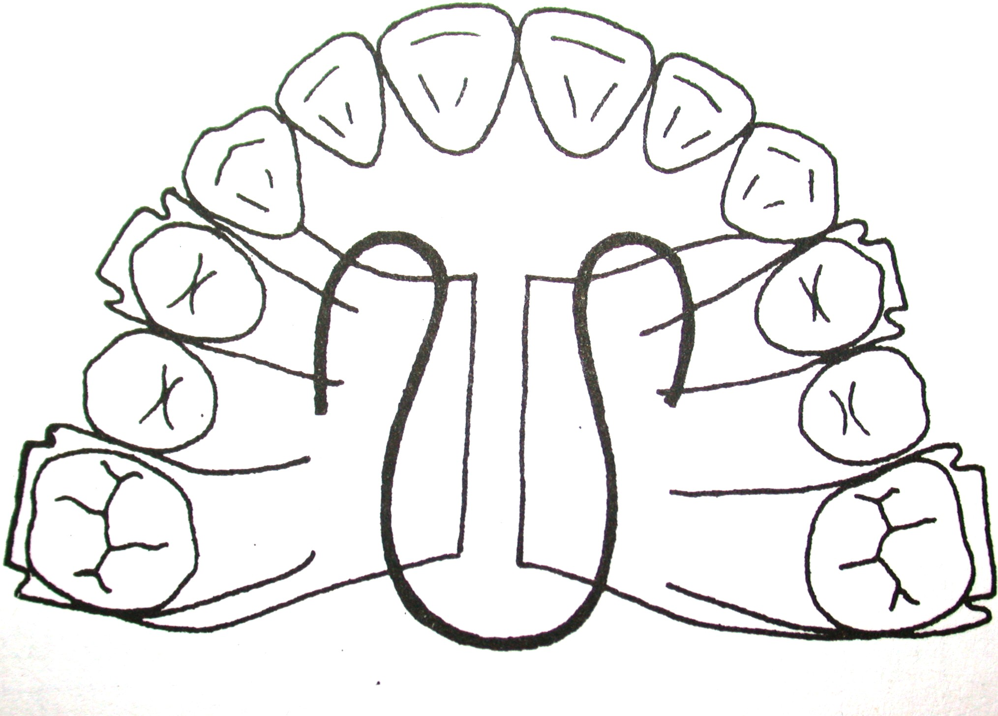
Coffin spring
Walter coffin – 1881
Slow dentoalveolar expansion
Activation - 2 – 4 mm before insertion
Disadvantages – heavy intermittent force, patient compliance, dislodgement.

Slide 14
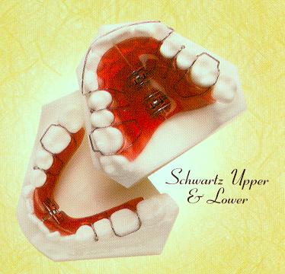
Expansion screws…
Schwartz- first to use this type of plate.
Base plate used as working part
Equal division - Reciprocal anchorage
Unequal - larger anchorage for movement of smaller part.
90 degrees-plates move apart by 0.2mm
PDL-0.1mm on each side.
SIZES - Maxillary-broader and Mandibular-narrower

Slide 15
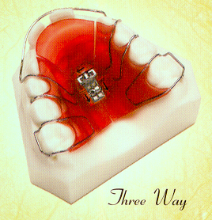
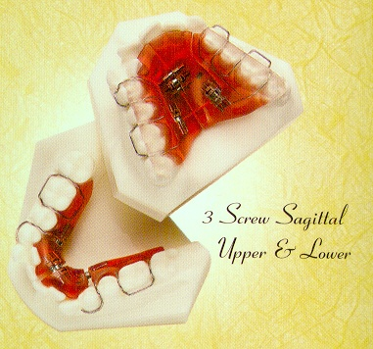

Slide 16
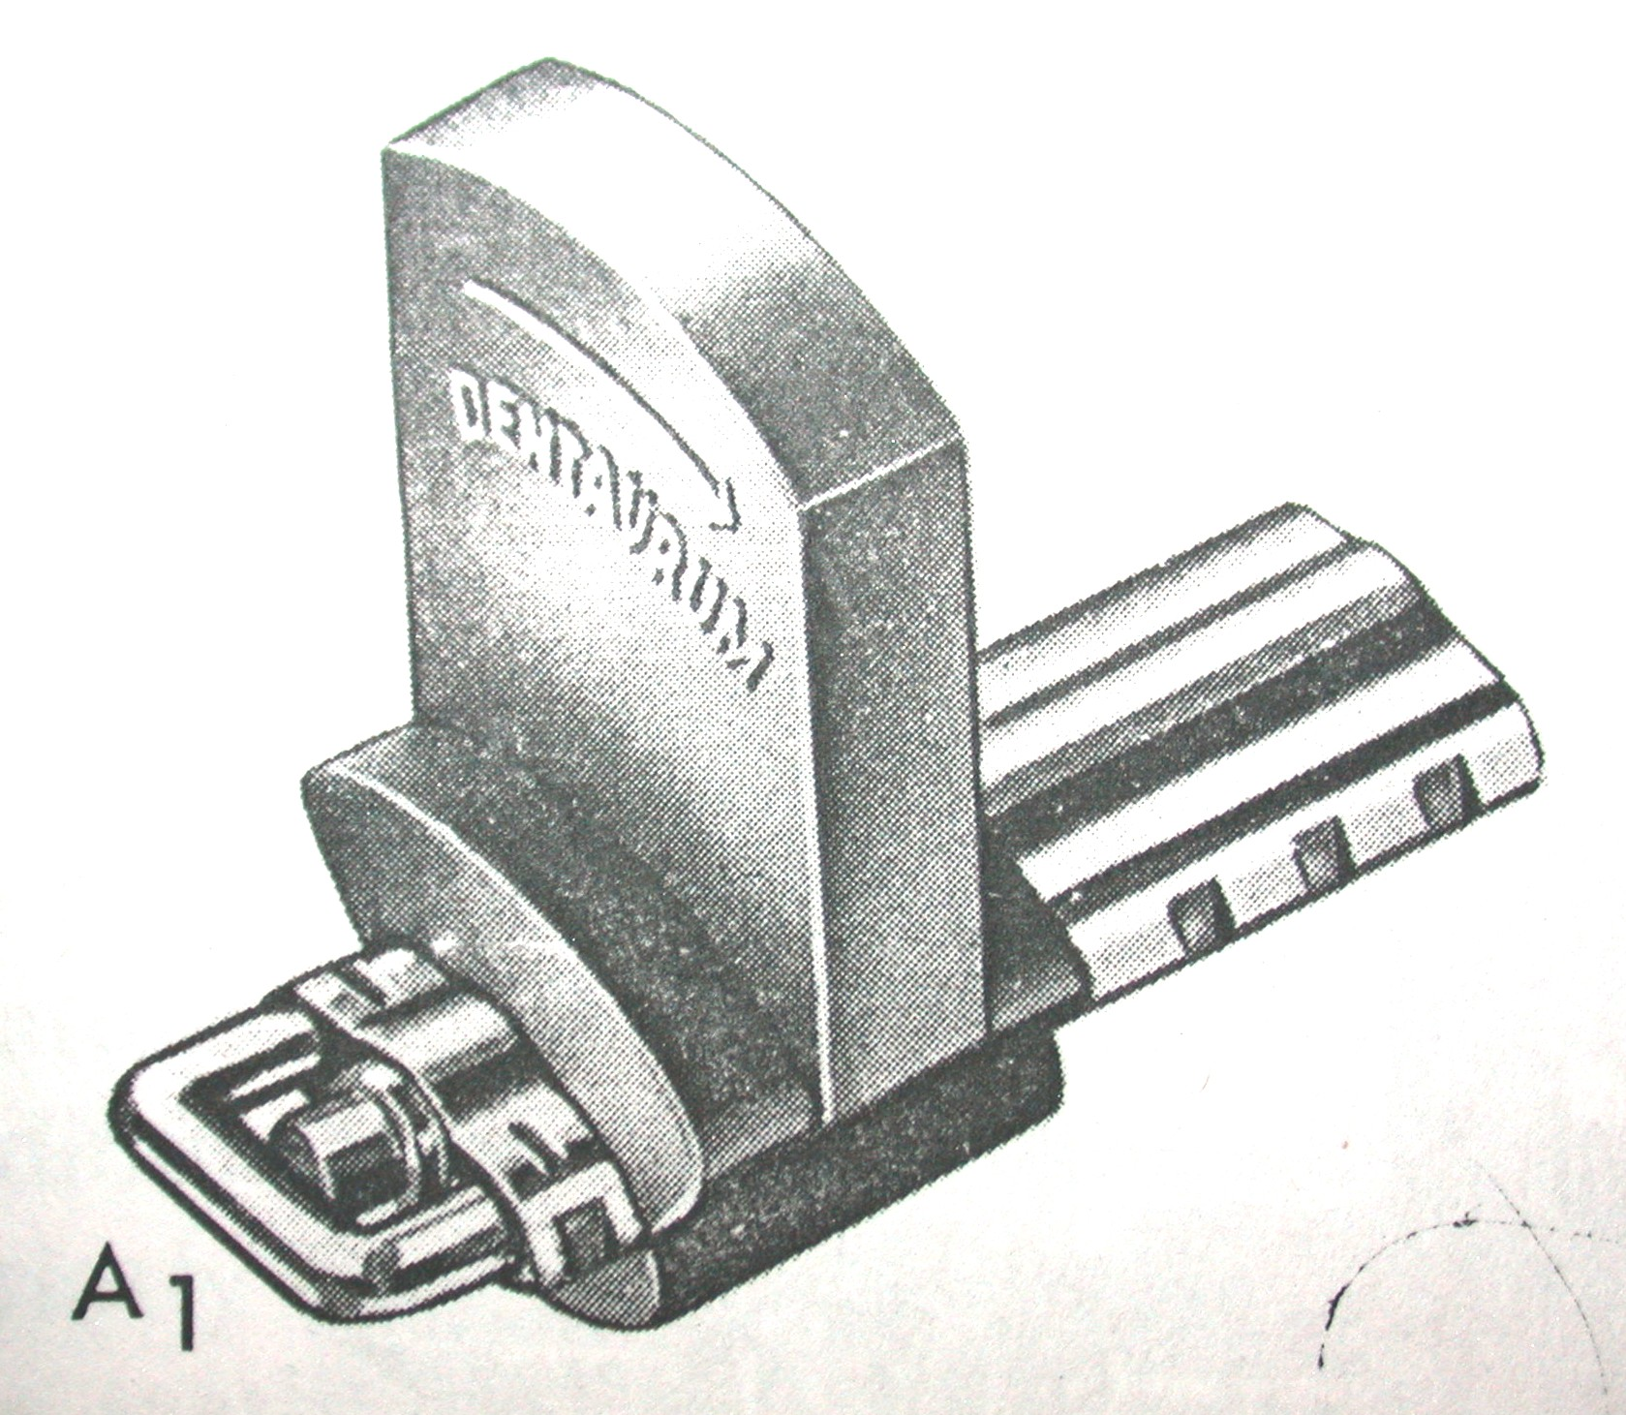
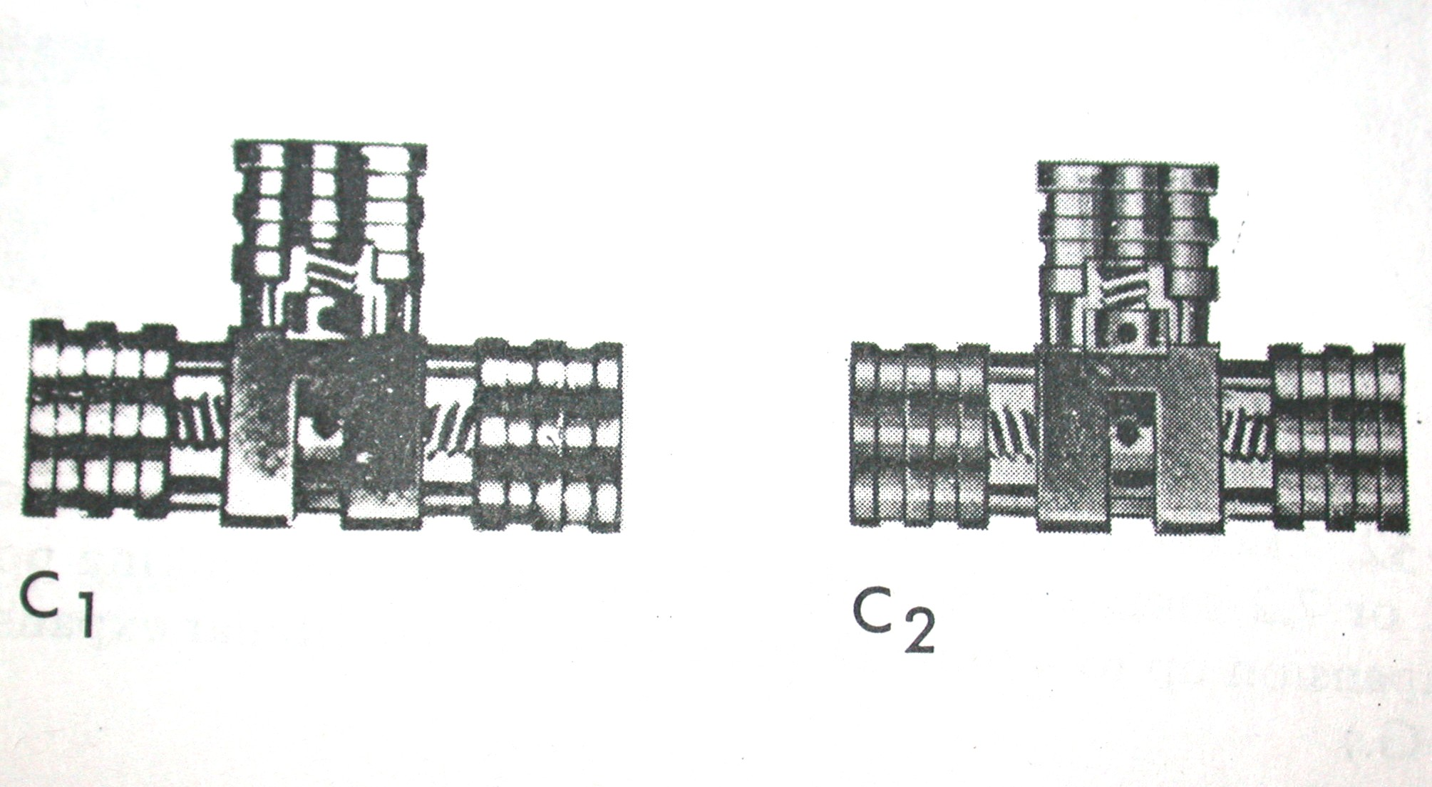
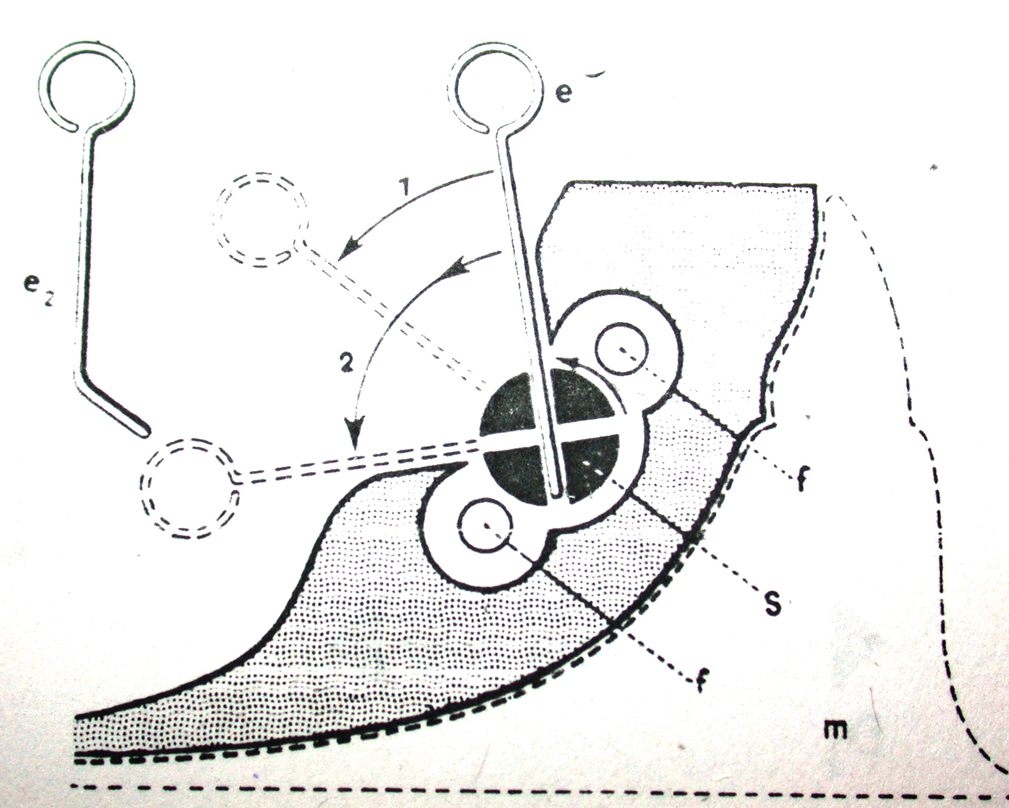
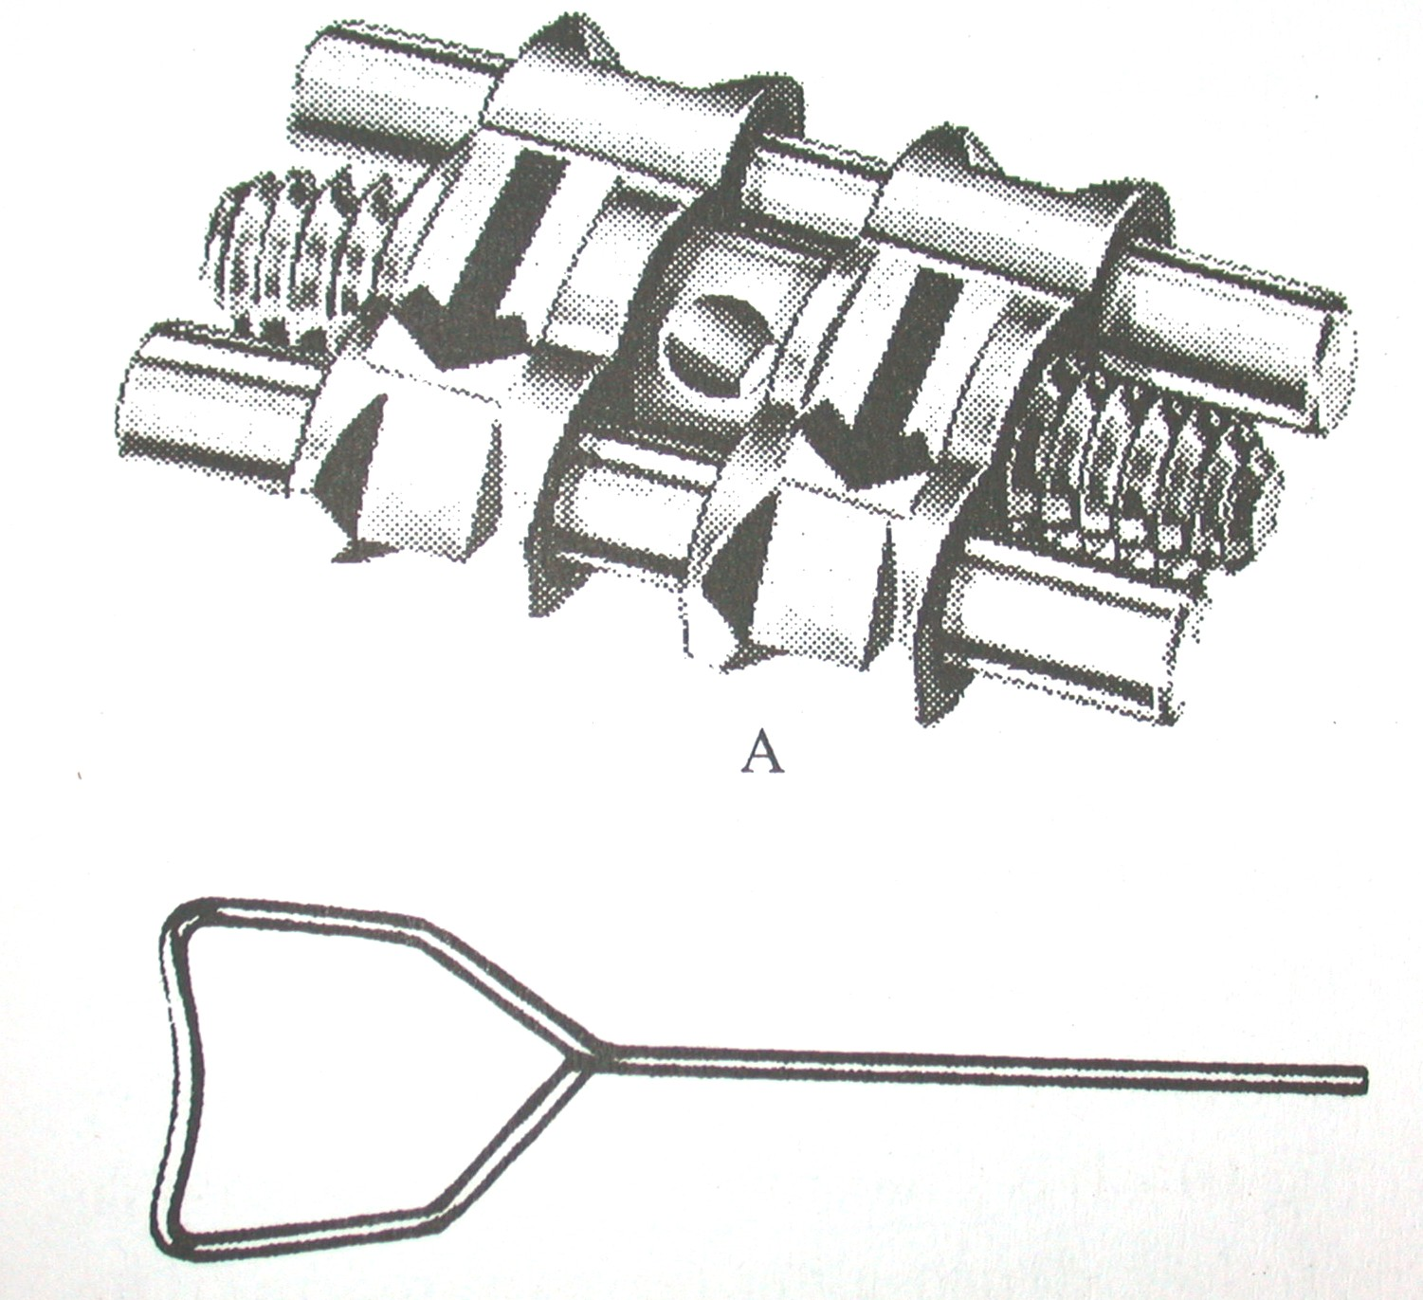

Slide 17
Activation…
1mm/complete revolution.
Rate of active movement – do not exceed 1mm/month
Only twice a week-1mm bilateral movement.
Turn screw with appliance in mouth.

Slide 18
Disadvantages of removable appliances…
Produce only tipping tooth movement.
Activation of screw produces heavy intermittent force.
Initial high and rapid decay- potential of damaging teeth.
Limited indications

Slide 19
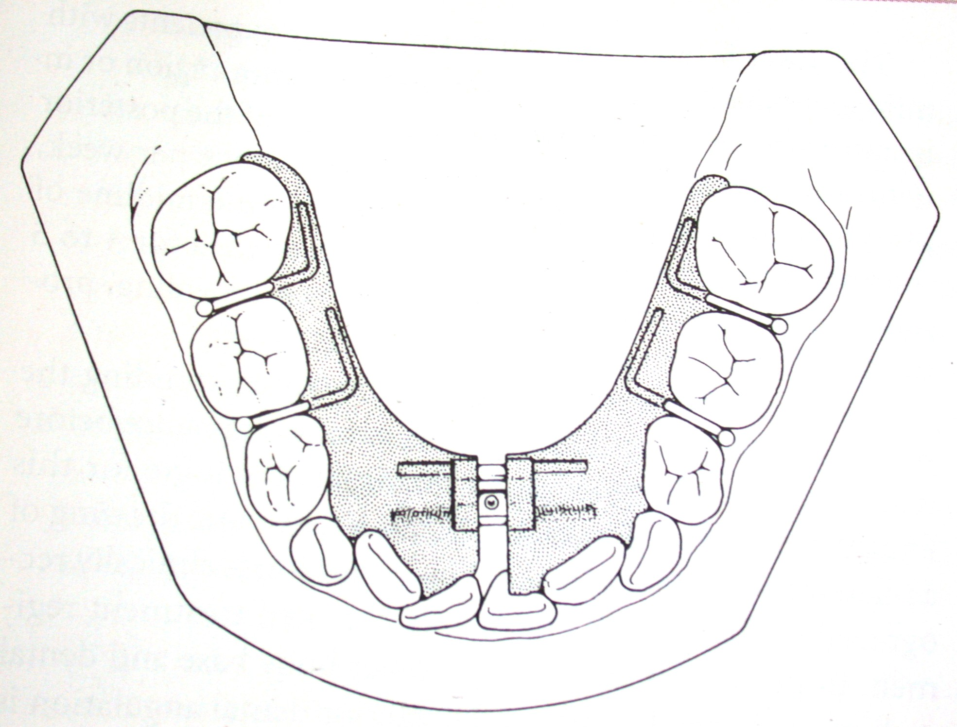
Lower Schwarz appliance
Indications:
Mild to moderate lower anterior crowding,
Lingual tipping of posterior teeth.
Activation: once/week
3-4months; gain 4-5mm of arch length anteriorly.

Slide 20
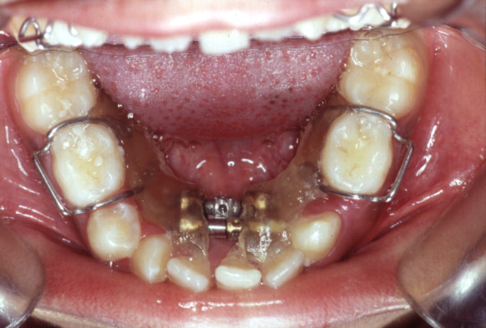
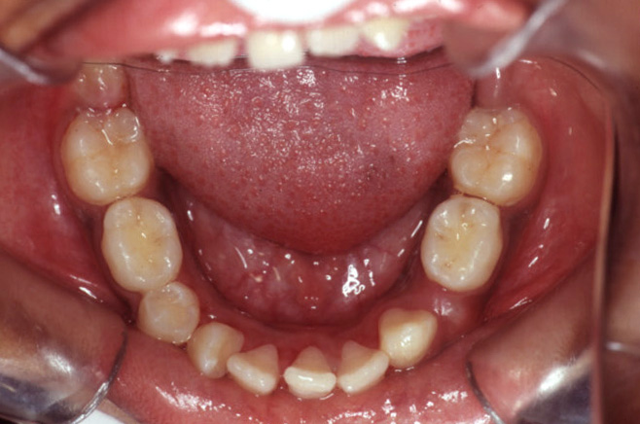
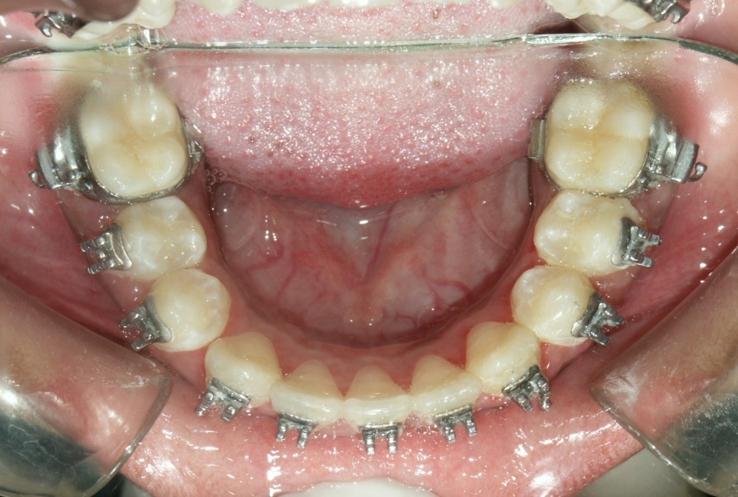

Slide 21
Slow expansion
2 - 4 pounds
1 mm/ week for 4 -6 months
Rapid expansion
0.3 – 0.5 mm/ day
Minimum tipping and maximum skeletal changes
2 – 4 weeks
Force – up to 10 – 20 pounds
Equal amount of skeletal and dental expansion

Slide 22
FIXED EXPANSION DEVICES

Slide 23
Rapid Maxillary Expansion

Slide 24
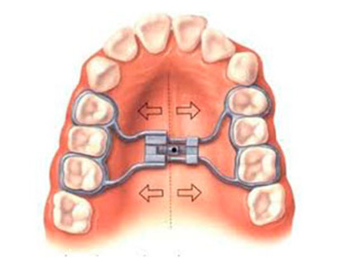
Rapid maxillary expansion…
Movement of two halves of the maxilla away from each other
Emerson C Angell – 1860

Slide 25
Indications:
  Unilateral/bilateral discrepancies.
  Skeletal/dental constriction.
  Gain arch length in cases of moderate crowding.
  AP discrepancies-class II div I, class III.
  Inadequate nasal capacity- chronic respiratory problems.

Slide 26
Contraindications…
Single tooth cross bite
Vertical growers-steep mandibular plane angle.
Pre school children.
Non compliant patients.

Slide 27
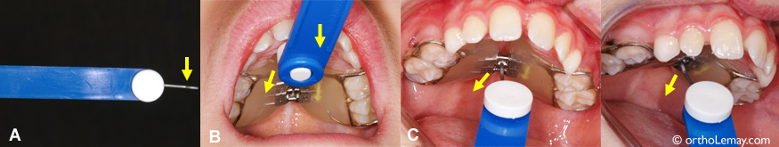
Activation…
Basic principle of the appliance involves the generation of forces that are capable of splitting the mid-palatine suture
Forces generated are close to 10 to 20 pounds
Expansion of 0.2 to 0.5mm should be activated per day
1 cm of expansion is expected in 2 to 3 weeks

Slide 28
Effects of RME
On the maxillary teeth and alveolar bone
Maxillary skeletal effects
On the mandible
On the nasal cavity and adjacent cranial bones

Slide 29
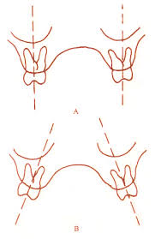
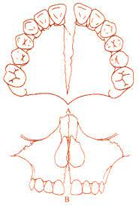
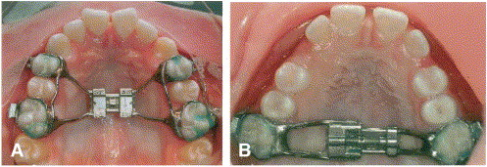
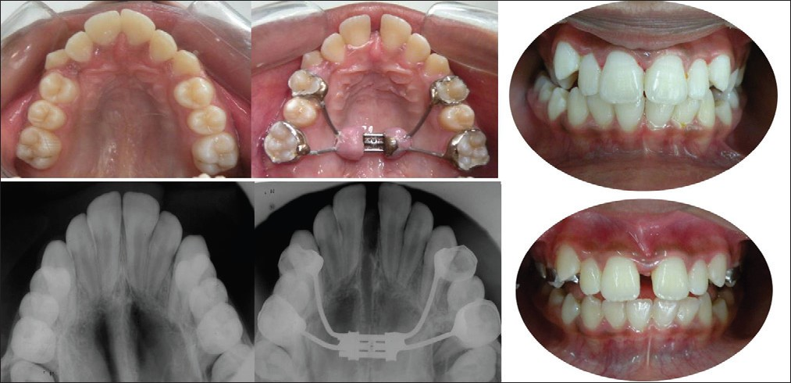
On the maxillary teeth & alveolar bone

Slide 30
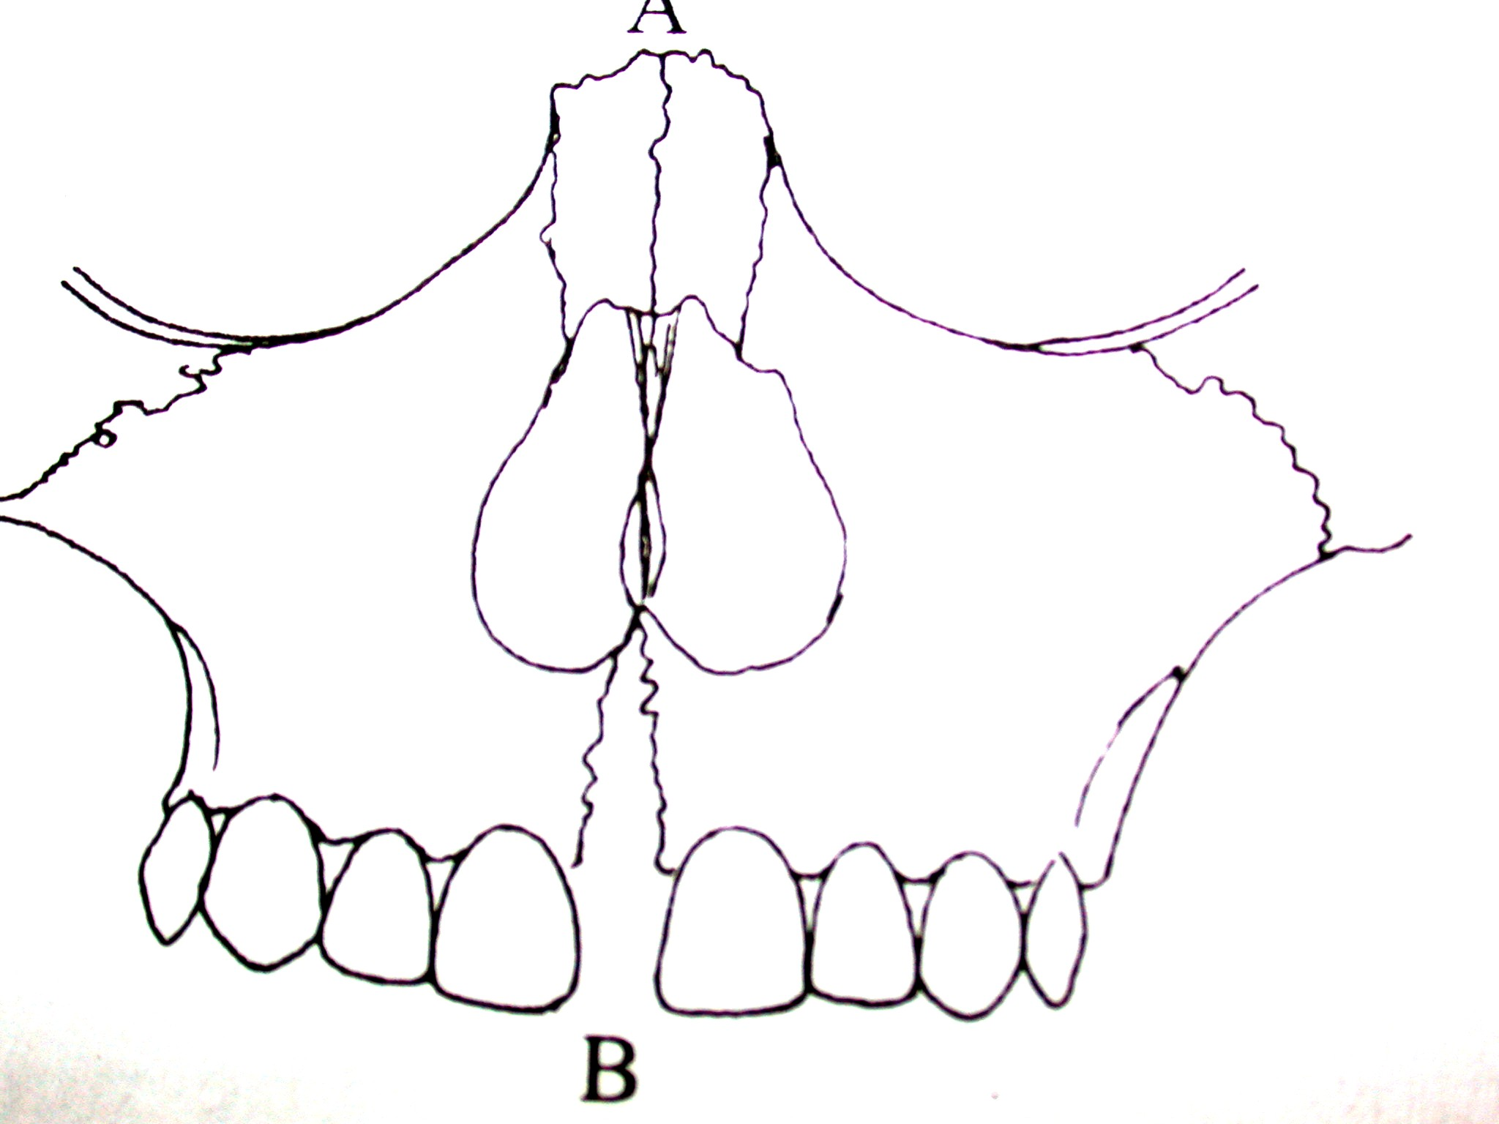
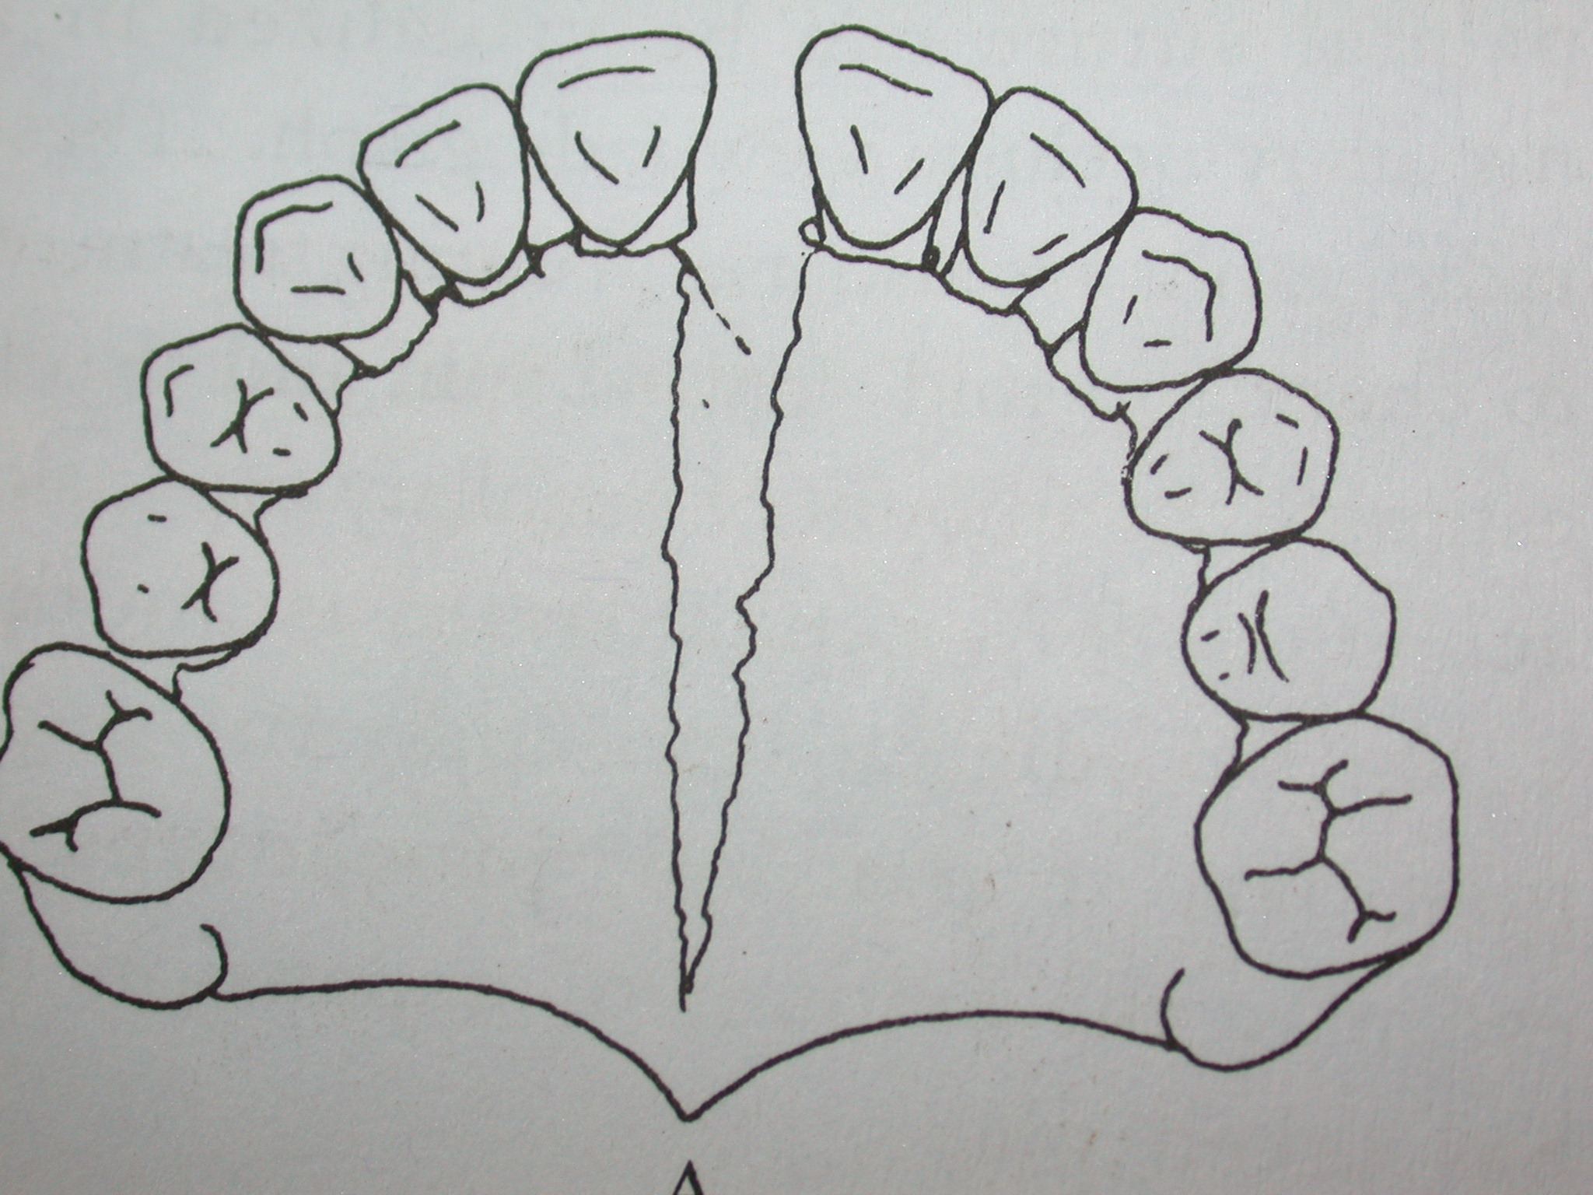
Triangular split of Maxilla
A. Transverse view B. Frontal view

Slide 31
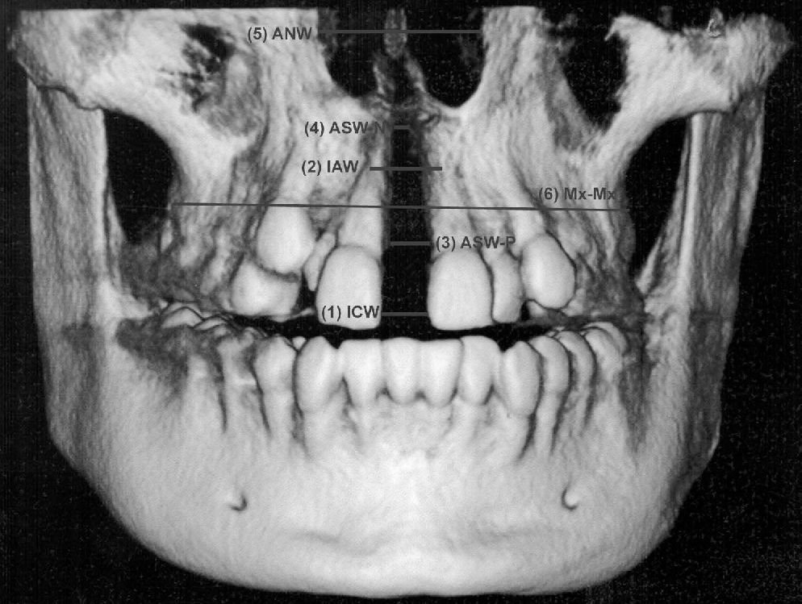
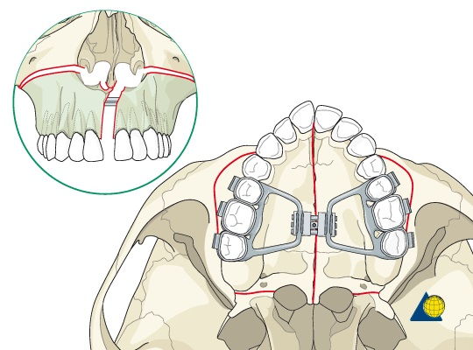
On the nasal cavity and adjacent cranial bones…

Slide 32
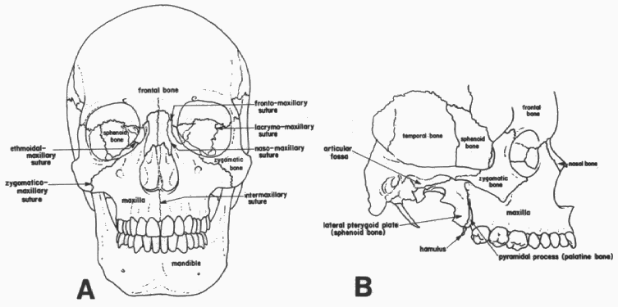
Effects of expansion on facial bones
Sutures affected....
Intermaxillary
Naso maxillary
Zygomatico maxillary
Ethmoidal maxillary
Fronto maxillary
Lacrymo maxillary

Slide 33
Maxillary rotation following expansion
Sagittal
coronal
Downward and forward rotation
Rotation around frontomaxillary suture – two halves move away from each other

Slide 34
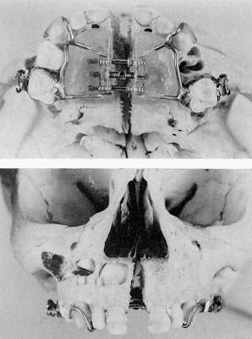
Evident splitting of the maxilla
Representing Orthopedic effect.
Nasal cavity widened.

Slide 36
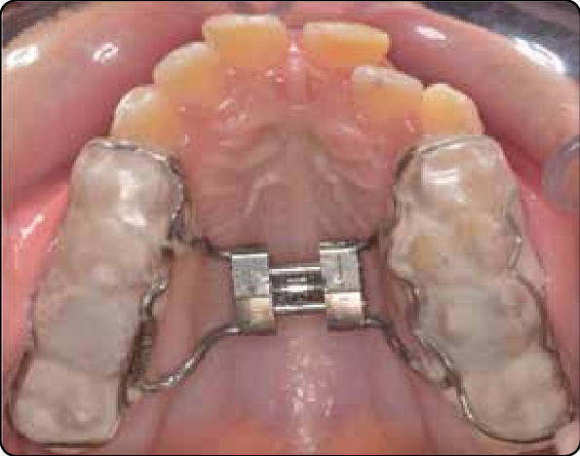
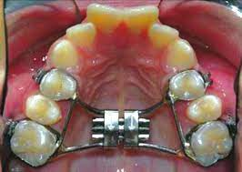
Bonded RME
Cast Cap Splints.
2. Acrylic cap splints.
Banded RME

Slide 37
Activation schedule:
TIMMS:
Upto 15yrs: 90 degrees rotation in morning and evening.
Over 15yrs: 45 degrees activation 4 times a day.
Over 20yrs: initial 90 degrees, 45 degrees morning and evening. Surgical intervention.
ZIMRING and ISSACSON
Young growing patients: 2 turns/day for 4-5 days. later 1turn/day till desired expansion.
Non growing adult: 2 turns for 1st two days, 1turn/day for next 5-7 days. And 1 turn every alternate day.

Slide 38
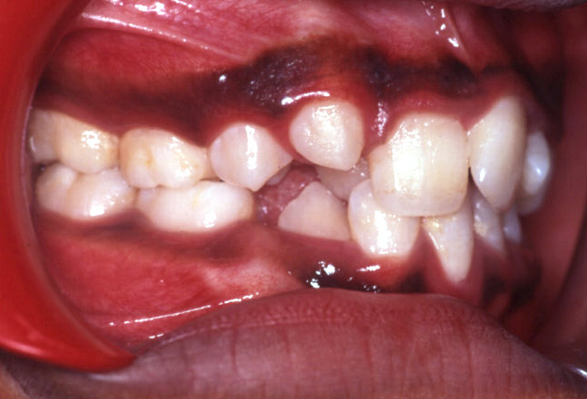
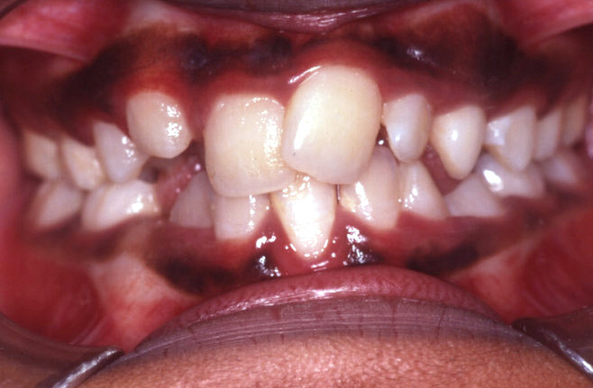
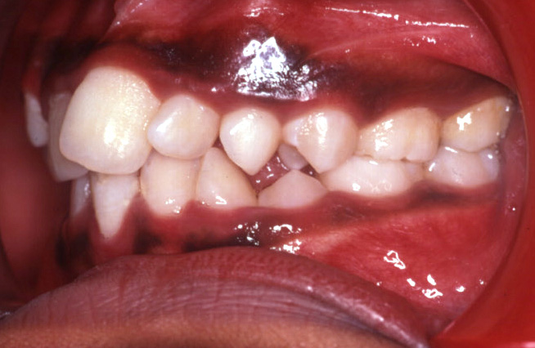
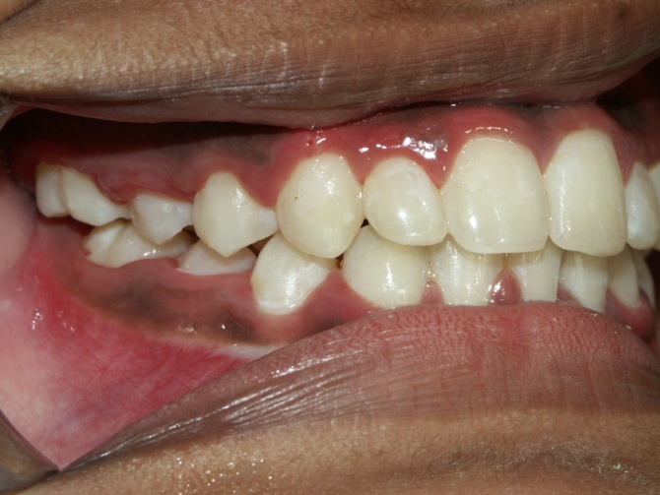
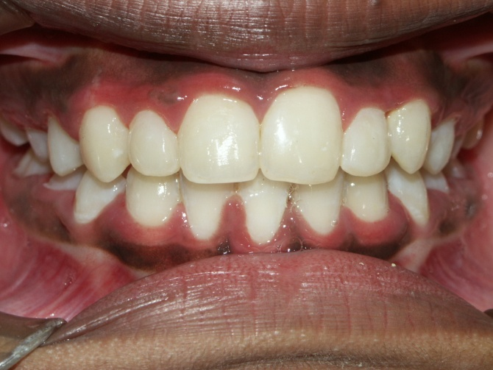
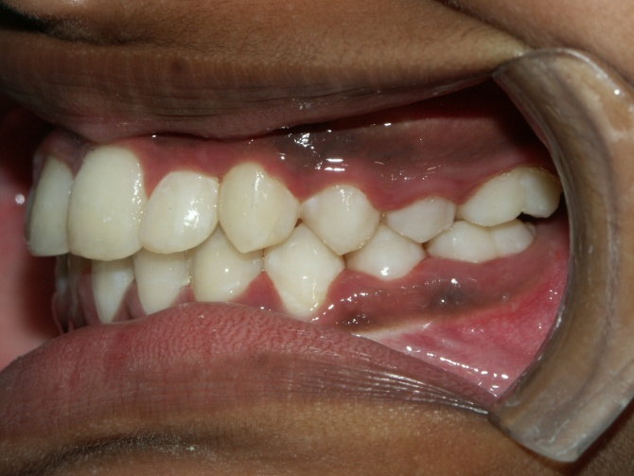

Slide 39
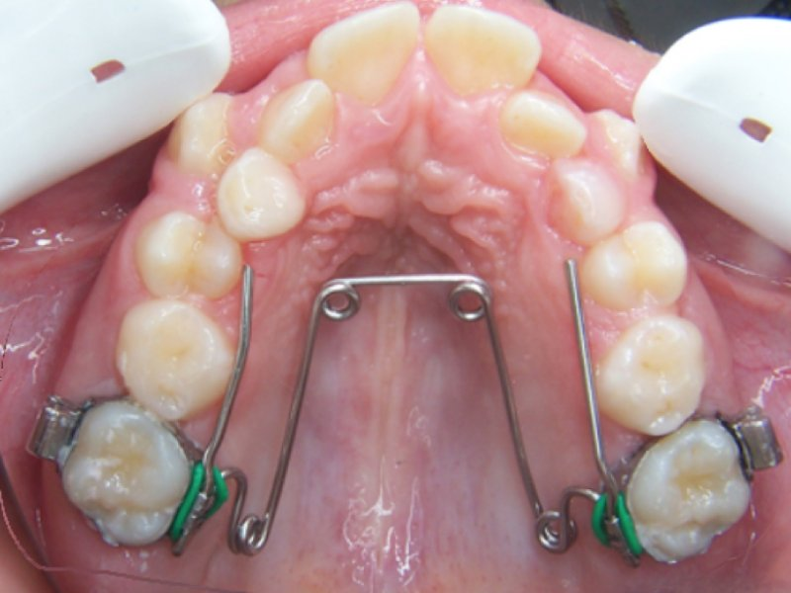
Fixed Expansion appliances
Quad Helix
Evolved- original coffin loop.
4 helices - increase range and springiness of the appliance
2 types:
fixed
removable
Indications:
Bilateral posterior cross bite.
Finger sucking habit.

Slide 40
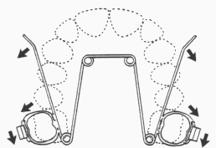
ACTIVATION
Slow dentoalveolar expansion.
2mm/month. 1mm on each side.
In primary and early mixed dentition- skeletal midpalatal splitting.

Slide 41





Slide 42



Other fixed expansion devices…
W arch
Nickel titanium palatal expander
Lip Bumper

Slide 43

THANK YOU…

