Slide 1

GOOD MORNING

Slide 2
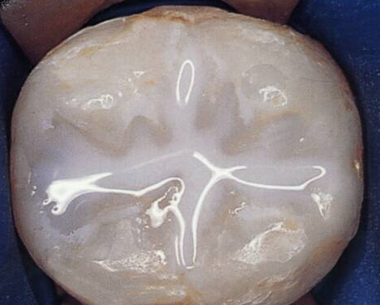
Pit and Fissure Sealants

Slide 3
At The End…
What are pits and fissures?
What are pit and fissure sealants?
Indications and contraindications
Procedure of application
Factors affecting sealant retention

Slide 4
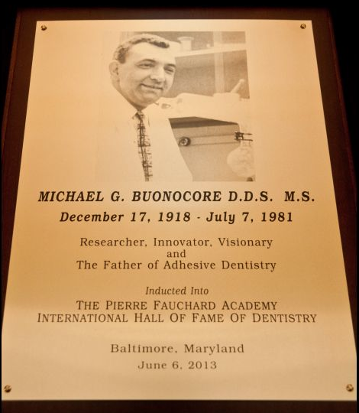
HISTORY- attempts for preventing caries
1895-Wilson-placement of dental cements-to prevent dental caries
1905 – Miller- silver nitrate
1922 - Hyatt- prophylactic odontotomy
1929 – Bodecker- Fissure eradication
1955- Buonocore –adhesive resin system
1962 - BISGMA by Bowen

Slide 5
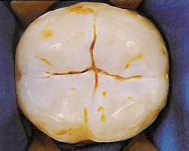
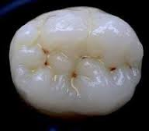
What is a pit ?
What is a Fissure ?
  FISSURE
  Long clefts between cusps or ridges
  (Orban)
  PITS
  small pinpoint depressions located at the junction of developmental grooves or at terminals of those grooves.
  (Ash and Nelson)

Slide 6
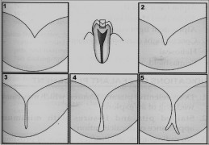
Types Of Pits And Fissures
(Nagano,1960)
5 types(Nagano)
V type
U type
I type
IK type
Inverted Y type
Other:
Shallow, wide
Deep ,narrow

Slide 7
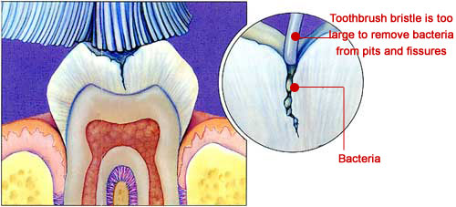
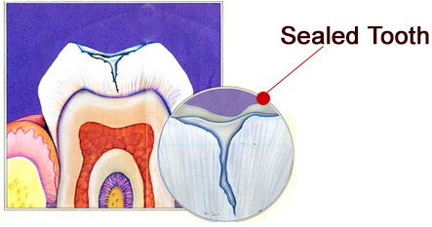
Why Pit And Fissures Are To Be Sealed ??

Slide 8
Pit and sealant materials are the plastic and professionally applied materials used for the purpose of occluding pit and fissure areas in tooth to prevent dental caries
Pit and Fissure Sealants

Slide 9
Classification
Based on | Types | Characteristics
I. Generations | 1. First Generation Sealants. | UV light(350nm) e.g. Nuva light No more used, as a UV light is harmful
 | 2. Second Generation Sealants. | Chemical curing resins, based on catalyst-accelerator system. e.g. Concise(3M)
 | 3. Third Generation Sealants. | Activated by visible light (430-490nm) e.g. Delton
 | 4.Fluoride containing Sealants | Double protection-addition of fluoride e.g. Helioseal

Slide 10
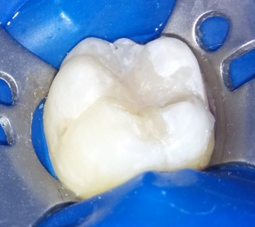
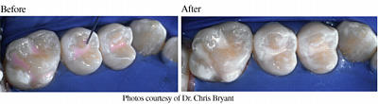
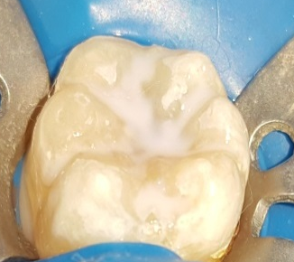
II. Fillers | 1. Free of fillers 2. Semifilled | Flow is better. More resistant to wear.
III. Colour of the sealants | 1. Clear | Esthetic but difficult to identify at recall examination.
 | 2. Tinted | Can be easily identified.
 | 3. Opaque | Can be easily identified.

Slide 11
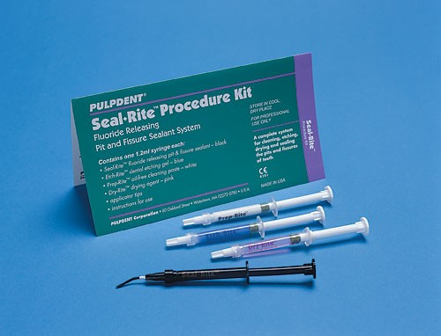
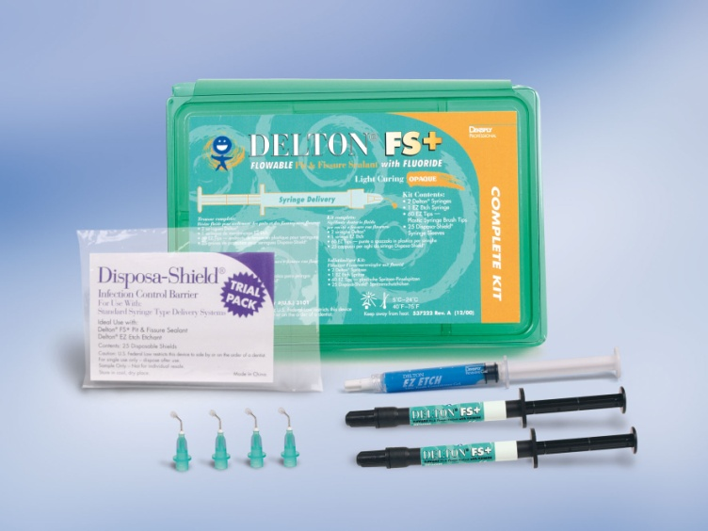
Materials Used as Sealants
Cyanoacrylates
Polyurethanes Eg. Epoxylite
BIS-GMA
Glass ionomer

Slide 12

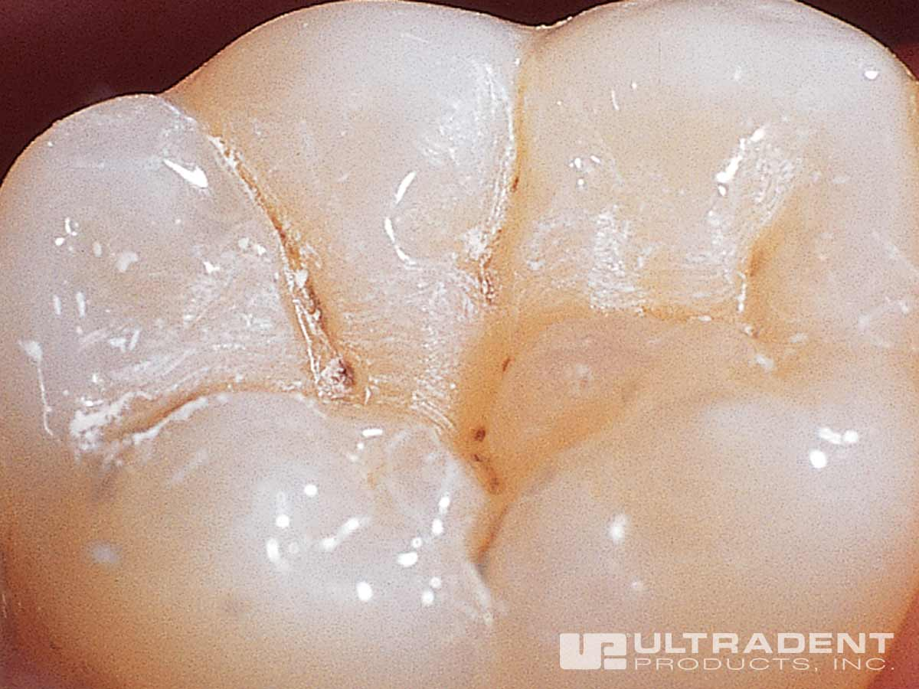
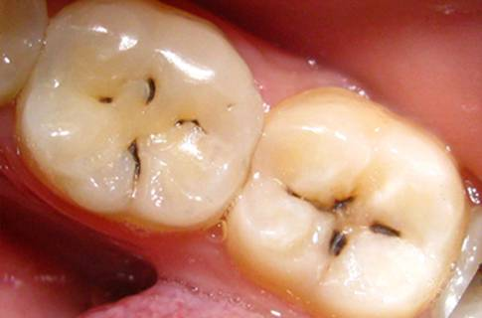
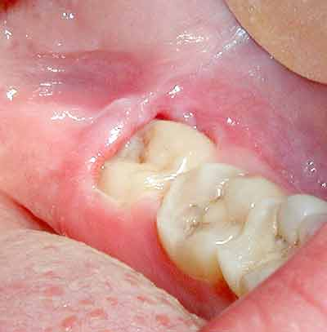
Indications

Slide 13

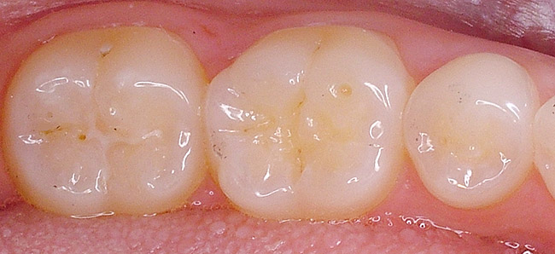
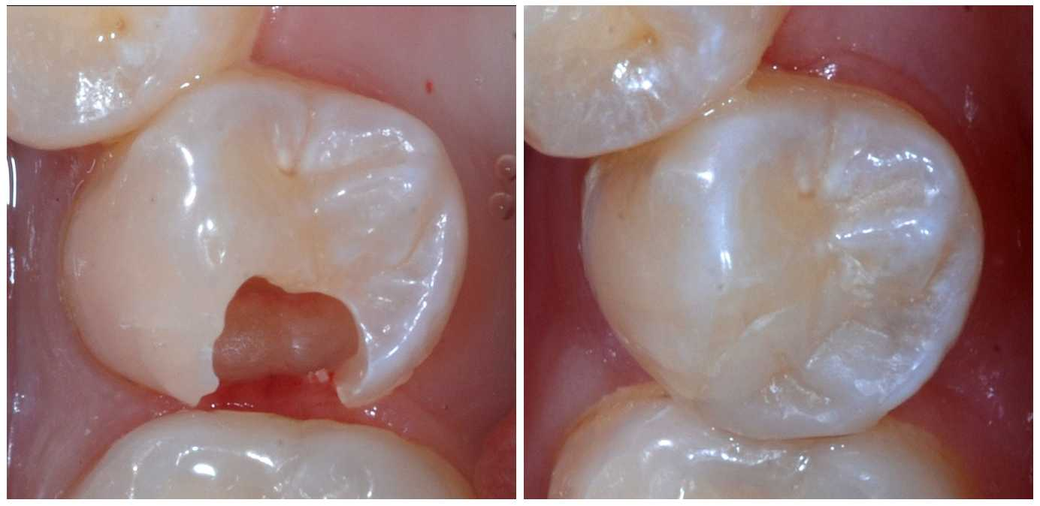
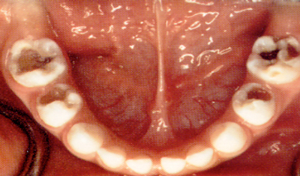
Contraindications

Slide 14
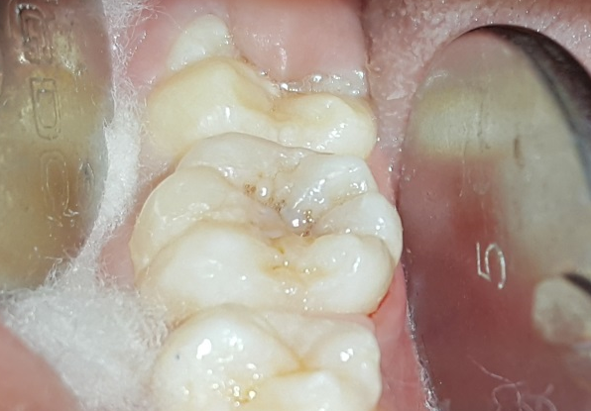
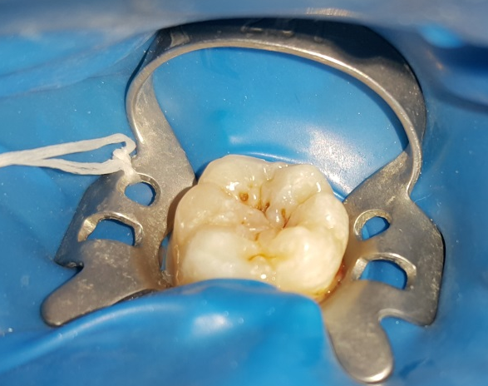
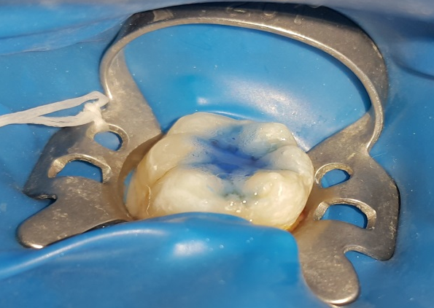
Procedure for Application
Selection of patient and the tooth
Cleaning and polishing the surface
Isolate and dry the tooth surface
Acid etching

Slide 15
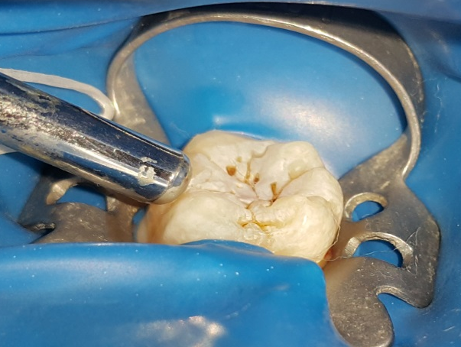
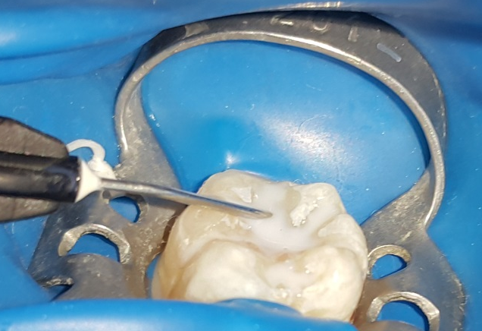
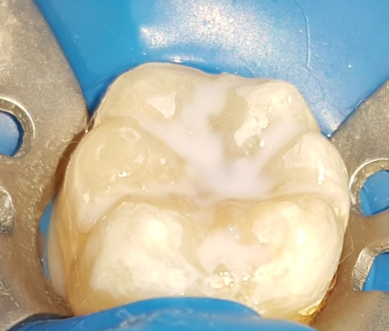
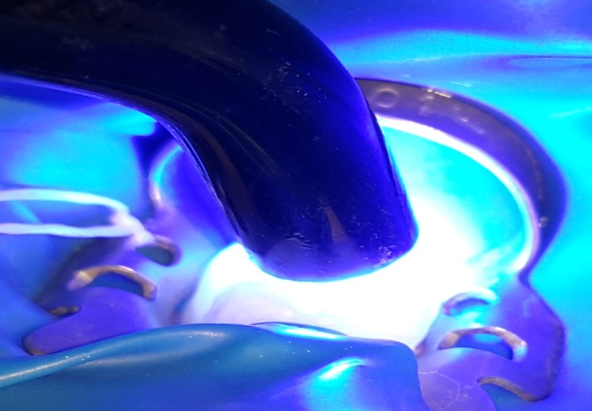
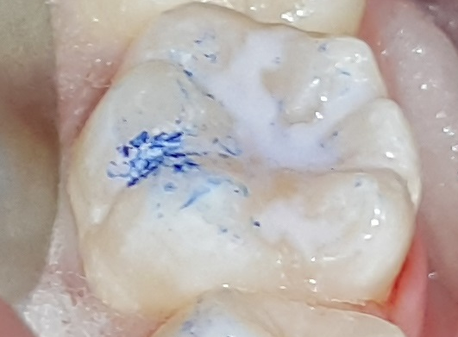
Rinse and dry the tooth surface
Sealant application and curing
Evaluation
Check the occlusion

Slide 16








Slide 17
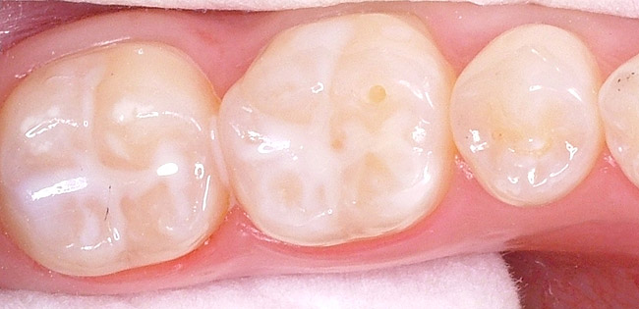
Sealant Retention Depends on
Type of sealant used
Position of teeth in the mouth
Clinical skill of the operator
Age of the child
Eruption status of teeth

Slide 18
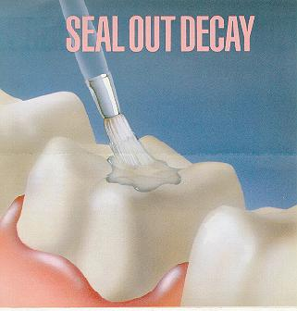
Conclusion..
“SEALANTS ARE EXTENSIVELY STUDIED BUT MOST UNDER USED.”

Slide 19

Questions…

Slide 20

Thank You

