Slide 1
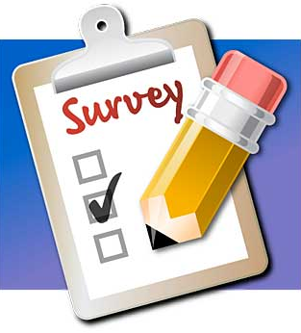

Slide 2

Survey (Surveying)
Types of surveys
Uses of surveys
Methods of data collection
Steps in surveying
BASIC ORAL HEALTH SURVEYS
CONTENTS

Slide 3
Surveying
It is a non-experimental type of research that attempts to gather information about the status quo for a large number of people by describing present conditions without directly analyzing their causes.

Slide 4
Types of surveys
Descriptive studies-describe
Analytical studies-analyse or explanatory
Cross-sectional studies- prevalence
Longitudinal studies-incidence

Slide 5
USES OF SURVEYS
Monitoring trends in oral health and disease
Assessment of dental needs
Insight into health related issues
Policy development
Program evaluation

Slide 6
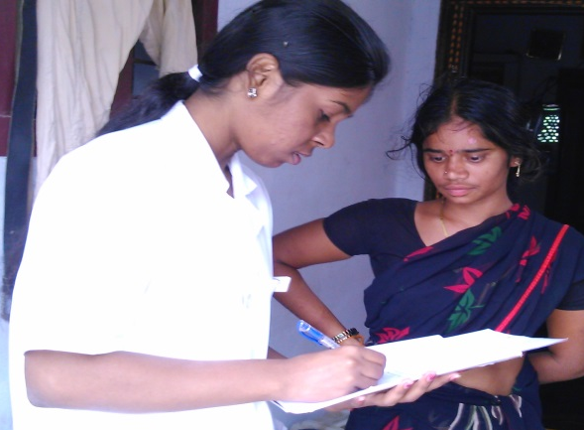
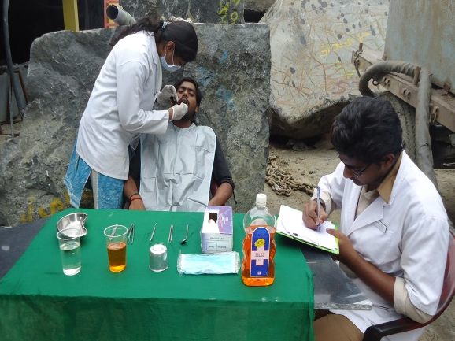




METHODS OF DATA COLLECTION
Health records
Health interview survey
Health examination survey
Questionnaire
Telephones
Mailed questionnaires

Slide 7

STEPS IN SURVEY PROCEDURES
Establishing the objectives.
Designing the investigation.
Selecting sample.
Conducting (organizing) examination.
Analyzing the data.
Drawing the conclusions.
Publishing the results.

Slide 8
1. Establishing the objectives
Objective should be clear,precise,relevant
The objectives of oral health survey usually are:
Initially to provide a full picture of oral health status and needs of population.
Subsequently to monitor changes in disease levels or pattern.

Slide 9
2. Designing the investigation
Survey protocol- written form and should contain-objective, type of information, approval, needful resources in terms of money, manpower, time
Sampling methods
Statistical methods
Approval from authorities

Slide 10
3. Selecting the sample
Not all individuals are included in the survey
Sample is the subset of the population under investigation.
Select the sample which is “Representative” of the population using one of the methods of sampling technique.
Obtain consent from study group

Slide 11
4. Conducting (organizing) examination
Scheduling - to prevent wastage of resources
Instruments and supplies - mouth mirrors, probes, tweezers, sterilizing solutions, gloves, masks, towels etc
Infection control measures
Examination area & type of examination
Training and Calibrating examiners

Slide 12
The objectives of standardization and calibration are
To ensure uniform interpretation, understanding and application of the criteria for the various diseases and conditions to be observed and recorded.
To ensure that the each examiner can examine to a uniform standard and to minimize variation between different examiners.

Slide 13
5. Analyzing the data
Statistical analysis using appropriate tests
Interpretation of the results
6. Drawing the conclusions
After the results are obtained, conclude the survey

Slide 14
7. Publishing the results
Introduction
Purpose of the study
Material and methods
Results
Discussion
Conclusions

Slide 15
Oral health survey
Oral health survey is the process of collecting information about oral health status and treatment needs that is needed for planning or monitoring on a group of people.
Basic Oral health survey
Used to collect information about oral health status and treatment needs of population
BASIC ORAL HEALTH SURVEYS

Slide 16
PATHFINDER SURVEYS
Practical, economic survey sampling method
It is a stratified cluster sampling method that aims to include most important population subgroups
It proposes appropriate numbers of subjects in specific index age groups
CLASSIFICATION:
PILOT SURVEY
NATIONAL PATHFINDER SURVEY

Slide 17
PILOT SURVEYS
Only the most important sub groups in population & 1 or 2 index ages(usually 12 years & another age group)
Minimum data is required
NATIONAL PATHFINDER SURVEYS
All important subgroups & atleast 3 of index age groups
National wide surveys-for planning and monitoring services
Random sampling is employed-many sample sites

Slide 18
INDEX AGE GROUPS
5 years- between 5th & 6th birthday,caries in primary teeth,age at which children begin primary school
12 years- leave primary school,all permanent teeth are erupted(except 3rd molars)-Global monitoring age
15 years- permanent teeth exposed to oral environment for 3-9 years, assesssment of periodontal disease indicators
35-44 years(mean 40 years)- adults, standard monitoring group-caries,periodontal status
65-74 years(mean 70 years)- represents geriatric group

Slide 19
WHO ORAL HEALTH ASSESSMENT FORM (1997)
Universally accepted and used recording methodology for oral health surveys.
Standard codes are used
So designed that they facilitate computer processing
Uses FDI system of notation

Slide 20
WHO ORAL HEALTH ASSESSMENT FORM (1997)
Survey identification & general information
Extra oral examination
TMJ assessment
Oral mucosa
Enamel opacities /hypoplasia
Dental fluorosis
Periodontal status(CPI)
Loss of attachment
Dentition status and treatment needs
Prosthetic status
Prosthetic need
Dentofacial anomalies
Need for immediate care and referral
Notes

Slide 21
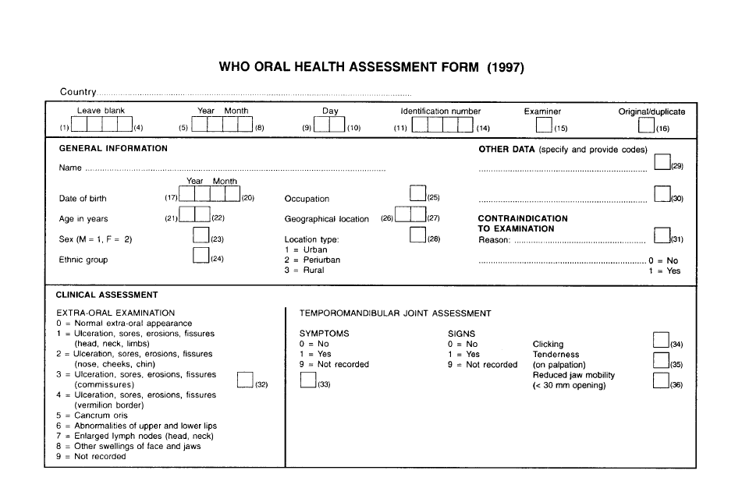
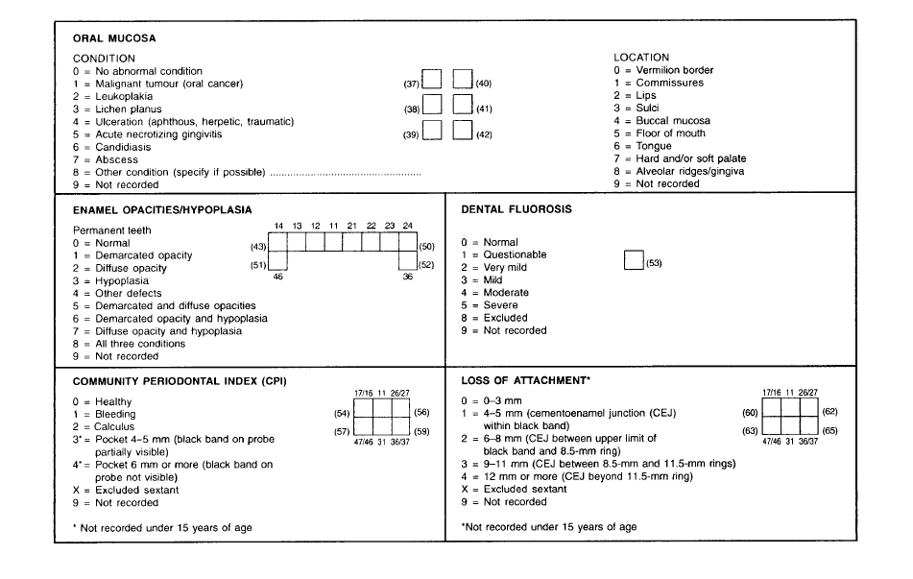

Slide 22
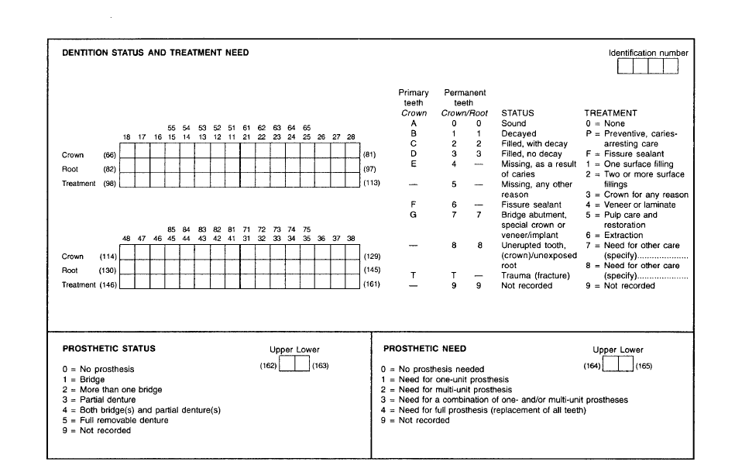
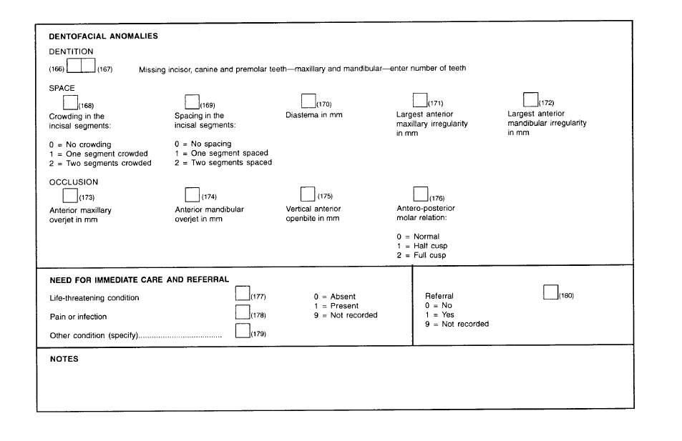

Slide 23
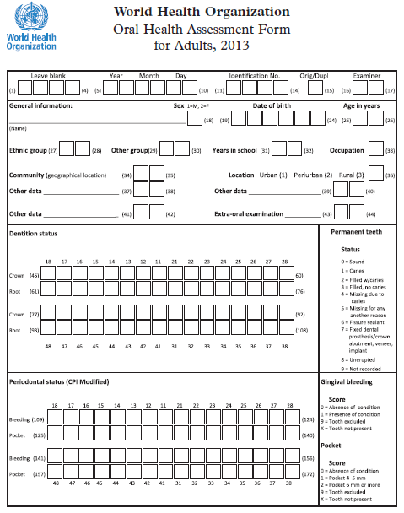
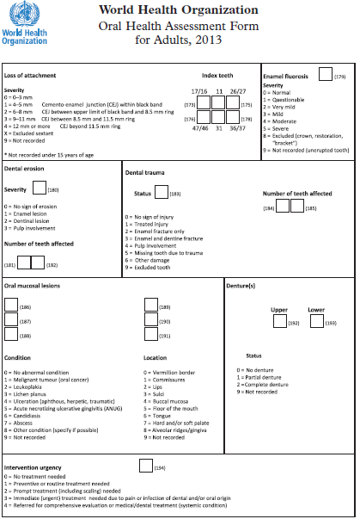

Slide 24


